Slide 1
Preventing firearm injuries and deaths among children and youth
Understanding and Preventing Child Maltreatment Fatalities
Pennsylvania State University
April 25, 2025
Rebeccah Sokol, PhD

Slide 2
Acknowledgements
The Centers for Disease Control and Prevention (R01CE003496)
The Eunice Kennedy Shriver National Institute of Child Health and Human Development (F32HD100021)
Research colleagues conducting work to inform efforts to prevent firearm injuries among children and youth
Community organizations and practitioners who work daily to improve the safety of children and youth
Notes:
I’d like to begin with some acknowledgements…
First, for the funders of some of my own research that I will present today, including the NIH and CDC
Second, the science of preventing firearm injuries among children and youth is a large and growing field. And so in today’s talk, I will be sharing the work of many of my colleagues.
And finally, I want to give a huge acknowledgement and thanks to the community organizations and practitioners who work daily to improve the safety of children and youth, many of whom are joining us today. Thank you!

Slide 3
Overview
Topic 2: Understanding firearm involved deaths among children and youth
Topic 3: Opportunities to improve safety among children and youth
Topic 1: Firearms and the child welfare system
Notes:
In terms of the structure of today’s presentation, I’ll start with a specific focus on firearms and the child welfare system.
I will then expand this out to better understand firearm involved deaths among all children and youth, of which deaths among children with prior child welfare involvement are a smaller but substantial subset.
And finally, we will close with considering various interventions and strategies to make this problem smaller—both within and outside the child welfare system.

Slide 4
Professional background
Assistant Professor at the University of Michigan School of Social Work
Co-Director of Training and Education at the University of Michigan Institute for Firearm Injury Prevention
Affiliate with the Child and Adolescent Data Lab
Notes:
With respect to my professional background, I come to this area from a public health research perspective.
I am currently an Assistant Professor at the University of Michigan School of Social Work
Co-Director of Training and Education at the University of Michigan Institute for Firearm Injury Prevention
I am also a member of the Child and Adolescent Data Lab in the School of Social Work, where we use administrative data to better understand and inform the child welfare system in Michigan

Slide 5
Firearms and the child welfare system
Notes:
And so, let’s get into our initial specific focus on firearms and the child welfare system.

Slide 6
Presence of firearms during child maltreatment investigations
Firearms & the child welfare system
~2.4% of substantiated cases of child maltreatment in Michigan involve a firearm-related risk¹
Understanding deaths by firearms
Unsecure firearm storage
Minor’s unsupervised firearm access
Carrying a firearm for malicious intent
Negligent or concerning access/use of the firearm
Presence of an illegal firearm
Presence of a firearm in a home with high potential for violence
Child’s exposure to gun violence
Past firearm incident with no evidence that the threat has been mitigated
Opportunities to improve safety
1. Sokol et al., 2020, Child Abuse & Neglect
Notes:
In 2019, our team within the Child and Adolescent Data Lab reviewed the investigation summaries of substantiated cases of child maltreatment in Michigan from 2015-2017.
As you may know, investigation summaries are written by the caseworker and include relevant evidence pertaining to the allegations obtained during the investigation.
We developed an expert dictionary to review these summaries and flag any summaries that included the mention of a firearm.
Around 3% of summaries mentioned a firearm, and around 80% of the summaries that mentioned a firearm involved a firearm-related risk to the child.
So overall, around 2.4% of substantiated cases of child maltreatment in Michigan involve a firearm-related risk. These risks involved circumstances such as unsecured firearms, and using a firearm while under the influence of substances.
And these are real risks that lead to child death in some circumstances.
This work focused just on Michigan. So, what do other national datasets tell us??

Slide 7
Prior and current contact with child protective services
Firearms & the child welfare system
Understanding deaths by firearms
Among children (0-18 years) who died by firearm from 2007-2016 :
20%
4%
Opportunities to improve safety
History of maltreatment
Open case at time of death
2. Trigylidas et al., 2023
Notes:
Well…in a retrospective review of the National Fatality Review Case Reporting System, researchers found that among the children aged 0-18 who died by firearm from 2007-2016:
20% had a history of maltreatment, and
4% had an open case at the time of death
Now, these estimates aren’t too far off from CPS involvement in the general population. For example, lifetime prevalence of CPS involvement is around 37%. Yet, these estimates do suggest that a system response to firearm-related harms could be life-saving.
**The National Fatality Review-Case Reporting System (NFR-CRS) is a web-based standardized case report tool available to states that was first created in 2005. The system allows local and state Child Death Review (CDR) and Fetal and Infant Mortality Review (FIMR) users to enter case data, summarize findings, review team recommendations, access and download data, and create standardized reports***

Slide 8
How does the child welfare system detect and respond to firearm-related risks?
Firearms & the child welfare system
….it depends
Understanding deaths by firearms
Opportunities to improve safety
Notes:
Given this information from Michigan and the National Fatality Review Case Reporting System, you might be wondering how the child welfare system detects and respond to firearm-related risks.
Well…it depends….
As you know, states, and sometimes even counties, use different definitions of child maltreatment. And so let’s focus on the first question regarding how systems detect firearm-related risks….

Slide 9
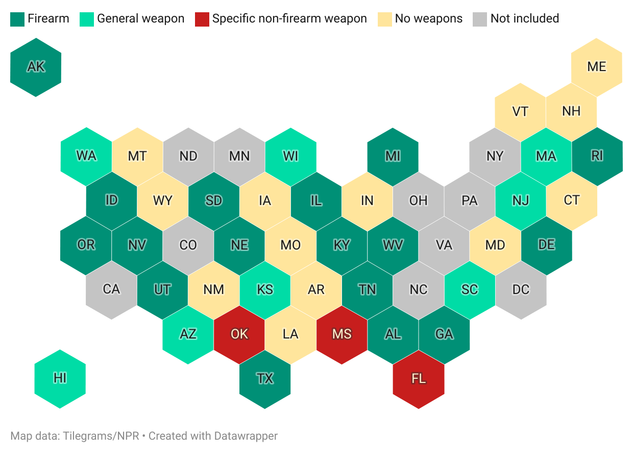
How does the child welfare system detect firearm-related risks?
Firearms & the child welfare system
Understanding deaths by firearms
Opportunities to improve safety
Figure reproduced, with permission, from Dr. Vivian Lyons
Notes:
Based on work led by Dr. Vivan Lyons, state CPS guidelines regarding the presence of a firearm vary
~17 states explicitly mention firearms as part of the state’s definition of child maltreatment,
~ 8 states mention weapons, generally
And within these definitions, states vary in how much caseworkers should consider the firearm in determining maltreatment. For example, some states include explicit guidance that the presence of a firearm itself is not evidence of maltreatment, but rather should be considered in the context of other factors.
And in other states, maltreatment might be conditional on additional assessment, including evaluating firearm storage practices.

Slide 10
How does the child welfare system respond to firearm-related risks?
Firearms & the child welfare system
….it depends
Understanding deaths by firearms
Opportunities to improve safety
Notes:
So…for the second part of the question…how do child welfare systems respond to firearm-related risks?
Again, it depends.
Only a handful of states provide specific written guidance on firearm storage and advise CPS worker action for firearm safety and education when firearms are present
However, lots of prevention strategies operate outside the child welfare system, and I would argue that these are our best line of defense against these deaths.

Slide 11
Understanding firearm involved deaths among children and youth
Notes:
Indeed, the problem of firearm involved deaths among children is bigger than the child welfare system, and so is the solution
Even if we define the outcome, child death by firearm, as child maltreatment, the population at risk for the outcome is broader than the families that are likely to come in contact with child welfare systems
Understanding the scope and risk factors for the problem can help identify solutions

Slide 12
Epidemiology of firearm deaths among children and youth
Firearms & the child welfare system
Understanding deaths by firearms
Opportunities to improve safety
National Center for Health Statistics-CDC annual mortality data files for WISQARS Fatal data, 2023
Notes:
When thinking about prevention efforts, it can be helpful to first understand that firearm death rates vary by age and intent
Regarding age, we see rates increasing as children age.
The trends for intent are a bit different. We see that unintentional deaths by firearm are highest among the youngest children, 0-4 years. In 2023, unintentional deaths by firearms resulted in just over 40 deaths among 0-4 year olds.
Risks for suicide and homicide deaths by firearm, however, are always more common than unintentional deaths, and risk increases as children age. Among 15-19 year olds in 2023, there were nearly 2,500 homicide deaths and over 1,000 suicide deaths by firearm.

Slide 13
Circumstances surrounding firearm deaths among children and youth
Firearms & the child welfare system
The firearms that kill children most often come from their own home or the home of a friend or family member^{3,4}
Most pediatric deaths by firearm occur in the child’s home⁵
From 2003-2020, 12.0% of child firearm homicides were related to family and intimate partner violence⁶
Understanding deaths by firearms
Opportunities to improve safety
3. Wilson et al., 2023 MMWR; 4. Choi et al., 2017; 5. Fowler et al., 2017 Pediatrics; 6. Wilson et al., 2023 Pediatrics
Notes:
And let’s consider the context and circumstances that surround these deaths.
First, the firearms that kill children most often come from their own home or the home of a friend or family member
And most pediatric deaths by firearm occur in the child’s home
As we know from the previous slide, most of these deaths are homicide or suicide. In the case of homicide by firearm, from 2003-2020, 12.0% of child firearm homicides were related to family and intimate partner violence (86% child corollary victims; 14% teens killed by current or former dating partners)
And again, we consider epidemiology and context because it helps us identify the scope of the problem, where it is, and how we can intervene.
Identifying risk factors is another key component of identifying effective prevention strategies….

Slide 14
Risk factors for firearm deaths among children and youth
Firearms & the child welfare system
Access to a firearm⁷
Understanding deaths by firearms
Opportunities to improve safety
7. Schmidt et al., 2019
Notes:
Some risk factors vary by intent (e.g., suicide versus homicide versus unintentional), including age, mental health, substance use, and behavioral problems
Yet all share the risk factor of firearm access (i.e., firearm present and accessible). And so it may be unsurprising that many efforts to prevent firearm involved deaths among children and youth focus on firearm access.

Slide 15
Opportunities to improve safety among children and youth
Notes:
I want to take a breath to really recognize the weight of what I’ve presented so for. It’s a lot, and it’s heavy.
AND…there is so much that we can do—and so much that you are already doing---to prevent these deaths and improve safety among children and youth.
The first set of opportunities I will discuss in the following slides focus on the gun as the point of intervention;
The second set of opportunities I will discuss focused on the social environment

Slide 16
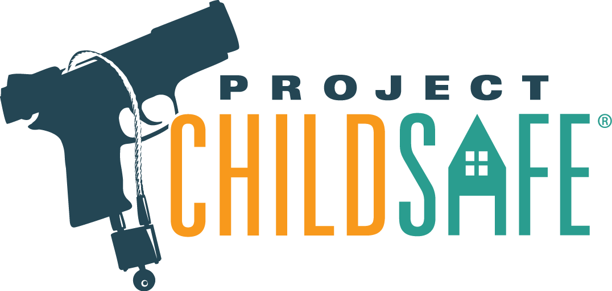
Interventions focused on the gun: Encourage locked and unloaded storage
Firearms & the child welfare system
Recommendations from various organizations to:
Store the firearm unloaded
Store the firearm locked
Store the ammunition separated from the firearm
Store the ammunition locked separately from the firearm
Understanding deaths by firearms
Opportunities to improve safety
8. Lee et al., 2022 Pediatrics
Notes:
So, let’s first focus on interventions surrounding the firearm.
One of the first things that many people might think of to prevent firearm injuries and deaths among children and youth is to restrict access to firearms through encouraging or requiring firearms owners to store firearms securely.
Many professional organizations support these secure storage recommendations including the American Academy of Pediatrics and The Firearm Trade Association.
These guidelines often include recommendations to:
Store the firearm unloaded
Store the firearm locked
Store the ammunition separated from the firearm
Store the ammunition locked separately from the firearm

Slide 17
Interventions focused on the gun: Encourage locked and unloaded storage^{9,10}
Firearms & the child welfare system
Understanding deaths by firearms
251
Opportunities to improve safety
½ of households with unlocked firearms switched to locking them
youth lives saved per year
9. Grossman et al., 2005 JAMA; 10. Monteaux et al., 2022 JAMA Ped
Notes:
And these recommendations are based in research.
When both firearms and ammunition are stored securely, children have a 78% lower risk of self-inflicted firearm injuries and an 85% lower risk of unintentional firearm injuries.
As one illustration, Monuteaux, Azrael, and Miller (2019) estimated that if half of households with unlocked guns switched to locking them, one third of youth gun suicides and unintentional deaths could be prevented, saving 251 lives per year.

Slide 18
Interventions focused on the gun: Child Access Prevention Laws¹¹
Firearms & the child welfare system
Child-access prevention (CAP) and safe storage laws allow prosecutors to charge adults who (intentionally or unintentionally) allow minors to access firearms unsupervised
These laws vary in strictness:
Minor could access the firearm
Minor actually accesses the firearm
child has to brandish the firearm in public
child’s access must result in death or serious injury
35 states + the District of Columbia have CAP laws
Understanding deaths by firearms
Opportunities to improve safety
11. RAND Gun Policy in America
Notes:
And there are many ways to encourage secured firearm storage, and one way is through policy.
Child-access prevention (CAP) and safe storage laws allow prosecutors to charge adults who (intentionally or unintentionally) allow minors to access firearms unsupervised
These laws vary in strictness
At the strictest end of the spectrum, laws impose criminal liability if owners store the firearm in a manner where a minor could access the firearm
At the more lenient end of the spectrum, laws require that a minor actually accesses the firearm to impose criminal liability on the owner. On this more lenient end of the spectrum, states further vary in whether the child has to brandish the firearm in public, or whether the child's access must result in death or serious injury. Similarly, states vary on whether criminal penalties are classed as misdemeanors or felonies
Currently, 35 states + the District of Columbia have CAP laws

Slide 19
Interventions focused on the gun: Child Access Prevention Laws¹¹
Firearms & the child welfare system
Stricter laws = larger effects¹²
Self-injuries and suicides
Understanding deaths by firearms
Violent crime
Opportunities to improve safety
Unintentional injuries and deaths
11. RAND Gun Policy in America; 12. Azad et al., 2020, JAMA Peds
Notes:
Evidence has found that CAP laws are associated with reduced firearm self-injuries or suicides, violent crime, and unintentional injuries and deaths among youth. Studies further suggest that the stricter laws (for example, those that impose criminal liability if the child might access a firearm) have larger life-saving effects
There are ongoing questions about the mechanisms by which CAP laws have their effects. Specifically, it is unclear whether CAP laws are causally associated with secure storage among firearm owners

Slide 20
A word of caution
Firearms & the child welfare system
36%
Understanding deaths by firearms
Opportunities to improve safety
of teens whose parents store all firearms locked and unloaded can access and load a household firearm¹³
14. Hastings et al., 2025, JAMA Network Open
Notes:
Storing household firearms loaded and unlocked remains an important strategy to preventing firearm injuries and deaths among children and youth, but it cannot be the only strategy
In a recent study led by doctoral candidate Katie Hastings, our team analyzed nationally representative data and found that 36% (95% CI: 23.6-49.0) of teens whose parents reported securely storing all firearms (i.e., locked and unloaded) indicated being able to access a household firearm and load it.
As such, we need to pay particular attention to child age/developmental stage when focusing efforts on firearm storage. And we can’t focus only on firearm storage to prevent all deaths by firearms among youth.

Slide 21
Interventions focused on the gun: Extreme Risk Protection Orders (ERPOs)¹⁴
Firearms & the child welfare system
Risk-based, temporary, and preemptive protective orders that remove firearms from individuals at risk for harming themselves or others
Common uses¹⁵:
Concerns of self-harm or suicide
Threats of mass violence
Understanding deaths by firearms
Opportunities to improve safety
14. RAND Gun Policy in America; 15. Zeoli et al., 2022 Prev Med
Notes:
One additional firearm policy strategy that can help prevent firearm involved deaths among youth are Extreme Risk Protection Orders (ERPOs), which people sometimes refer to as Red Flag Laws.
ERPOs are risk-based, temporary, and preemptive protective orders that authorize the removal of firearms from individuals who have been determined to be at risk for committing gun violence against others or themselves.
To date, the evidence remains inconclusive for the effects of these laws on firearm involved deaths among children and youth, largely because these are relatively newer policies. But, we do have information regarding under what circumstances people make ERPO petitions. Common circumstances include concerns of self-harm or suicide, threats of mass violence
This QR code presented on this slide links to an ERPO toolkit developed by Dr. April Zeoli and her team at the University of Michigan. The toolkit comprehensively describes what ERPOs are, which states have them, who can make petitions, and more.

Slide 22
Interventions focused on the social environment
Firearms & the child welfare system
Call to prioritize and strengthen support programs for children and their families¹⁶⁻²¹:
Standardizing a living wage
Child Tax Credit
Earned Income Tax Credit
Temporary Assistance for Needy Families (TANF)
HeadStart
SNAP/WIC
Children’s Health Insurance Program
Understanding deaths by firearms
Opportunities to improve safety
16. Barrett et al., 2022; 17. Kovski et al., 2022; 18. Raissian & Bullinger, 2017; 19. McGinty et al., 2022; 20. Austin et al., 2023; 21. Spencer et al., 2021
Notes:
Beyond focusing on the firearm itself, there are many opportunities to prevent firearm injuries and deaths among children and youth that focus on the social and economic environment.
We know that both pediatric firearm mortality and child maltreatment increase with community poverty
As such, experts have called for more work to prioritize safety-net programs that serve children and their families, including:
Standardizing a living wage
Child Tax Credit
Earned Income Tax Credit
Temporary Assistance for Needy Families (TANF)
HeadStart
SNAP/WIC
Children’s Health Insurance Program
Research is robust regarding the effects of these policies on preventing child maltreatment.
More research is needed, however, to evaluate the specific causal effects of these programs on firearm injuries and deaths among children and youth.
But theory and years of observational data tell us that outcomes will improve if we support the developmental, economic, and social wellbeing of children.

Slide 23
The problem of firearm injuries among youth is big, but our collective effort to address it can be BIGGER
Notes:
I’d like to conclude with the message that the problem of firearm injuries and deaths among youth is big, and it’s bigger than the child welfare system
But there are so many things we can all do to prevent these injuries and deaths:
You can have conversation with families you work with to identify if they have a firearm, and if so, encourage them to store it securely.
You might be able to use your state’s specific policy context, such as the presence of a CAP law, to facilitate these conversations
Community partners can also be hugely helpful in this space: from churches hosting firearm disposal events to health clinics and law enforcement providing free lock boxes and trigger locks
In your own life, you might ask grandparents or fellow parents if they have firearms, and if so, how they store them. Normalizing these types of conversations can help us create communities that prioritize child safety.
And finally, any work that you are doing to improve to overall health, development, and social connections that a child has is working to keep that child safe.

Slide 24
References
Sokol RL, Victor BG, Piellusch EK, Nielsen SB, Ryan JP, Perron BE. Prevalence and context of firearms-related problems in child protective service investigations. Child Abuse Negl. 2020 Sep;107:104572. doi: 10.1016/j.chiabu.2020.104572. Epub 2020 Jun 5. PMID: 32512264; PMCID: PMC7494624.
Trigylidas TE, Schnitzer PG, Dykstra HK, Badolato GM, McCarter R Jr, Goyal MK, Lichenstein R. Firearm Deaths among Youth in the United States, 2007-2016. Children (Basel). 2023 Aug 8;10(8):1359. doi: 10.3390/children10081359. PMID: 37628358; PMCID: PMC10453890.
Wilson RF, Mintz S, Blair JM, Betz CJ, Collier A, Fowler KA. Unintentional Firearm Injury Deaths Among Children and Adolescents Aged 0–17 Years — National Violent Death Reporting System, United States, 2003–2021. MMWR Morb Mortal Wkly Rep 2023;72:1338–1345. DOI: http://dx.doi.org/10.15585/mmwr.mm7250a1
Choi, N. G., DiNitto, D. M., & Marti, C. N. (2017). Youth firearm suicide: Precipitating/risk factors and gun access. Children and youth services review, 83, 9-16.
Fowler, K. A., Dahlberg, L. L., Haileyesus, T., Gutierrez, C., & Bacon, S. (2017). Childhood firearm injuries in the United States. Pediatrics, 140(1).
Wilson, R. F., Xu, L., Betz, C. J., Sheats, K. J., Blair, J. M., Yue, X., ... & Fowler, K. A. (2023). Firearm homicides of US children precipitated by intimate partner violence: 2003–2020. Pediatrics, 152(6), e2023063004.
Schmidt, C. J., Rupp, L., Pizarro, J. M., Lee, D. B., Branas, C. C., & Zimmerman, M. A. (2019). Risk and protective factors related to youth firearm violence: a scoping review and directions for future research. Journal of behavioral medicine, 42, 706-723.
Lee, Lois K., Eric W. Fleegler, Monika K. Goyal, Kiesha Fraser Doh, Danielle Laraque-Arena, Benjamin D. Hoffman, and COUNCIL ON INJURY, VIOLENCE, AND POISON PREVENTION. "Firearm-related injuries and deaths in children and youth: injury prevention and harm reduction." Pediatrics 150, no. 6 (2022): e2022060070.
Grossman, D. C., Mueller, B. A., Riedy, C., Dowd, M. D., Villaveces, A., Prodzinski, J., ... & Harruff, R. (2005). Gun storage practices and risk of youth suicide and unintentional firearm injuries. Jama, 293(6), 707-714.
Monuteaux, M. C., Azrael, D., & Miller, M. (2019). Association of increased safe household firearm storage with firearm suicide and unintentional death among US youths. JAMA pediatrics, 173(7), 657-662.
RAND Gun Policy in America. The Effects of Child-Access Prevention Laws. https://www.rand.org/research/gun-policy/analysis/child-access-prevention.html
Azad, H. A., Monuteaux, M. C., Rees, C. A., Siegel, M., Mannix, R., Lee, L. K., ... & Fleegler, E. W. (2020). Child access prevention firearm laws and firearm fatalities among children aged 0 to 14 years, 1991-2016. JAMA pediatrics, 174(5), 463-469.
Hastings K, Carter PM, Zimmerman M, & Sokol R (2025). Parental firearm storage and their teens’ perceived firearm access in the United States. JAMA Network Open.
RAND Gun Policy in America. The Effects of Extreme-Risk Protection Orders. https://www.rand.org/research/gun-policy/analysis/extreme-risk-protection-orders.html
Zeoli, April M., Shannon Frattaroli, Leslie Barnard, Andrew Bowen, Annette Christy, Michele Easter, Reena Kapoor, Christopher Knoepke, Wenjuan Ma, Amy Molocznik, Michael Norko, Elise Omaki, Jennifer K. Paruk, Veronica A. Pear, Ali Rowhani-Rahbar, Julia P. Schleimer, Jeffrey W. Swanson, and Garen J. Wintemute, “Extreme Risk Protection Orders in Response to Threats of Multiple Victim/Mass Shooting in Six U.S. States: A Descriptive Study,” Preventive Medicine, Vol. 165, Pt. A, December 2022.
Barrett, J. T., Lee, L. K., Monuteaux, M. C., Farrell, C. A., Hoffmann, J. A., & Fleegler, E. W. (2022). Association of county-level poverty and inequities with firearm-related mortality in US youth. JAMA pediatrics, 176(2), e214822-e214822.
Kovski NL, Hill HD, Mooney SJ, Rivara FP, Rowhani-Rahbar A. Short-Term Effects of Tax Credits on Rates of Child Maltreatment Reports in the United States. Pediatrics. 2022 Jul 1;150(1):e2021054939. doi: 10.1542/peds.2021-054939. PMID: 35662354; PMCID: PMC11456322.
Raissian, K. M., & Bullinger, L. R. (2017). Money matters: Does the minimum wage affect child maltreatment rates?. Children and youth services review, 72, 60-70.
McGinty EE, Nair R, Assini-Meytin LC, Stuart EA, Letourneau EJ. Impact of Medicaid Expansion on Reported Incidents of Child Neglect and Physical Abuse. Am J Prev Med. 2022 Jan;62(1):e11-e20. doi: 10.1016/j.amepre.2021.06.010. Epub 2021 Sep 21. PMID: 34561125.
Austin AE, Shanahan ME, Frank M, Naumann RB, McNaughton Reyes HL, Corbie G, Ammerman AS. Association of State Expansion of Supplemental Nutrition Assistance Program Eligibility With Rates of Child Protective Services-Investigated Reports. JAMA Pediatr. 2023 Mar 1;177(3):294-302. doi: 10.1001/jamapediatrics.2022.5348. PMID: 36689239; PMCID: PMC9871943.
Spencer, R. A., Livingston, M. D., Komro, K. A., Sroczynski, N., Rentmeester, S. T., & Woods-Jaeger, B. (2021). Association between Temporary Assistance for Needy Families (TANF) and child maltreatment among a cohort of fragile families. Child Abuse & Neglect, 120, 105186.

Slide 25
Thank you!
Additional resources
RAND Gun Policy in America
Institute for Firearm Injury Prevention
Rebeccah Sokol, MSPH, PhD
University of Michigan, School of Social Work
University of Michigan, Institute for Firearm Injury Prevention
rlsokol@umich.edu

