Slide 1
Child Welfare Advocacy with Citizens, Media and Elected Officials

Slide 2
Goal: Restore child safety and well-being as central mission of child welfare in Minnesota
Raise awareness of what children’s lives are like
Make child welfare an important public policy issue

Slide 3
Why is this needed?
Policies and practices have increasingly given parents’ rights and political agendas priority
Children have no voice without advocates

Slide 4
Engage citizens
Work with media
Know and do research

Slide 5
Citizen Engagement
Pent up frustration about child welfare that was looking for an outlet
Having a legislative impact is a positive experience

Slide 6
Media Engagement
Can you trust journalists?
Benefits

Slide 7
Why Research?
Know what you are doing
Build credibility

Slide 8
Early Days – Volunteers and Electeds
Proof of Concept - Legislative Auditor
Q: Who knows this stuff? A: Safe Passage

Slide 9
First Investigative Report 2006 - 2015
83 children killed since 2006
Four long-form articles
4 year-old Eric Dean represented them all

Slide 10
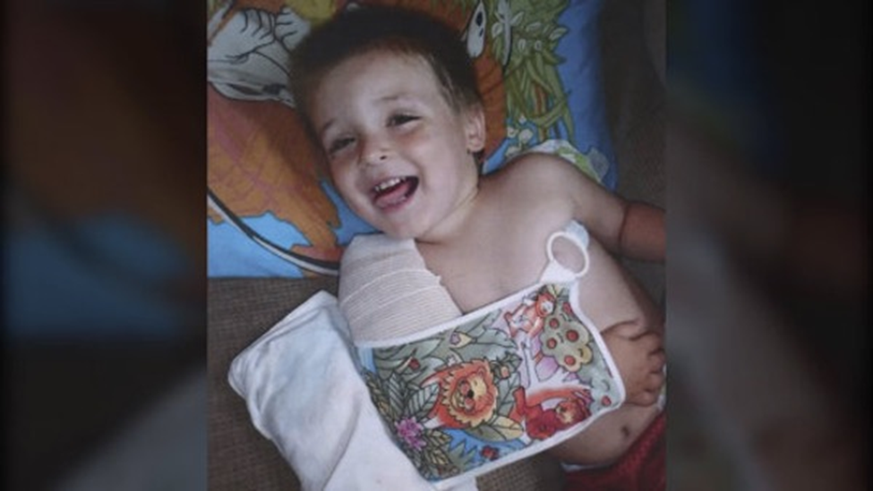

Slide 11
Governor’s Task Force Changes in Law
Priority is child safety not family preservation
24/7 statewide coverage
Uniform screening standards led to >10,000 more children getting help per year

Slide 12
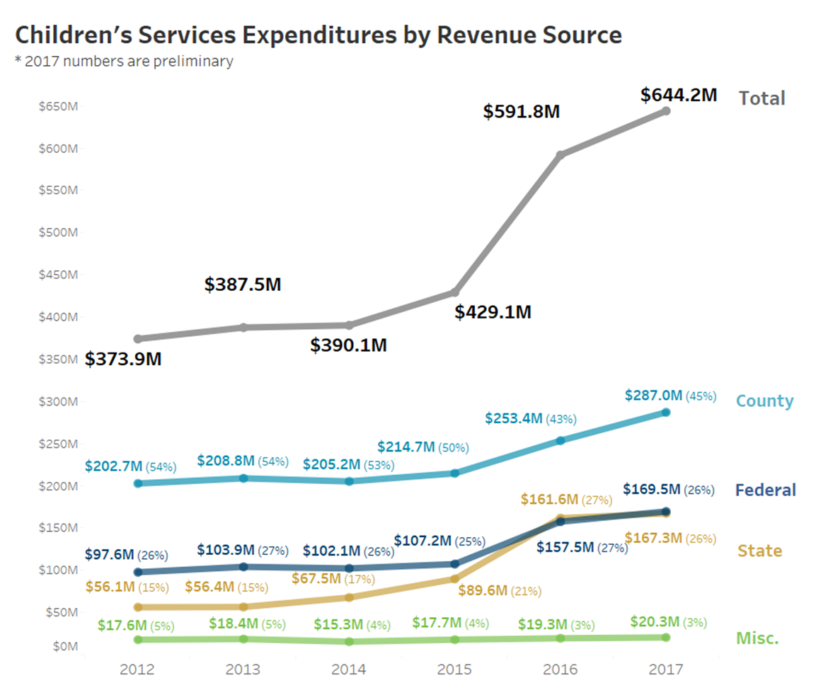

Slide 13
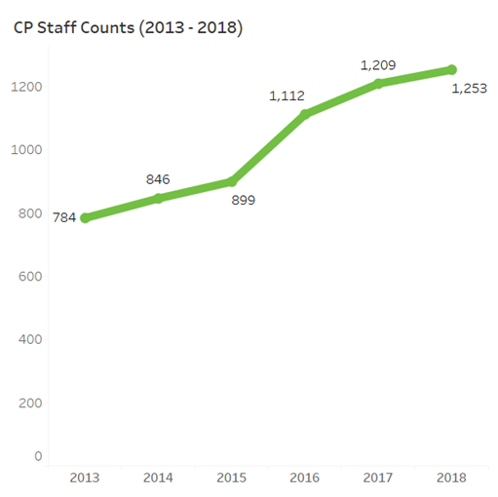

Slide 14
Recommendations not followed
Reduced use of Alternative Response
Move to a single response system
Stop interviewing children in presence adults
No advance notice of initial visit

Slide 15
Safe Passage research
Report on fatalities 2014 - 2022
Statistics
Case studies
Patterns of practice

Slide 16
Fatality Report Findings
Many deaths preventable
Professionals knew but didn’t act
Priority to parents’ rights and interests

Slide 17
Second investigative reporting series
Up to 2024
Led to Legislative Task Force
Delegated work to state Supreme Court
Recommendations due end of 2025

Slide 18
Where are we now?
Lost ground child safety and well-being
Still a vibrant advocacy community in MN
Advocates are needed everywhere!

Slide 19
Finally… Let’s plan for success

