Slide 1

Assembling the ‘Book of Life’ Through Record Linkage...
[and some candid remarks on child maltreatment and child protection systems]
Emily Putnam-Hornstein, PhD
Associate Professor, USC
Director, Children’s Data Network

Slide 2






Slide 3
overview
“leveraging administrative data to understand the scope and impact of child maltreatment”
1. Record linkage (and why it rocks)
2. Birth records (and how they can be used...x8)
3. Candid reflections
my latest / greatest (largely unscripted) thoughts, questions, and concerns...

Slide 4
Record Linkage
section
1
(and why we need more of it!)

Slide 5
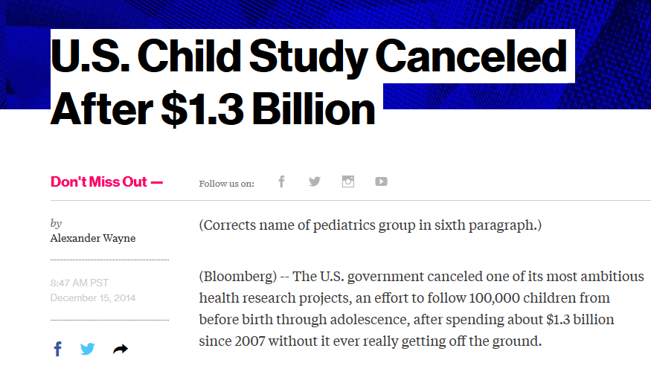

Slide 6
Birth Records
section
2
(so much more than what parents bring home from the hospital...)

Slide 7
“Each person in the world creates a Book of Life. This Book starts with birth and ends with death. Its pages are made up of the records of the principal events in life. Record linkage is the name given to the process of assembling the pages of this Book...”
Halbert L. Dunn, 1946

Slide 8
birth records?
Universally collected (good for research & real-time applications)
Nationally standardized and well-documented fields
Information for three individuals (child, mother, father)
Provides a population-base (spine) for developing prospective studies
Health, demographic, financial, and service information

Slide 9
Substance Use Disorder
vital birth records
CPS Report
Death
Birth Cohort
Child A
Child B
Child C
Child D
Age ?
Home Visiting
Subsidized Childcare
population-based information

Slide 10
A few ways birth records can be used...
1
2
3
4
5
Calculating cumulative rates of child welfare involvement
Developing population-based, prospective studies
Looking at ‘old’ questions through the lens of ‘new’ fields
Connecting to other health surveillance programs / systems
Documenting intergenerational maltreatment and child welfare involvement
6
7
8
Using ‘big’ data to look at small, understudied groups
Community monitoring of risks and assets at birth
Risk stratification for service delivery / maltreatment prevention

Slide 11
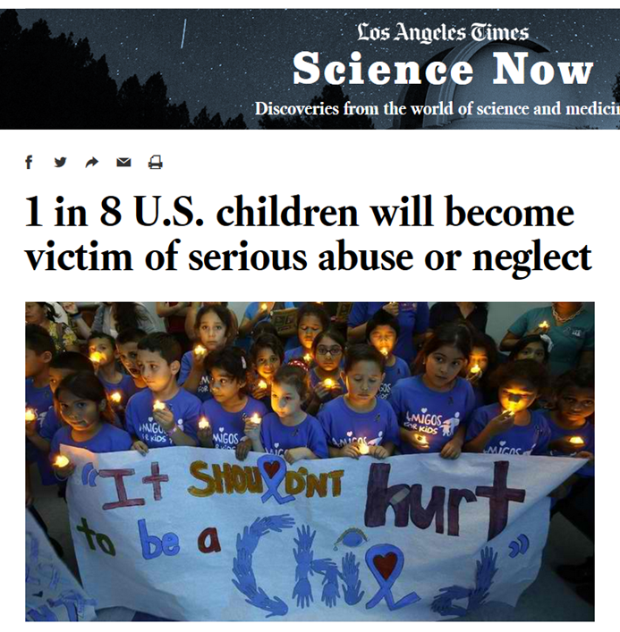
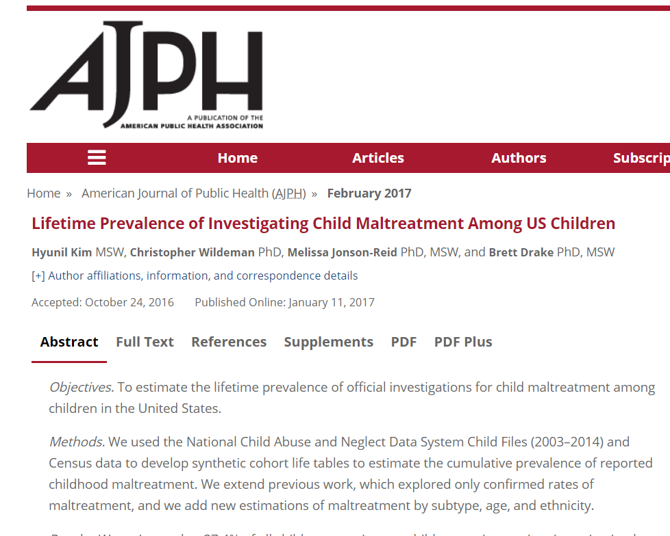
1
Calculating Cumulative Rates of Child Welfare Involvement

Slide 12
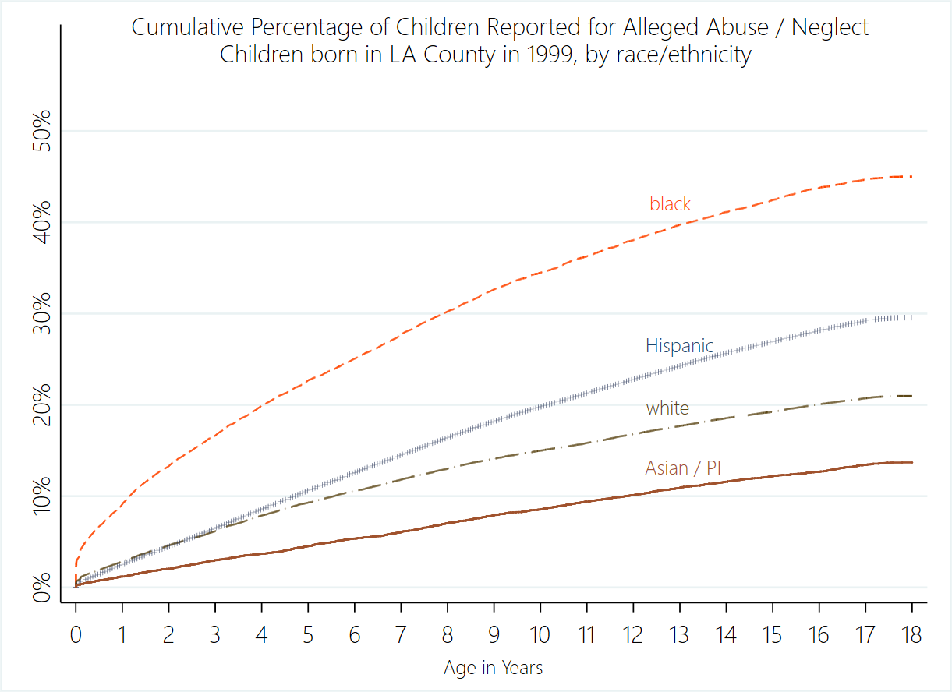

Slide 13
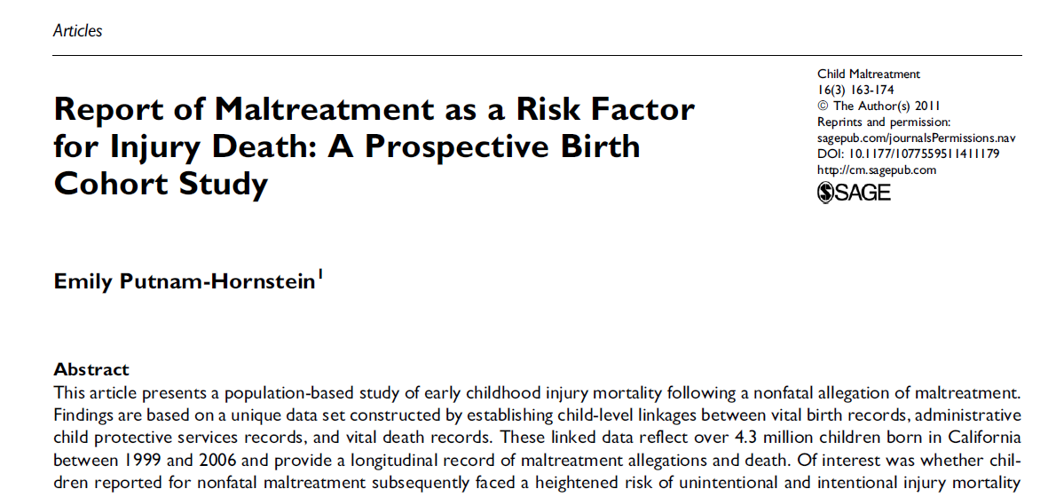
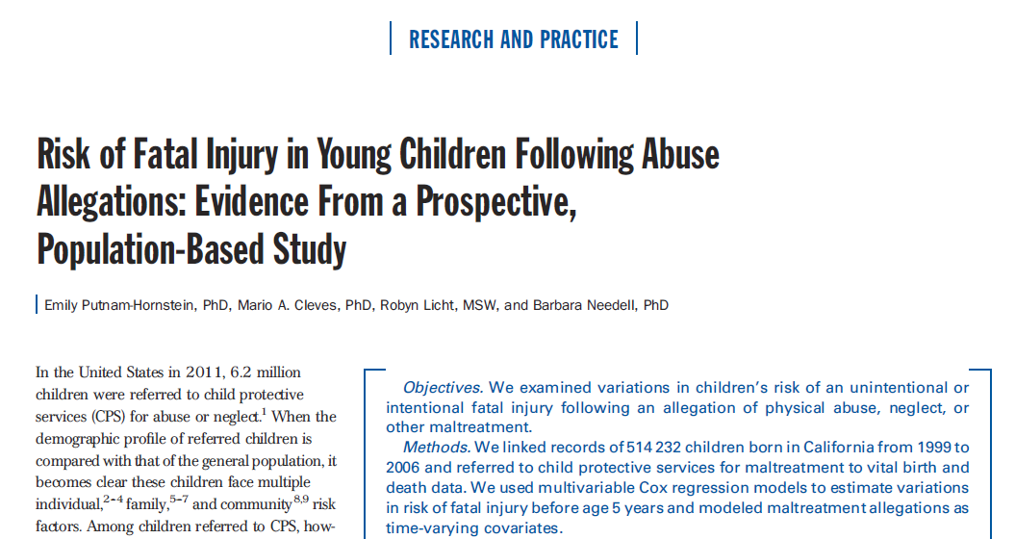
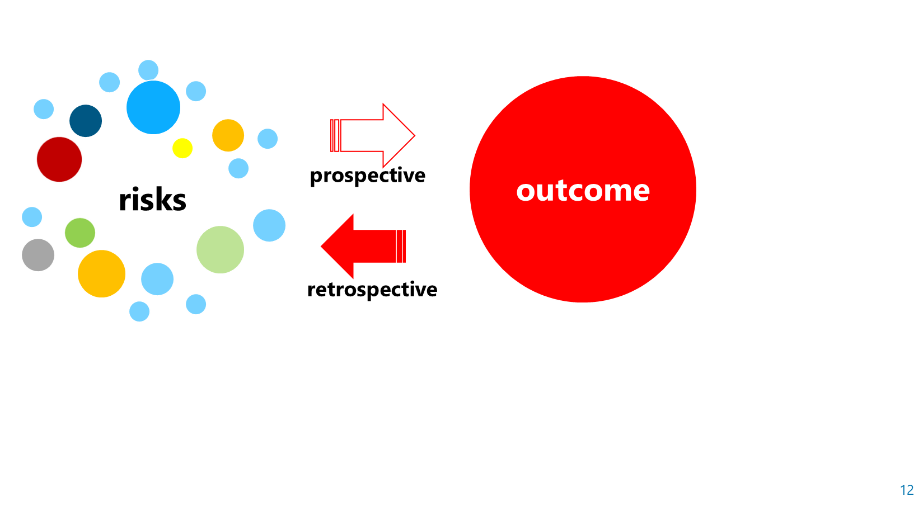
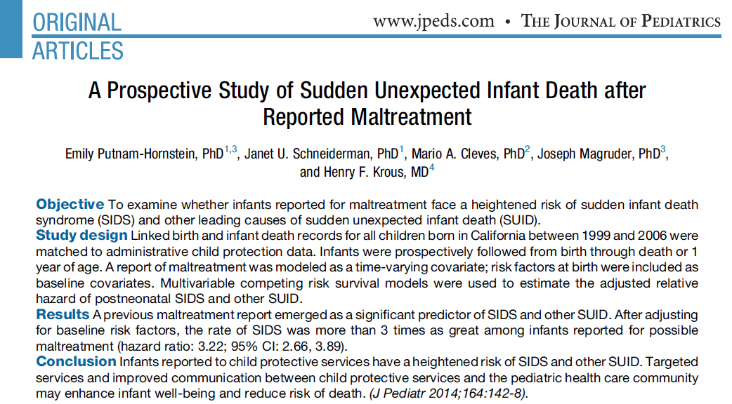
2
Population-Based, Prospective Studies

Slide 14
injuries

Slide 15
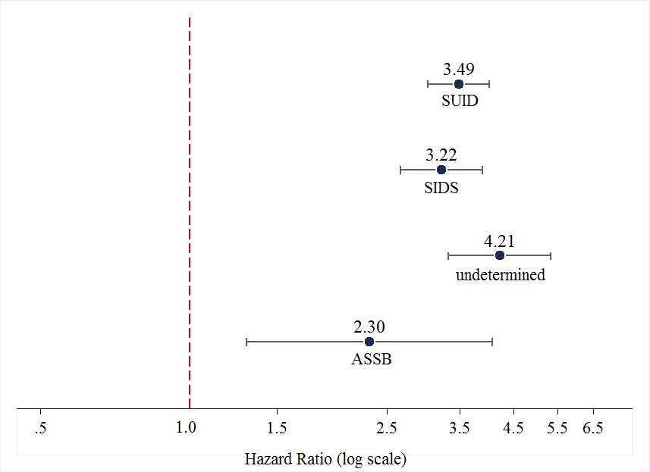
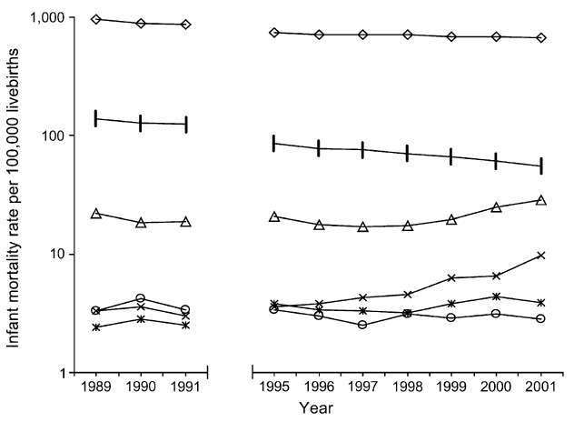
sleep-related
postneonatal death rate
SIDS (R95)
Undetermined (R99)
ASSB (W75)
1. Shapiro-Mendoza CK, Tomashek KM, Anderson RN, Wingo J. Recent National Trends in Sudden, Unexpected Infant Deaths: More Evidence Supporting a Change in Classification or Reporting. American Journal of Epidemiology. 2006;163(8):762–769.

Slide 16
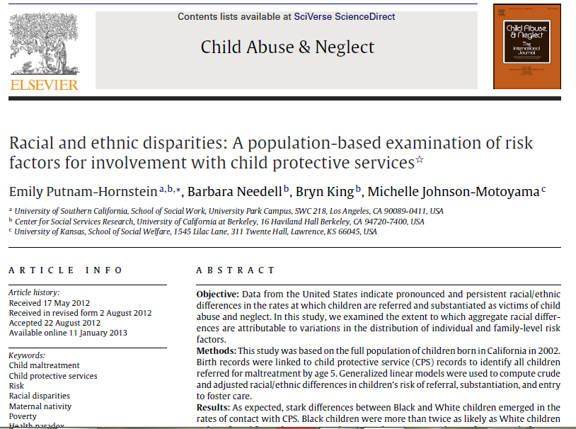
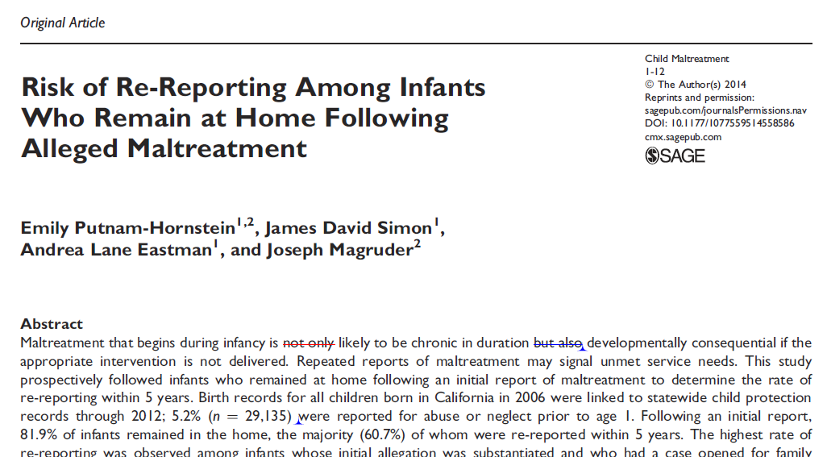
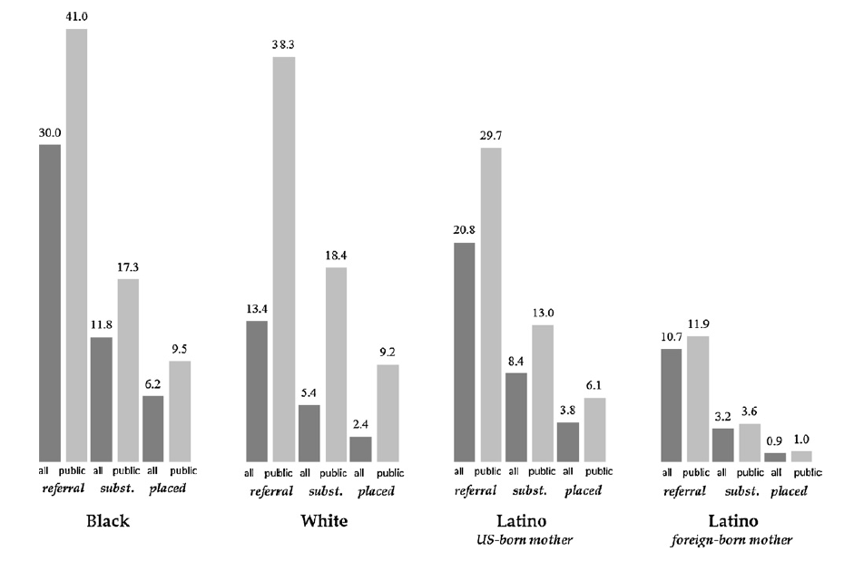
3
Looking at ‘old’ questions through the lens of ‘new’ fields

Slide 17
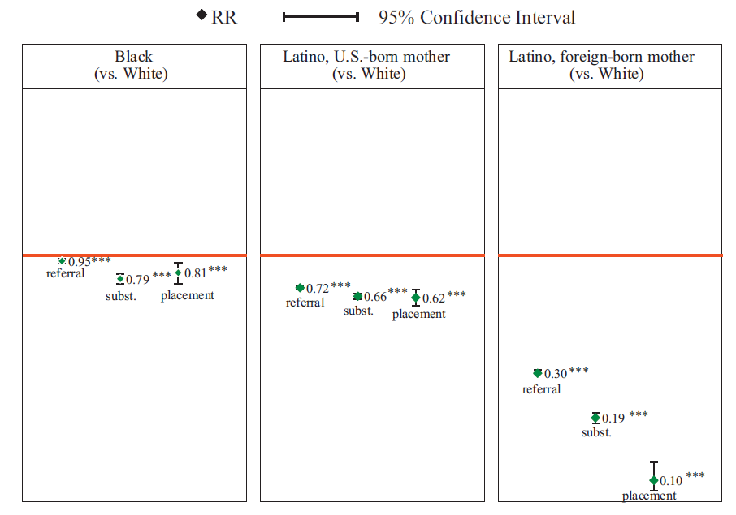

Slide 18
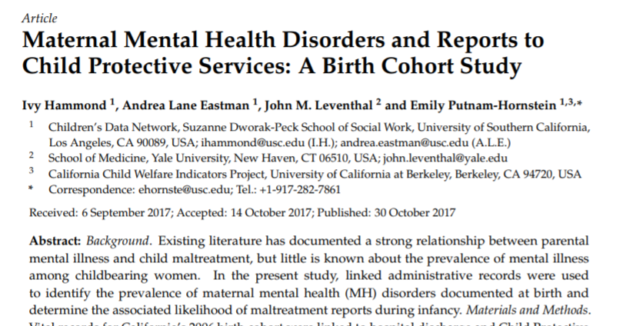
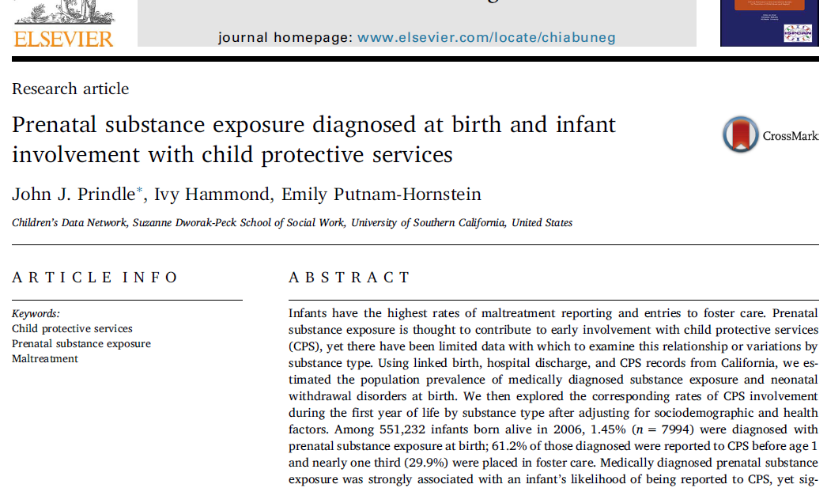
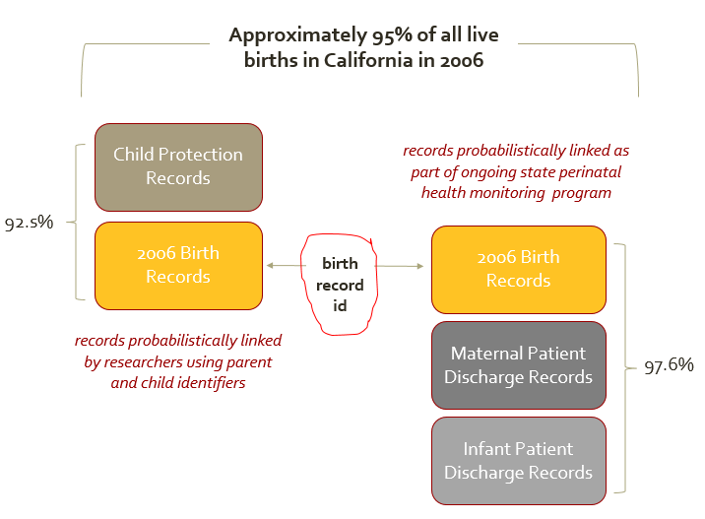
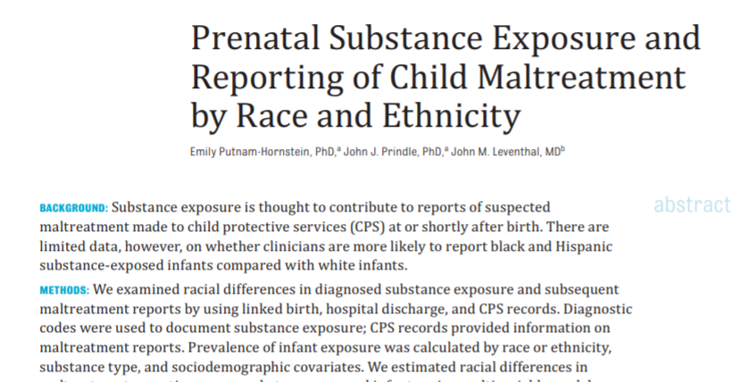
4
Opportunities to connect to other health surveillance programs / systems
Notes:
*ALSO mention birth cohort files and linkages to death records

Slide 19
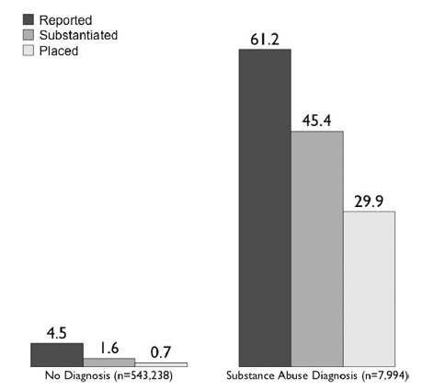
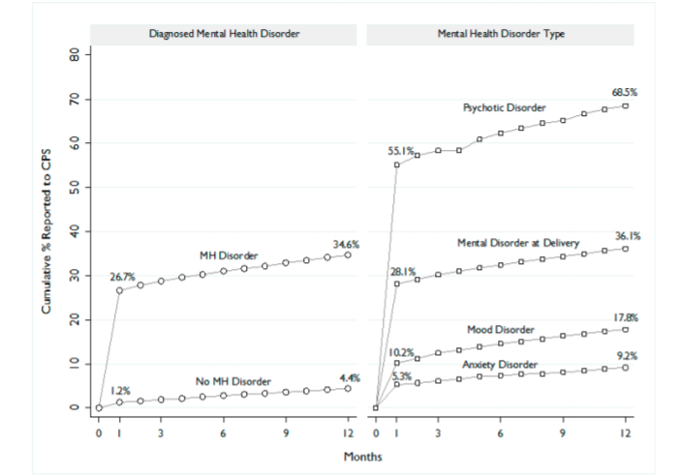

Slide 20
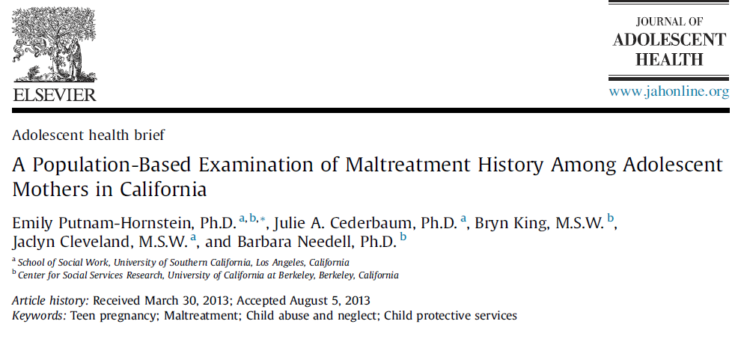
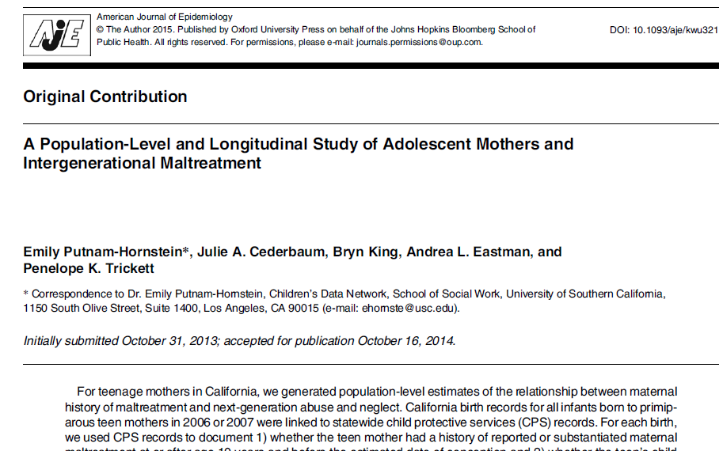
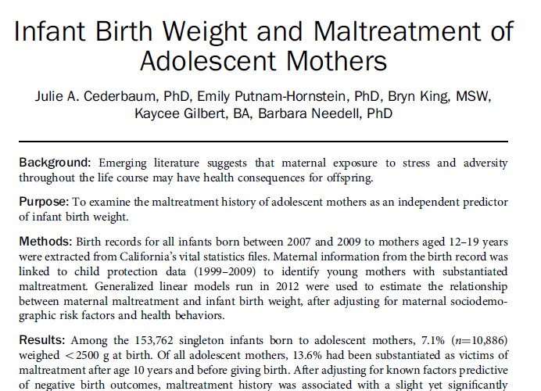
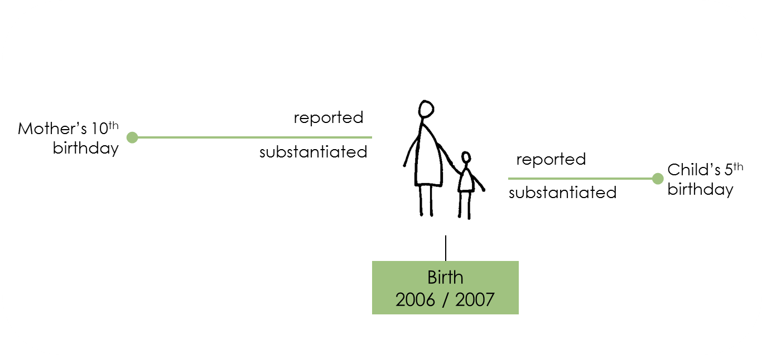
5
Documenting intergenerational maltreatment dynamics

Slide 22
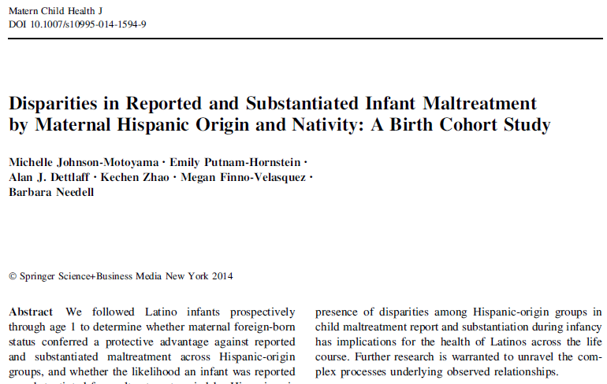
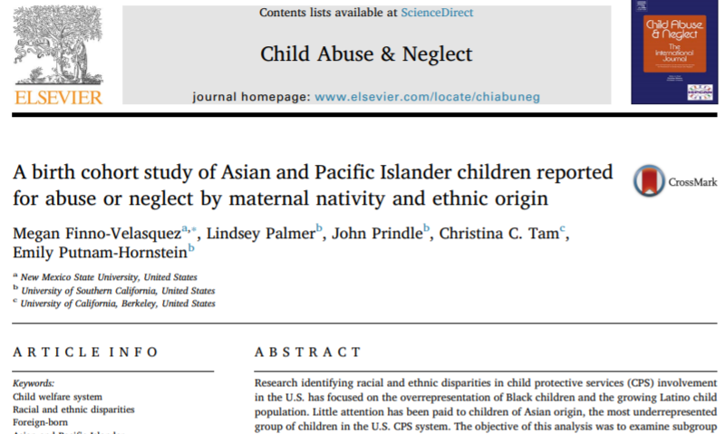
6
Using ‘big’ data to look at small and under-studied group dynamics

Slide 23
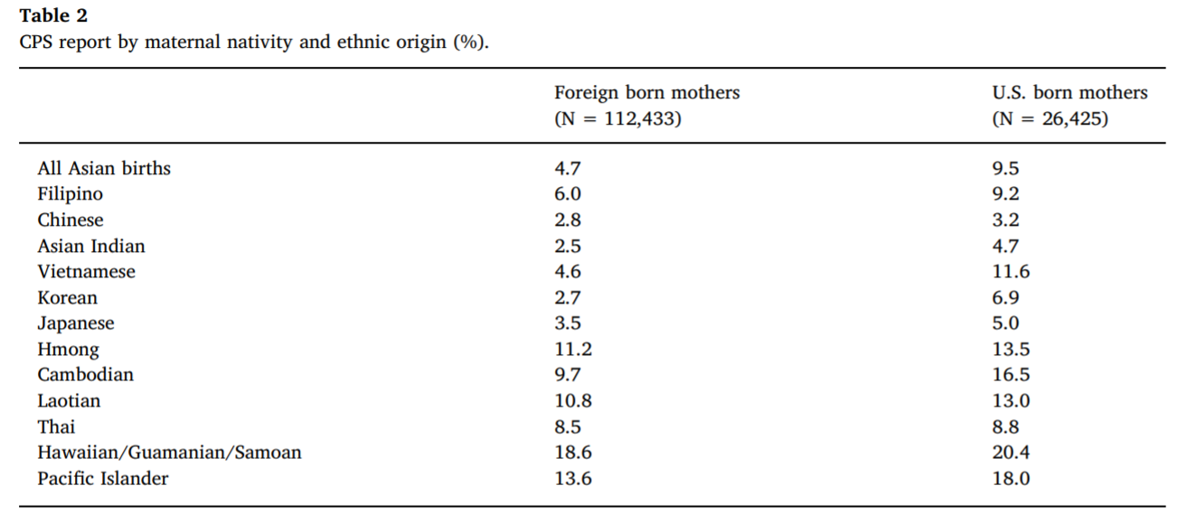

Slide 24
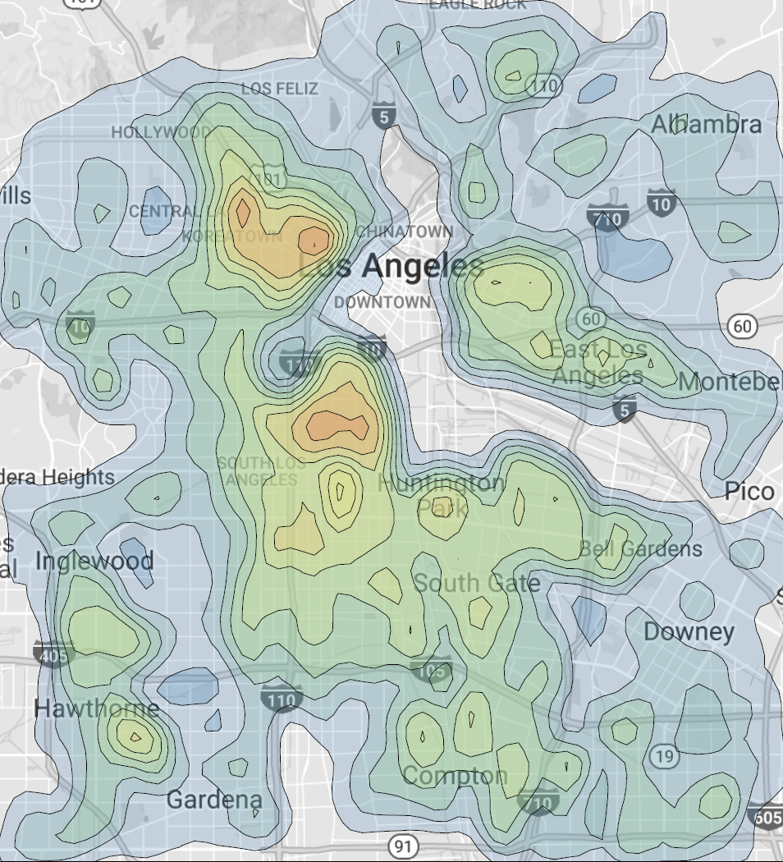
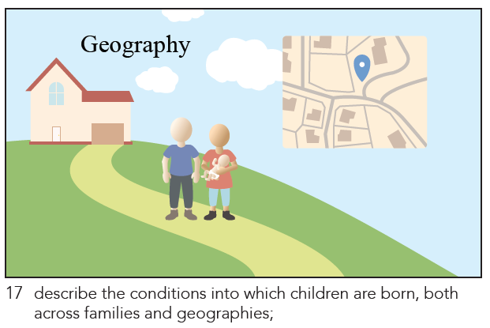
7
Community monitoring of risks and assets at birth

Slide 25
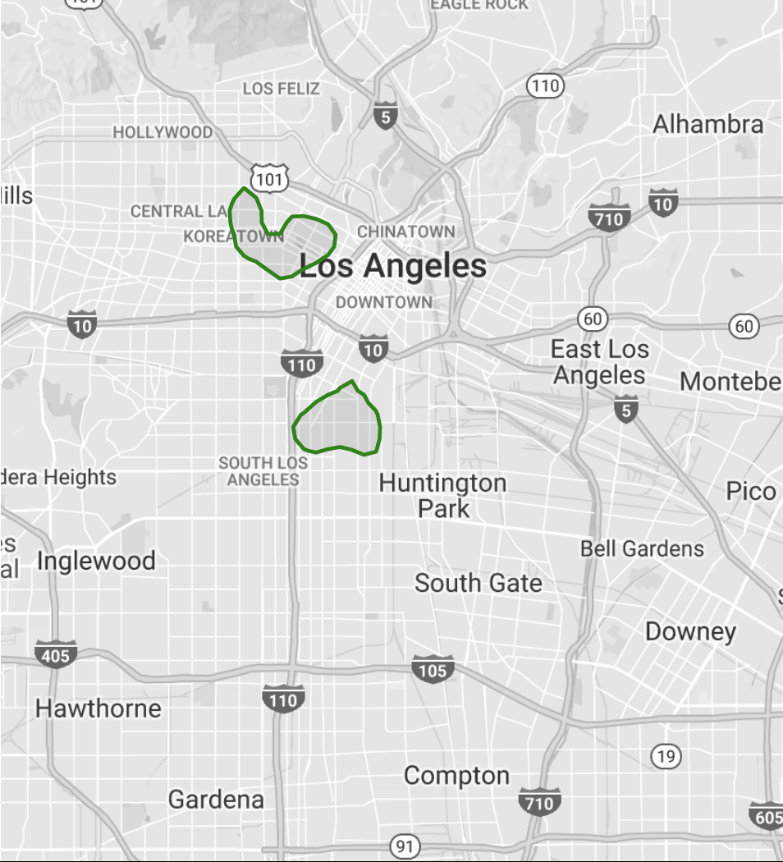
Isolating areas of peak birth density

Slide 26
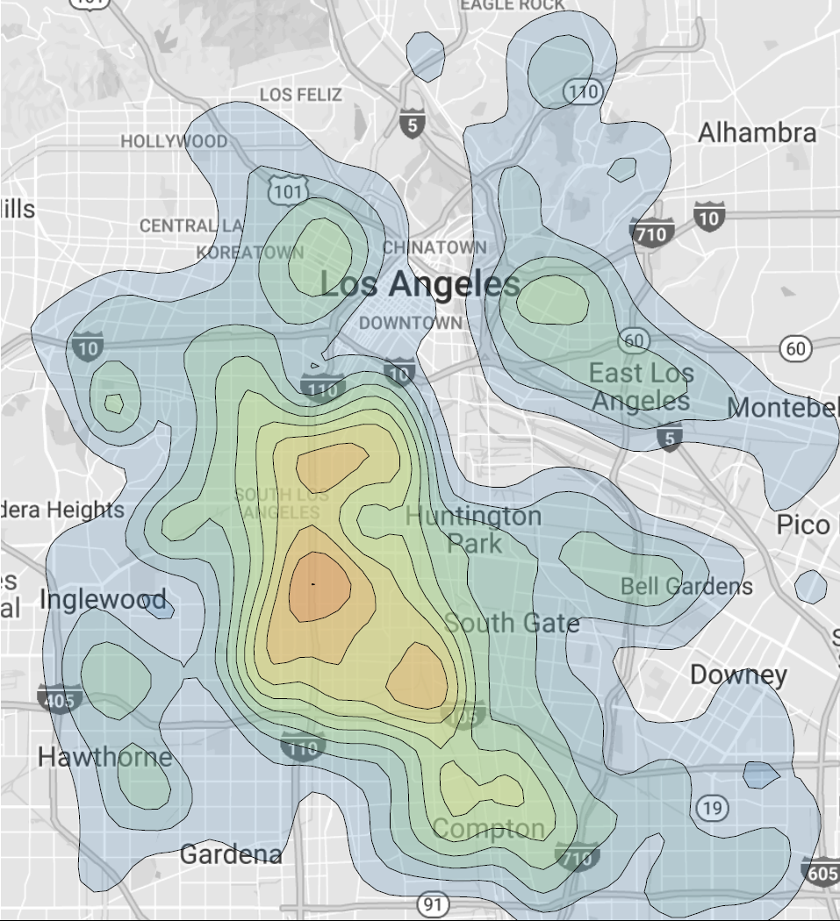
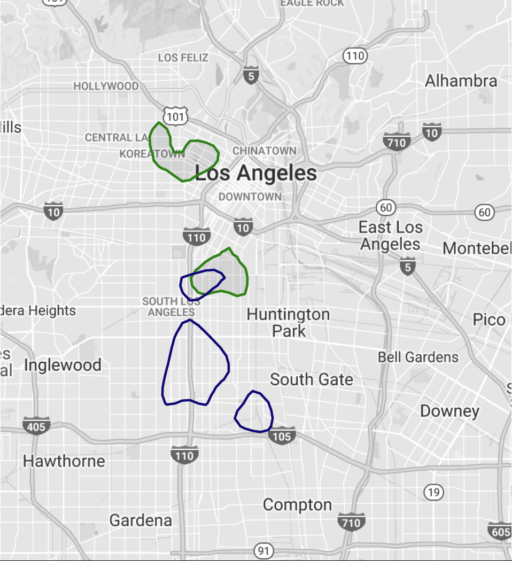
Where are the children at highest risk of a maltreatment referral (top 5%) ?
Peak Births
Peak Risk

Slide 27
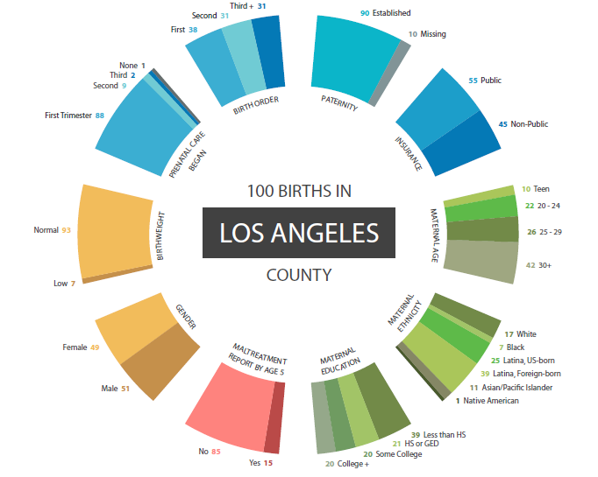
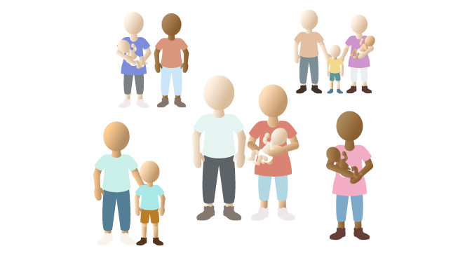
8
Risk stratification for service delivery / maltreatment prevention

Slide 28
 |  |  | All Birth Records for Los Angeles County |  | All Birth Records for XXX XXX Hospital
 |  |  |  |  | (N=5,129)
 |  |  | n | col% | n | col%
At-Risk Birth Score
 | 1 |  | 15,429 | 12% | 127 | 2.5
 | 2 |  | 14,420 | 11% | 206 | 4.0
 | 3 |  | 13,563 | 10% | 302 | 5.8
 | 4 |  | 12,153 | 9% | 337 | 6.5
 | 5 |  | 12,639 | 10% | 406 | 7.8
 | 6 |  | 11,805 | 9% | 546 | 10.5
 | 7 |  | 12,063 | 9% | 530 | 10.2
 | 8 |  | 12,867 | 10% | 703 | 13.6
 | 9 |  | 12,675 | 10% | 779 | 15.0
 | 10 |  | 12,613 | 10% | 1,253 | 24.2

Slide 29
12,800 Tier 3
30.6% of All Children Referred by Age 5
102,400 Tier 1

Slide 30
Candid Reflections
section
3
(fine to disagree with me!)

Slide 31
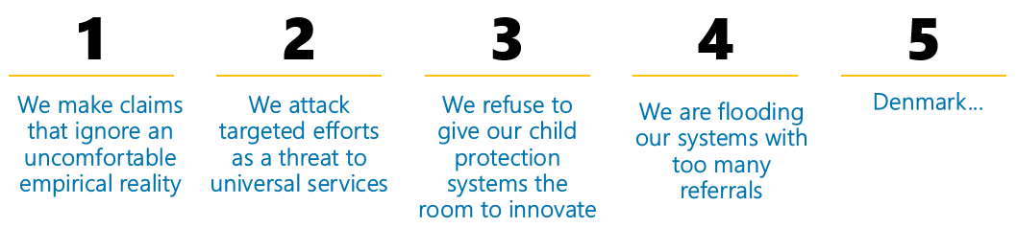

Slide 32
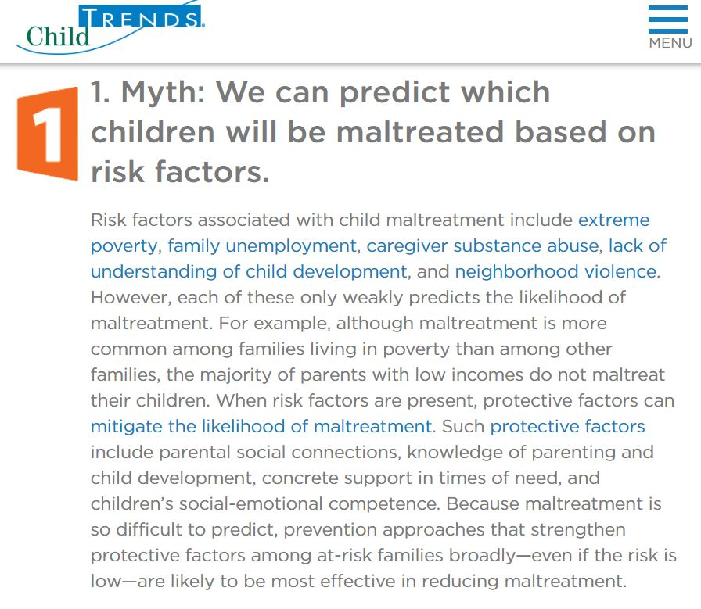
1
We make claims that ignore an uncomfortable empirical reality
TRUTH?
  On the day a child is born, we can identify those children with the greatest likelihood of maltreatment

Slide 33
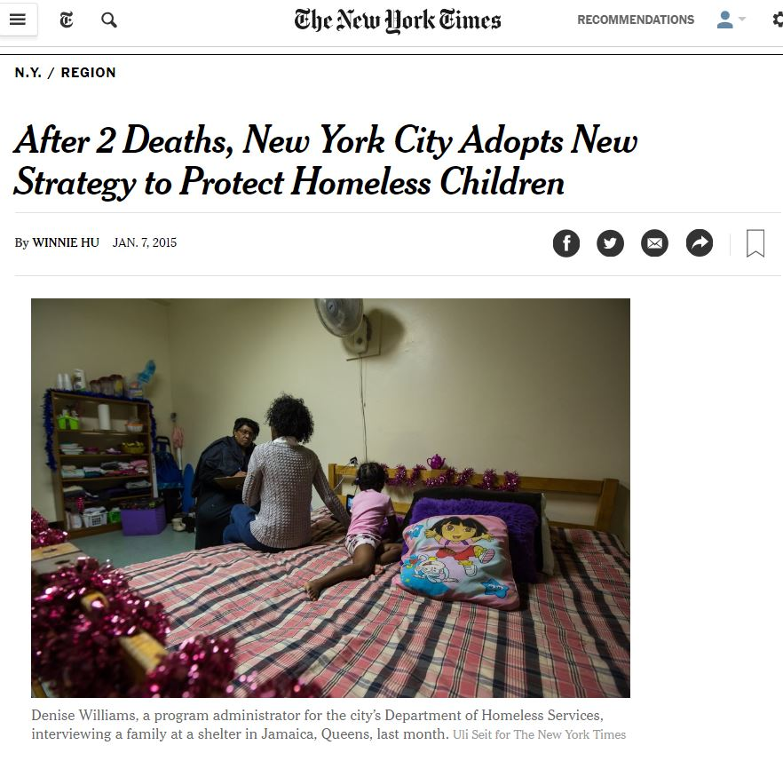
2
We attack targeted efforts as a threat to broader services
    “We prefer not to look at child abuse from the medical model of finding a sick person and treating them,” Dr. Rosenzweig said.
    “We prefer the inoculation model of preparing families and communities to raise safe and healthy kids.”
Notes:
A fundamental problem with the city’s focus on high-risk families, she said, is that even drawing on commonly recognized risk factors, “no list can predict 100 percent.” She pointed out that some families can have none of the risk factors and still abuse their children, while others can have all of them and not hurt their children because they may have supportive family members or other resources.
“We prefer not to look at child abuse from the medical model of finding a sick person and treating them,” Dr. Rosenzweig said. “We prefer the inoculation model of preparing families and communities to raise safe and healthy kids.”

Slide 34

50%
inflicted infant injury deaths
high risk
50%
Unintentional infant injury deaths
50%
Hospitalization for maltreatment injury by age 2
We need to be concrete and specific about where we need services and who should receives those services
46%
SUID
low risk

Slide 35
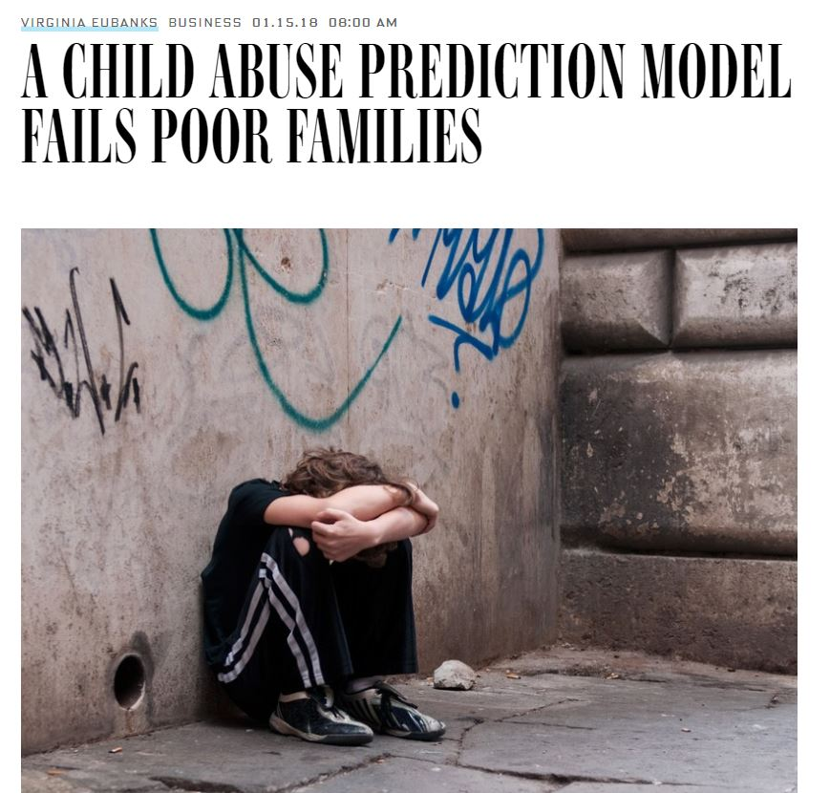
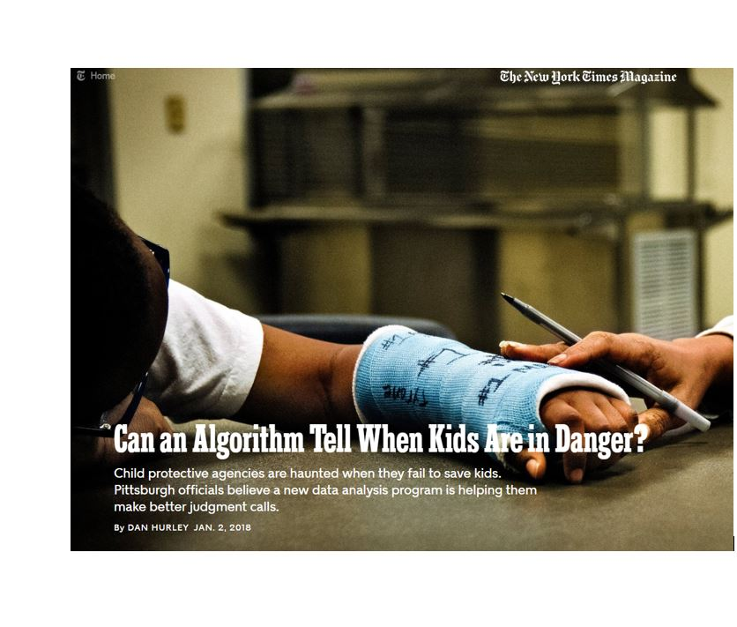
3
We refuse to give our child protection systems the room to innovate
We don’t like the system we have, yet we make it so hard for our child protection agencies to do anything other than “react” to child abuse
Notes:
The unfortunate societal issue of poverty does not negate our responsibility to improve our decision-making capacity for those children coming to our attention. Ms. Eubanks proposes that we all “join a social movement to solve poverty…”. We, of course, look forward to innovative solutions that may help address the underlying conditions so commonly observed in the families we serve. But in the meantime, we will continue to develop concrete solutions to refine and tackle our legal imperatives.

Slide 36

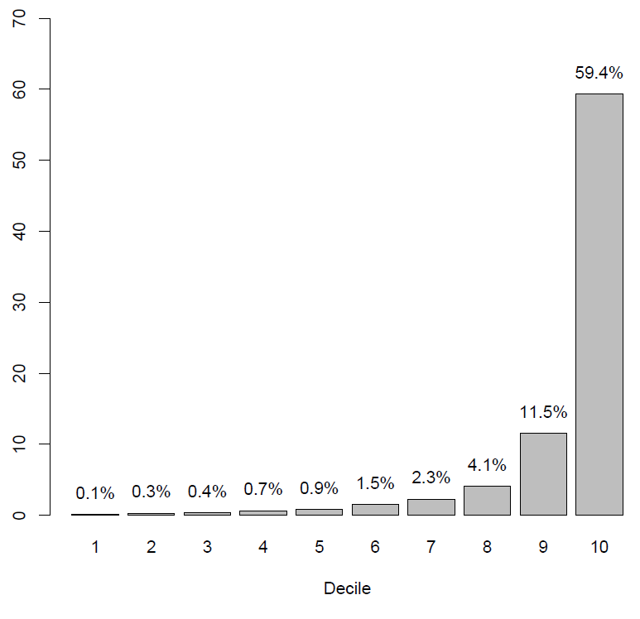
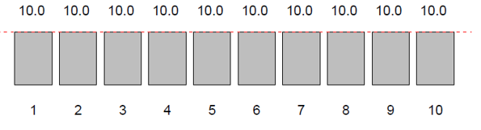

4
We are flooding our systems with very low risk referrals
Data can not only help focus attention on those children who most need protection and families who most need support...but it can also help us “see” unwarranted variation in our current practice

Slide 37
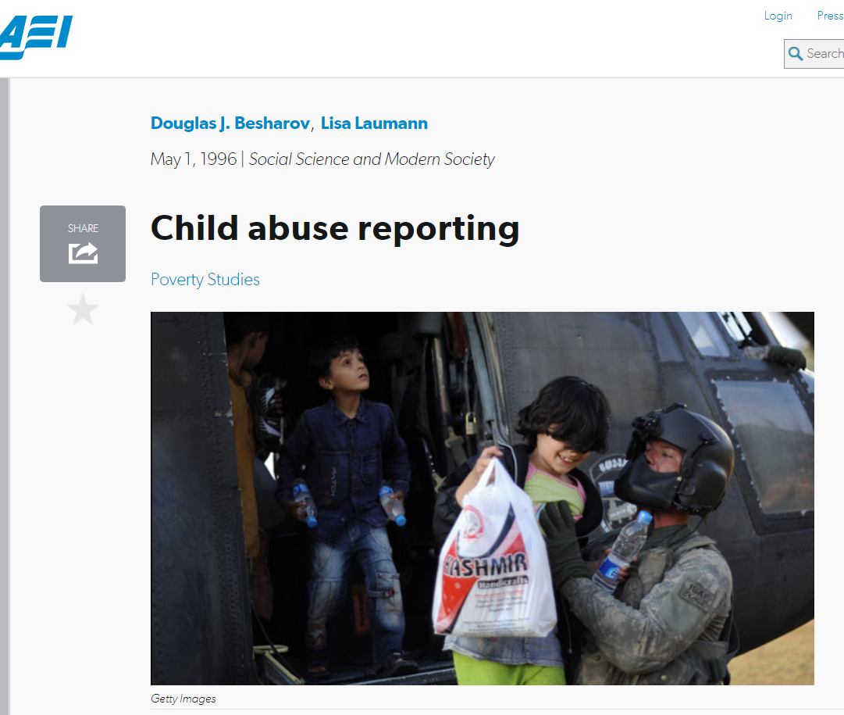
Mandatory Referrals
  “The current flood of unfounded reports is overwhelming the limited resources of child protective agencies...”
  Initially, mandatory reporting laws applied only to physicians, who were required to report only “serious physical injuries” and “nonaccidental injuries.”
  In the ensuing years, however, increased public and professional attention, sparked in part by the number of abused children revealed by these initial reporting laws, led many states to expand their reporting requirements.
Notes:
In the ensuing years, however, increased public and professional attention, sparked in part by the number of abused children revealed by these initial reporting laws, led many states to expand their reporting requirements.

Slide 38
4
We ignore the racial / ethnic inequities that define our current system
Data can not only help focus attention on those children who most need protection and families who most need support...but it can also help us “see” unwarranted variation in our current practice

Slide 39
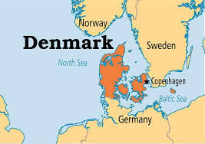
5
Denmark
  “Mutual Obligation”
  Broader social safety net for families – but strong sense that government should act to protect children when parents do not fulfill their caregiving obligations.
  Informal review of US child protection cases? Danish child welfare workers were surprised by the inaction of our system...

Slide 40
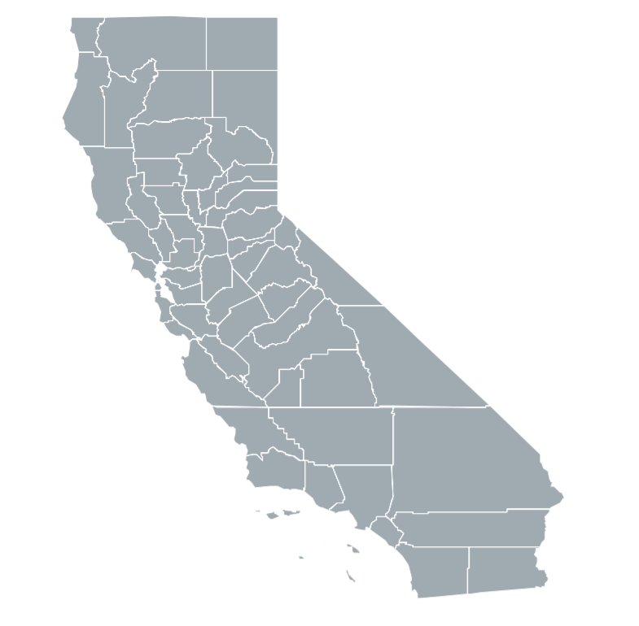
Questions?
ehornste@usc.edu

