Slide 1
Protecting Children Through Predictive Analytics
Emily Putnam-Hornstein, PhD

Slide 2
Five Things
Child Welfare agencies have been using risk algorithms for more than 25 years
The risk tools agencies are using are rudimentary and out of date
The correct question is NOT “Is this perfect”. We should instead ask “Is this better than what we are currently doing / using?”
Child protection is incredibly difficult – we ask our system to be both reactive and preventive. We are failing to equip our workforce with the technology and tools they need.
“This will solve all of our problems and we don’t need a skilled workforce because an algorithm can make decisions for us.” ---SAID NO ONE EVER.

Slide 3
Algorithms

Slide 4
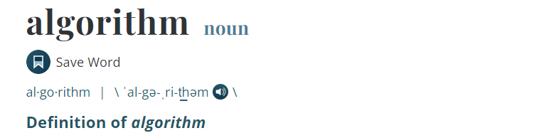

Slide 5
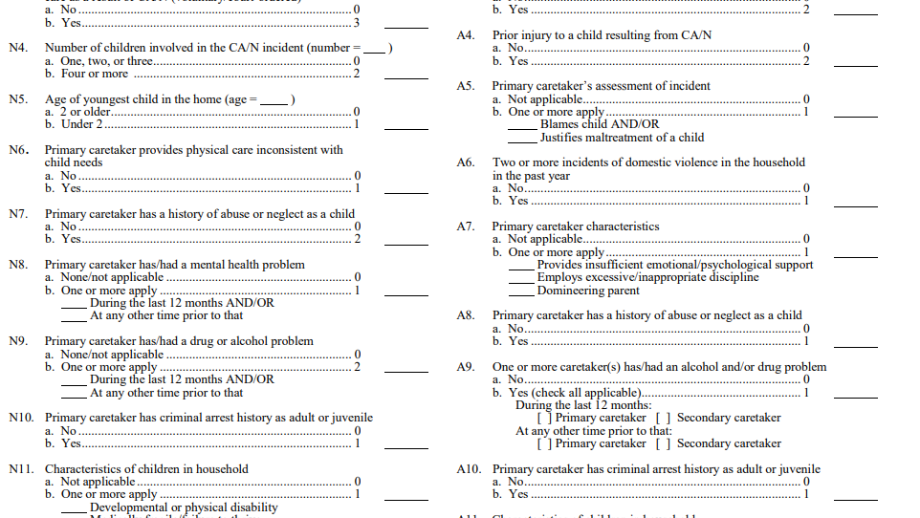

Slide 6
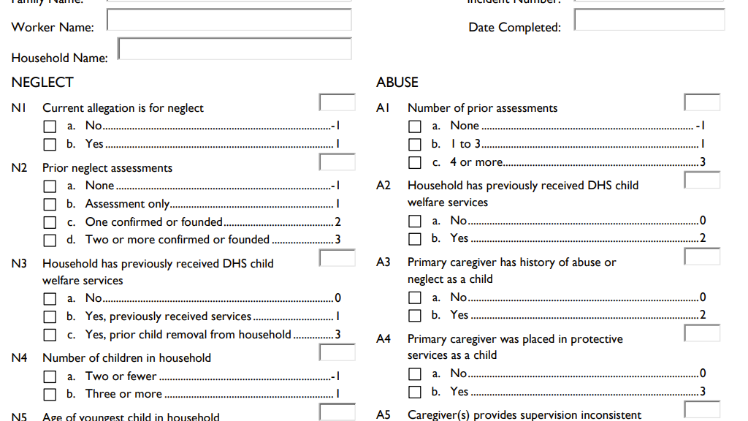

Slide 7
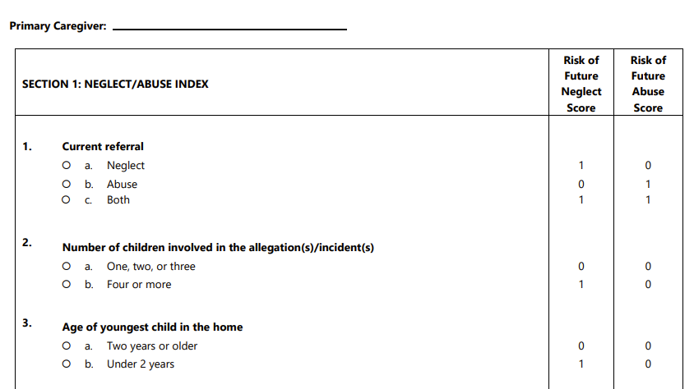

Slide 8
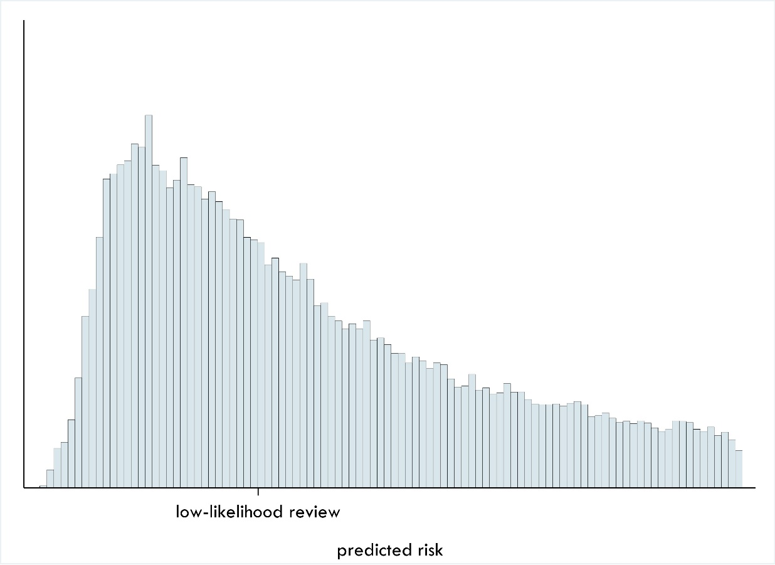
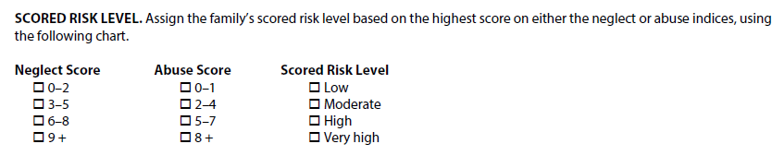
Computerized
(or automated)
Risk Algorithm
Mechanical
(or operator driven)
Risk Algorithm

Slide 9
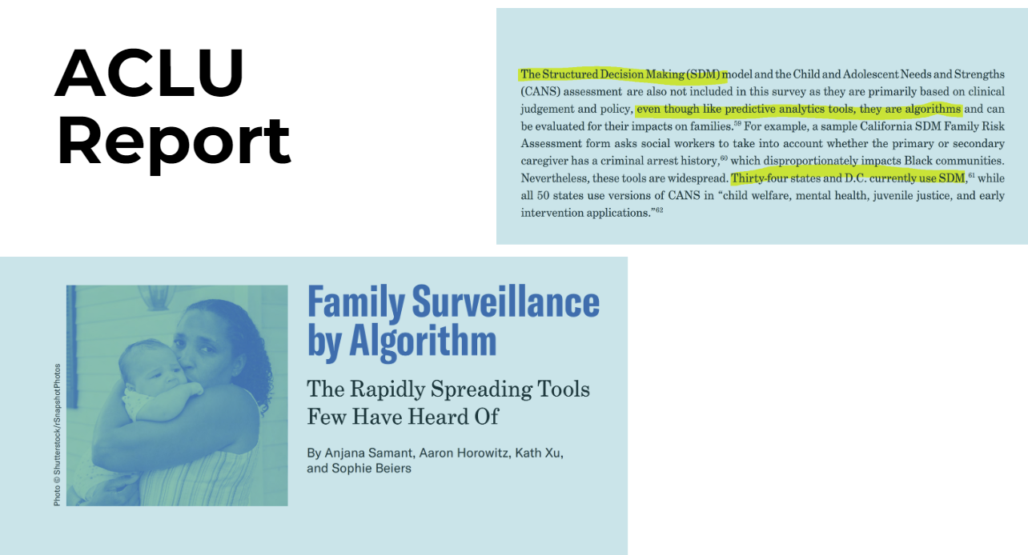


Slide 10
Where Things Started

Slide 11
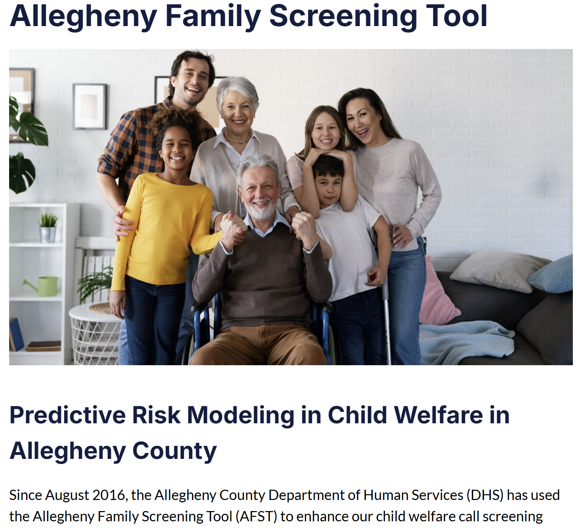
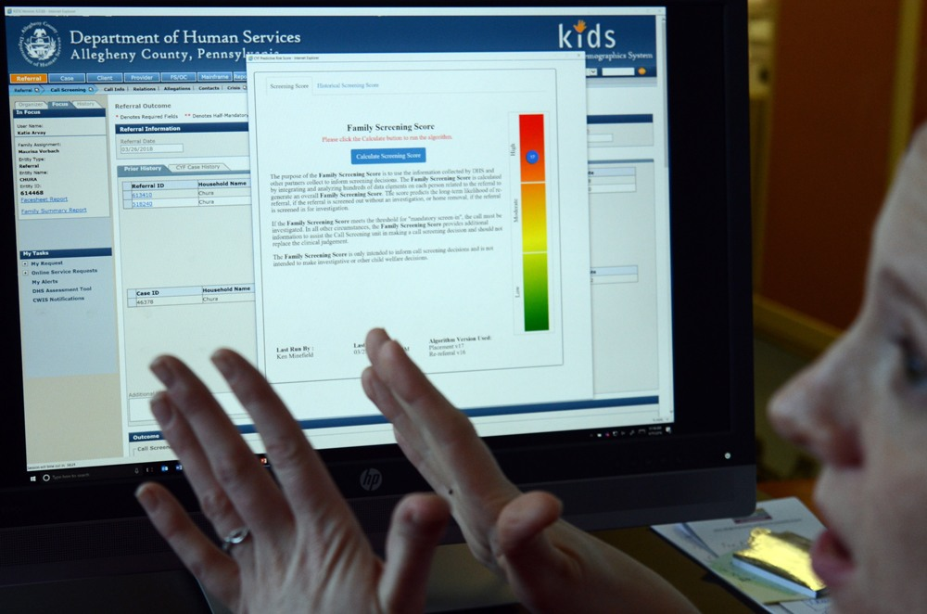

Slide 12
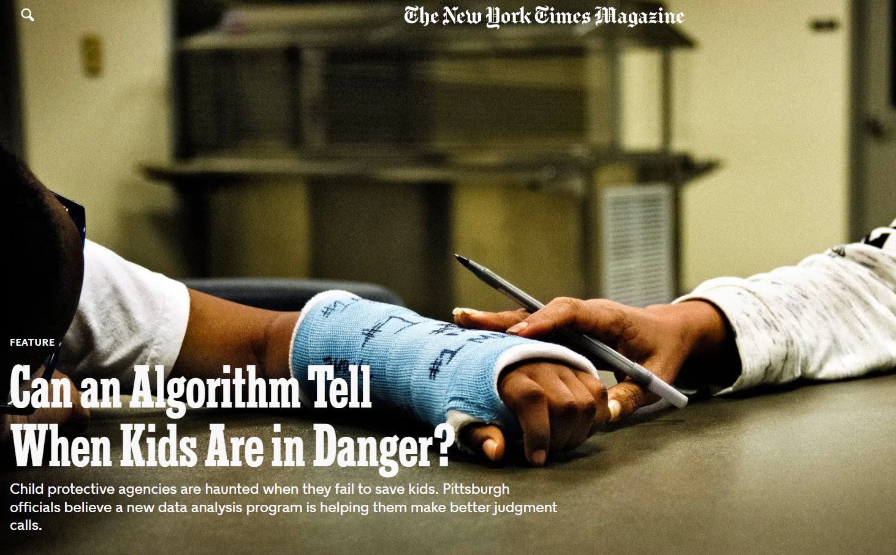

Slide 13
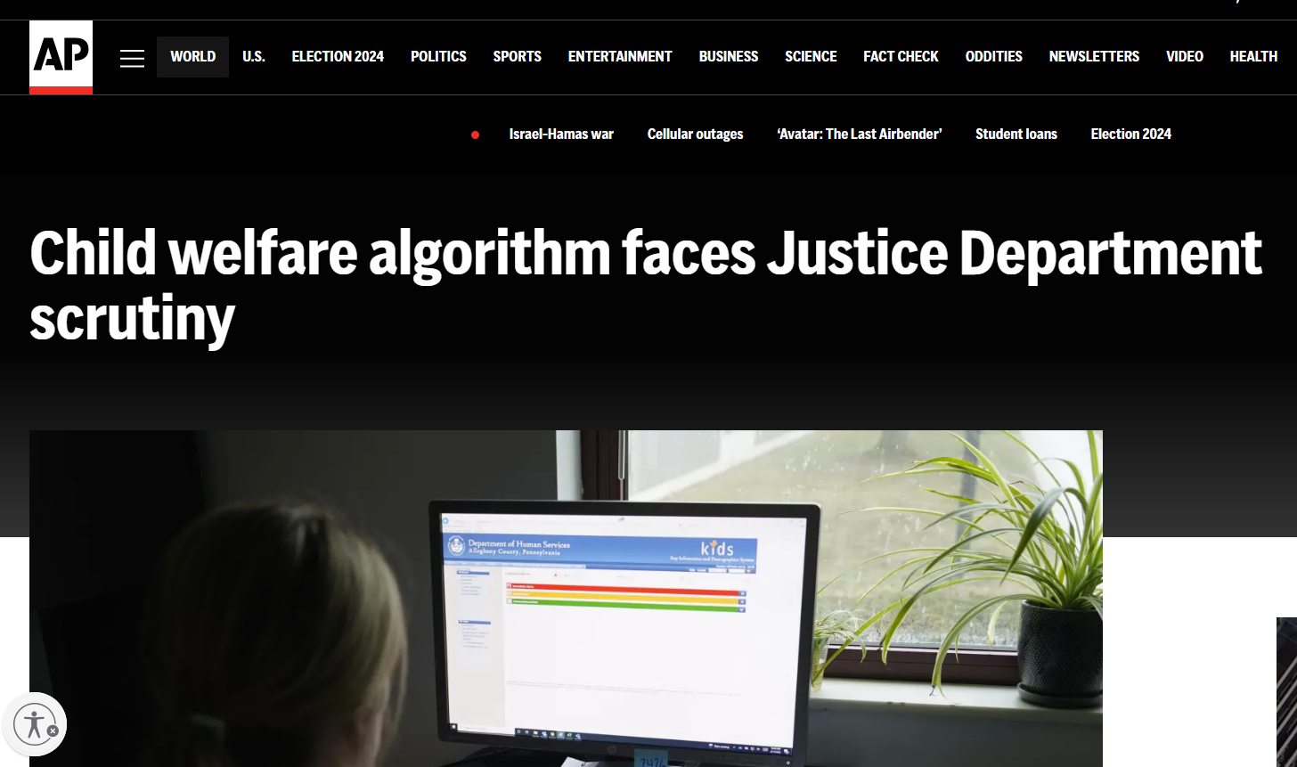

Slide 14
Los Angeles Context

Slide 15
Largest county in the US with a population of 9.6 million and more than 2 million children.
Los Angeles County
The Los Angeles County Department of Children and Family Services (LA DCFS) receives more than 100,000 referrals per year.
Entries to foster care have declined by 36% in the last decade

Slide 16
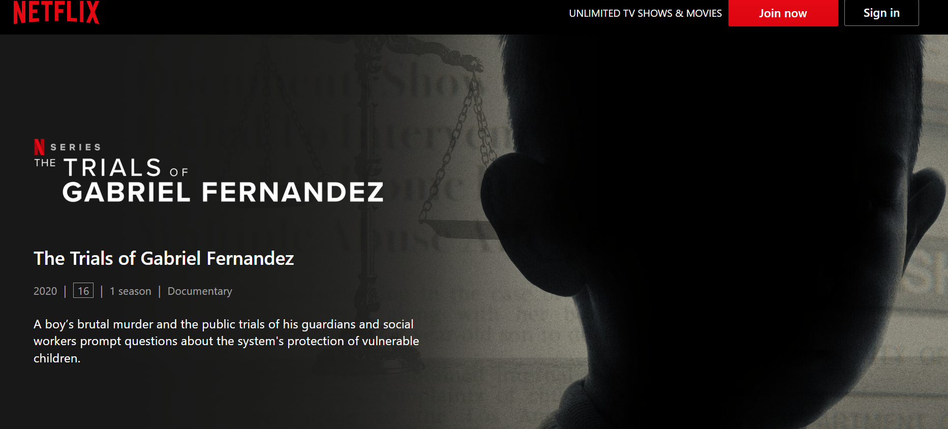
Gabriel Fernandez (died of abuse and torture; May 24, 2013)
Notes:
Anthony Avalos (died of abuse and torture; June 21, 2018)
2019 audit noted tool problems
Noah Cuatro (blunt force trauma and asphyxiation; sexual abuse July 5, 2019)

Slide 17
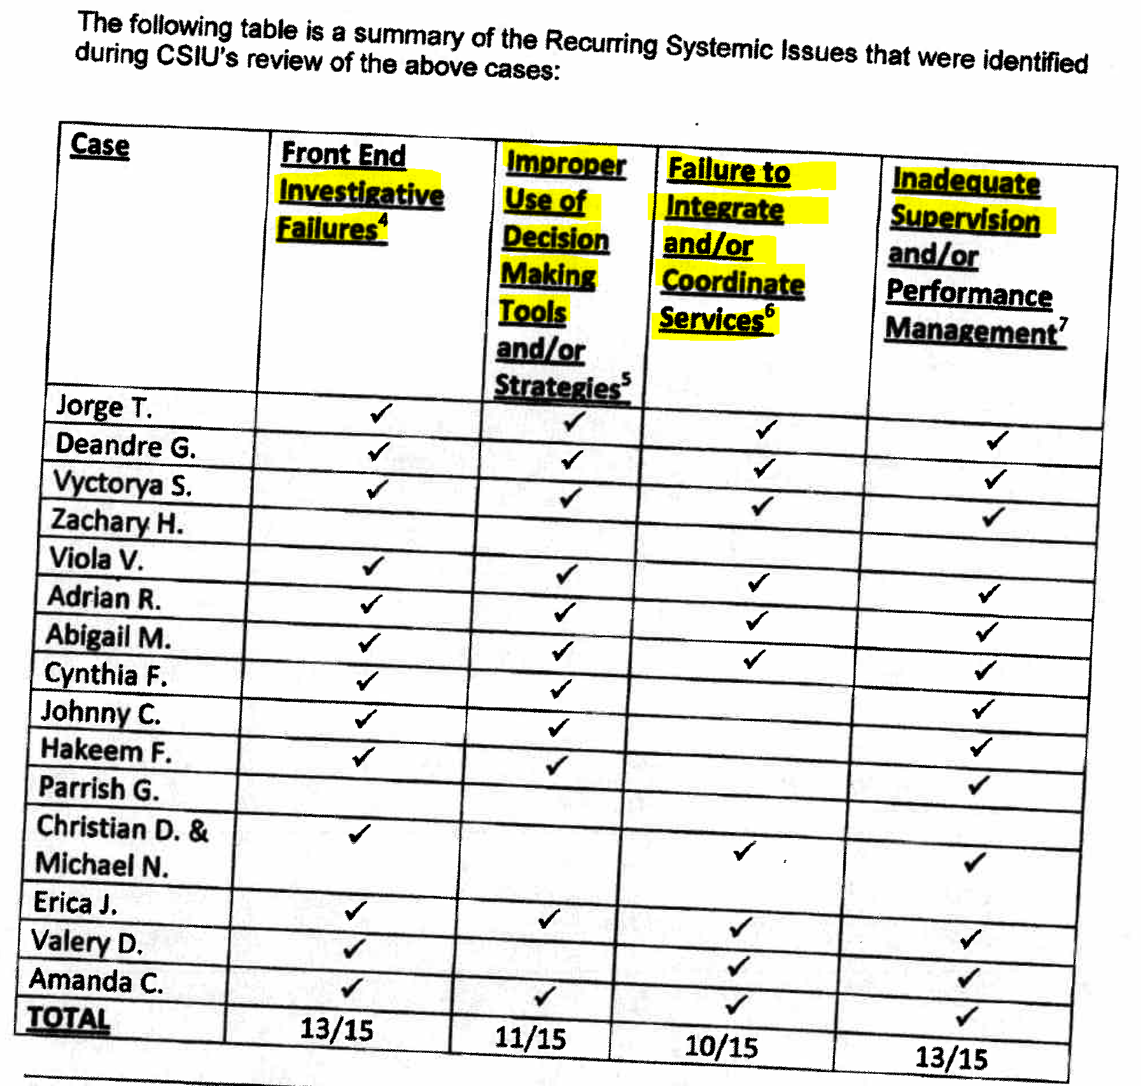
Systemic Challenges
Notes:
DCFS lacks a data-informed tool to help supervisors strategically direct their attention as they oversee ER CSWs during the very critical 30-day window when information must be gathered while investigating an allegation of abuse or neglect.
The lack of a supervisory triaging tool can compromise children’s safety (and any number of other related outcomes) for at least three related reasons…
DCFS lacks a data-informed tool to help supervisors strategically direct their attention as they oversee ER CSWs during the very critical 30-day window when information must be gathered while investigating an allegation of abuse or neglect.
The lack of a supervisory triaging tool can compromise children’s safety (and any number of other related outcomes) for at least three related reasons…
REPORT COMPLEXITY - Not all investigations are of the same severity, complexity, or risk. The failure to follow up on a conversation with a teacher, a missed boyfriend who lives in the home, or an inaccurately completed risk or safety assessment will amount to minor administrative oversights for a majority of investigations. But those same human errors can have tragic consequences in the context of a relatively small number of high-risk investigations.
WORKER EXPERIENCE - Large public agencies, including DCFS, perpetually struggle with consistent staffing (i.e., experience, training, recruitment, retention) both within and across regional offices. This leads to unevenness in the quality and completeness of investigations – affecting the decisions that are made and the services offered.
WORKLOAD & DECISION MAKING - Offices that often struggle the most with recruiting and retaining experienced staff are also often those that are defined by: (1) high volumes of child maltreatment investigations and correspondingly high caseloads; and (2) more complex cases due to above average rates of poverty, substance abuse, and other factors that compromise child safety.
These three practice realities in child protection create a situation where practice mistakes are more likely to occur because of staffing and workload dynamics AND where the consequences of those mistakes are more likely to be tragic.

Slide 18
Implementation

Slide 19
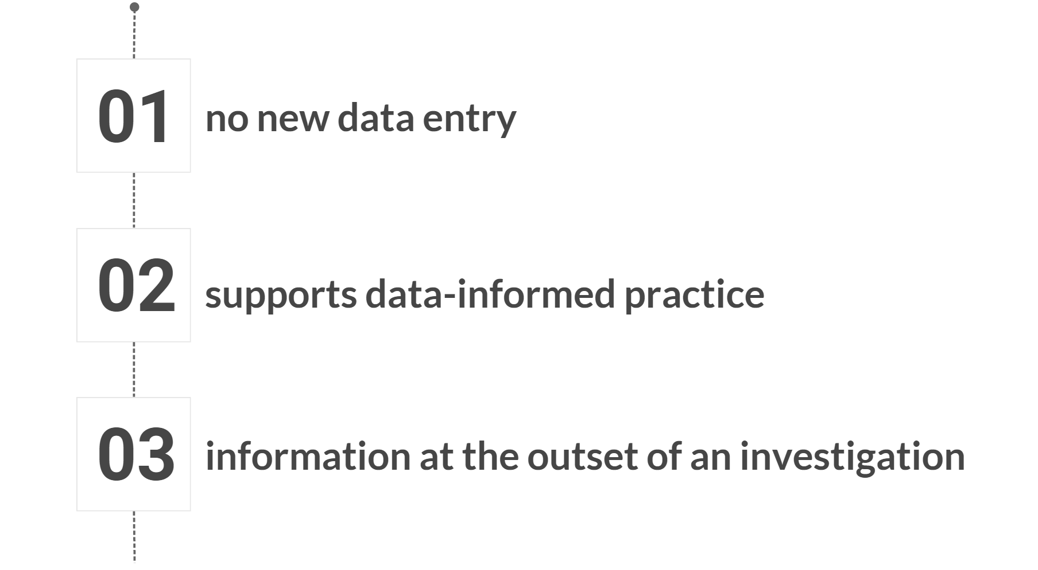
Not replacing other tools, simply making information more easily accessible to supervisors in a standardized format.

Slide 20










LA DCFS DataMart
Risk Stratification
Model
Supervision Tool
Hotline Screening
CWS/CMS
[CARES]
Person-Specific Information
Email Notifications

Slide 21
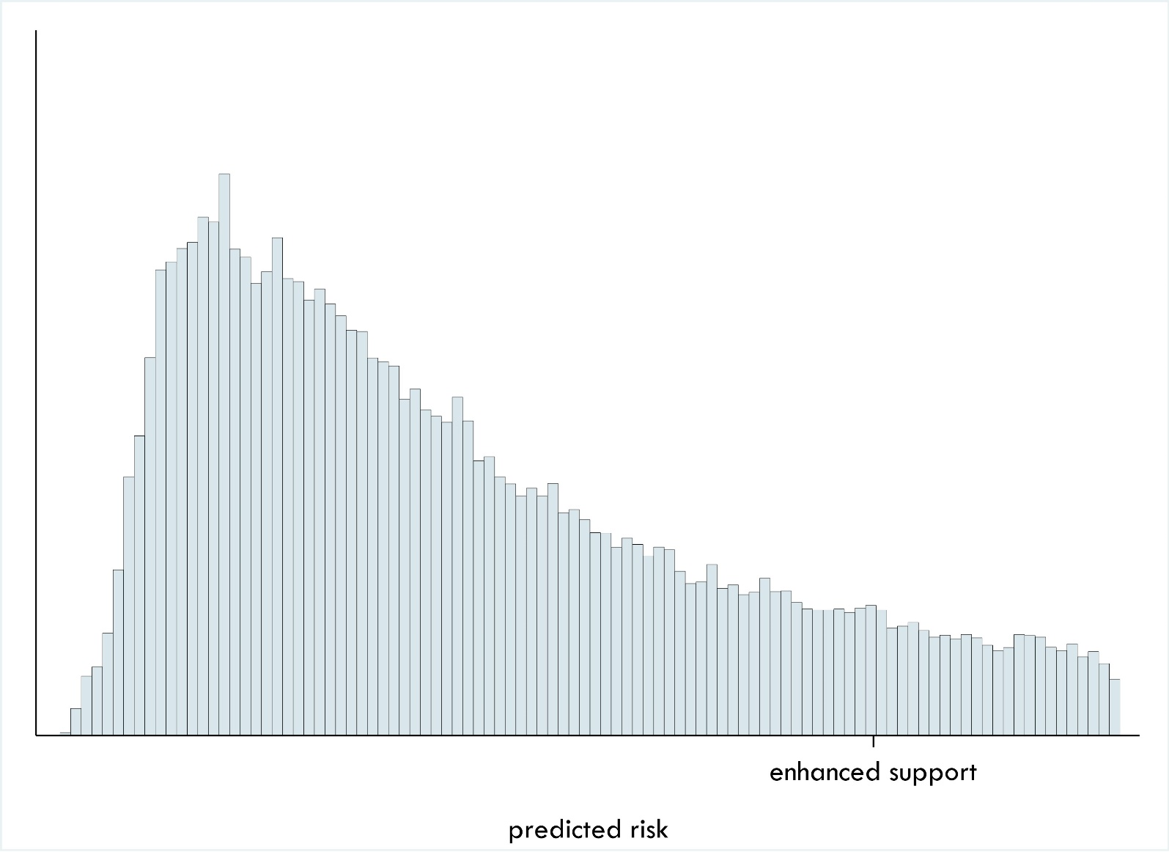
Risk Stratification Tool: Enhanced Support
Notes:
*Wendy

Slide 22
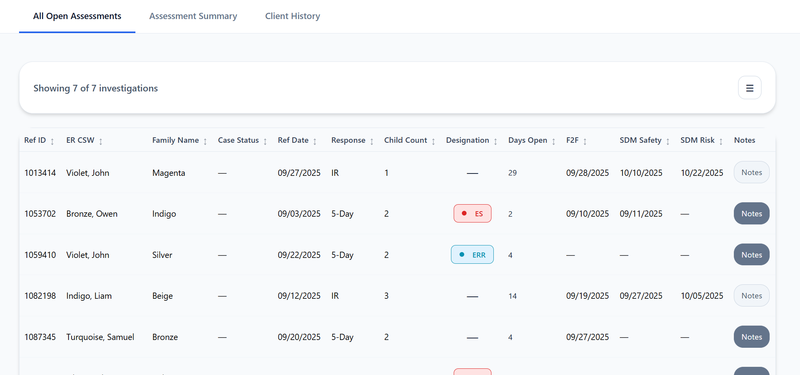

Slide 23
Enhanced Staffing practices
Assistant Regional Administrators
Earlier engagement on the most complex investigations
Intentional consultations and teaming
Closer monitoring, oversight, accountability for service decisions
“It keeps me connected to the investigations where my input and experience may be most helpful”
Supervising Child Social Workers
Ability to quickly review history and review caseload
More focused supervisions with assigned workers based
Closer coordination with continuing service supervisors (when relevant)
“Our caseworkers go out with more knowledge of the family and with a plan”

Slide 24
Investigations Designated for Enhanced Support (ES)
During the pilot, 12,980 investigations met criteria for designation as ES
We could compare:
ES vs. Other (overall)
ES in pilot offices (treated) vs. ES in non-pilot offices (control)
Other in pilot offices vs. Other in non-pilot offices

Slide 25
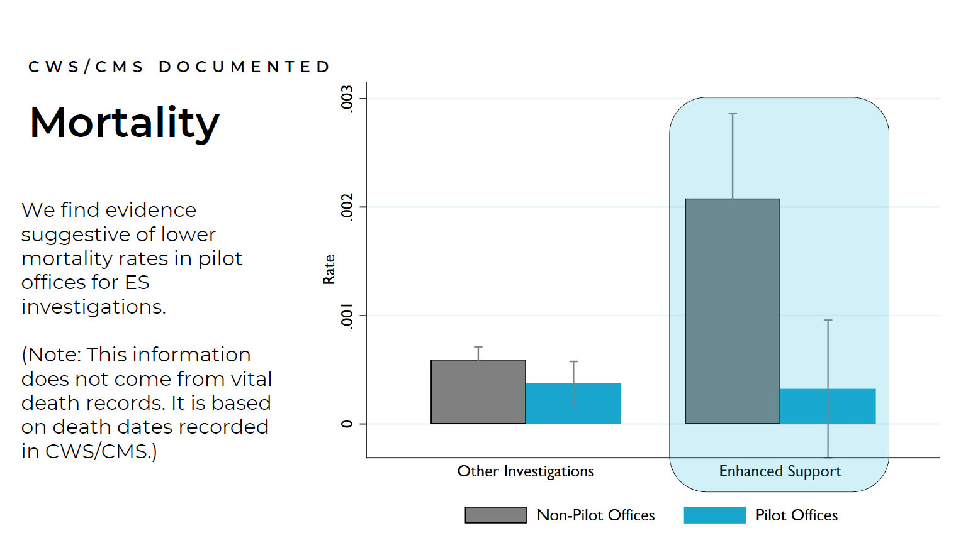
Notes:
Recall that the non-pilot office had no treatment at all.
As expected, the rate of fatalities is higher for complex risk scored investigation.
Pilot office and non-pilot offices have similar rates of fatalities when there was no complex risk flag shown.
The treated group is the complex flag for pilot offices. Large c.i because of the small numbers – but is suggestive of a large reduction in fatalities.

Slide 26
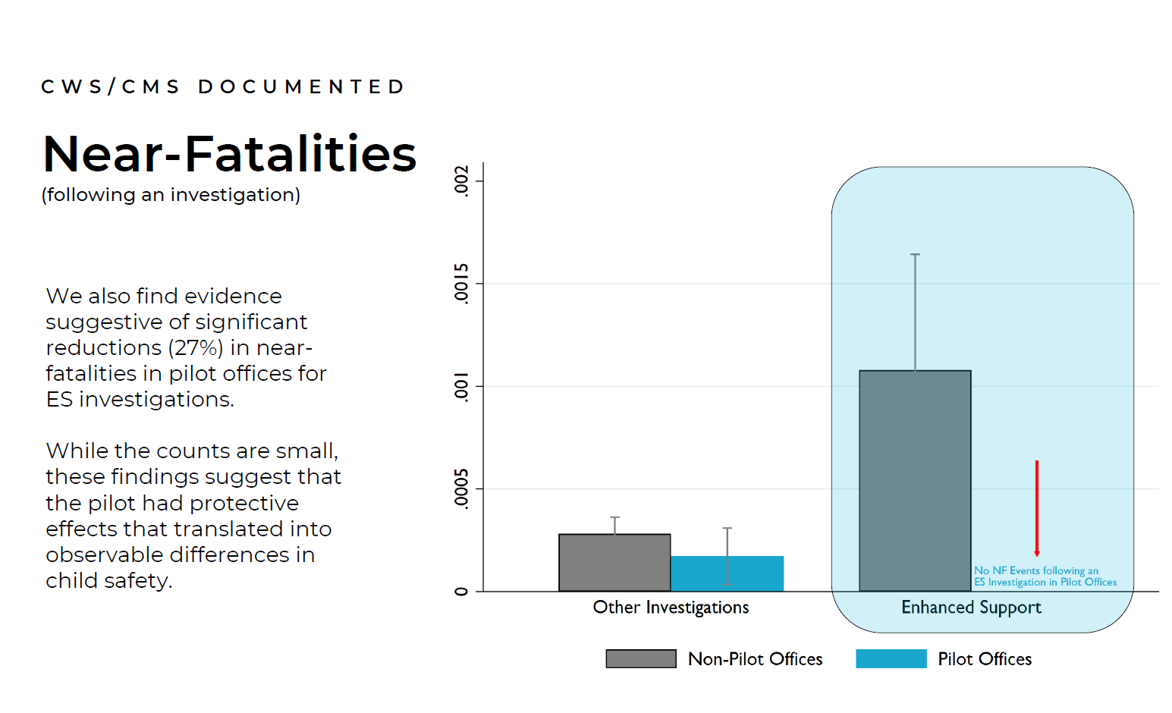

Slide 27
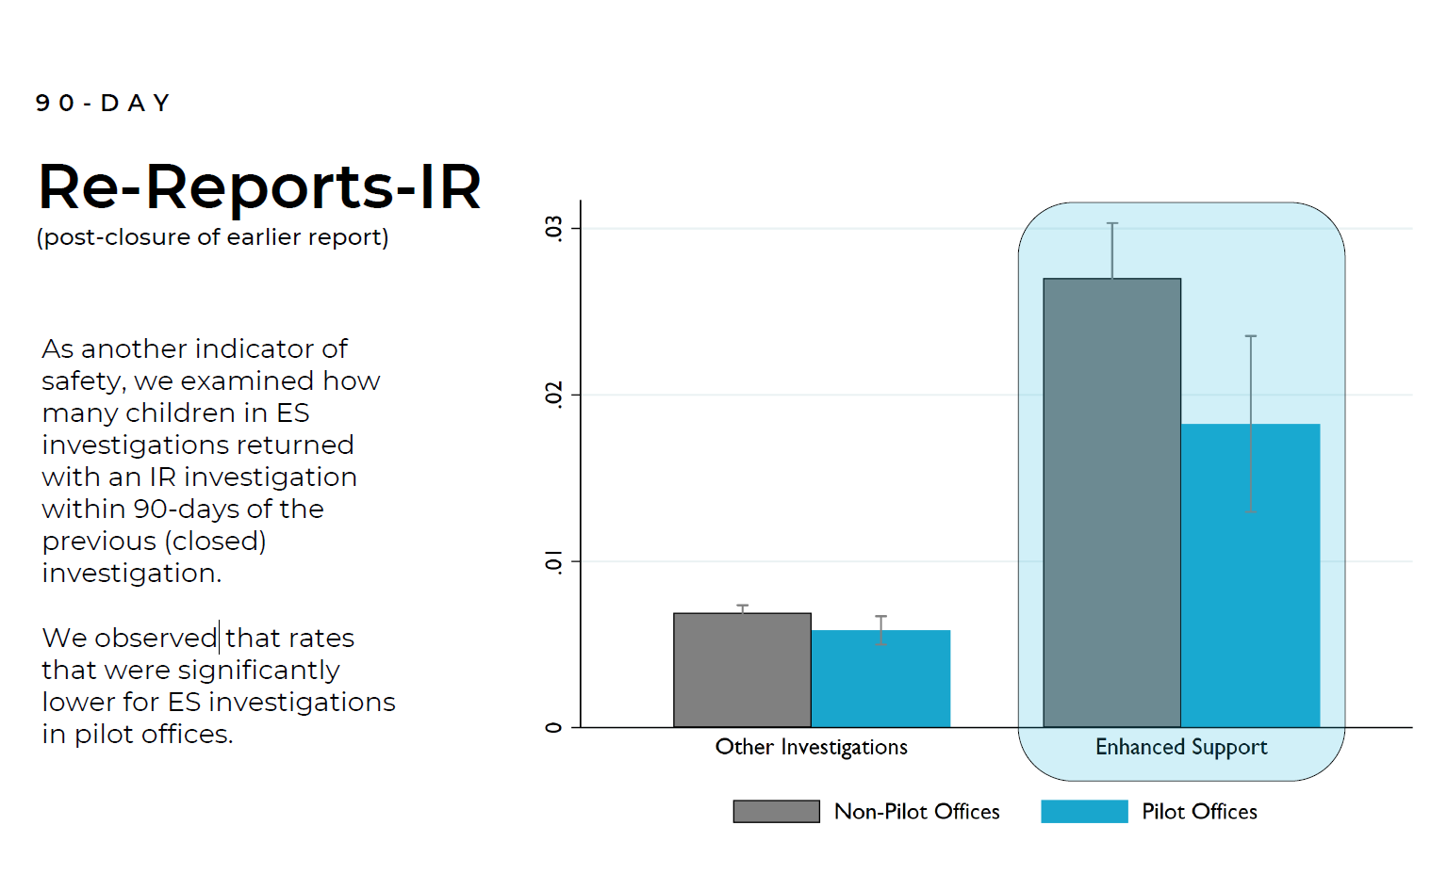

Slide 28
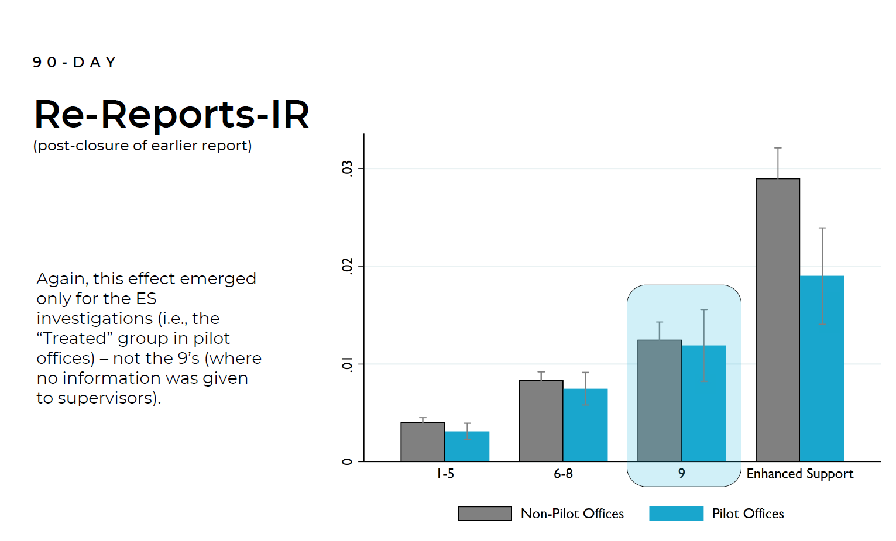

Slide 29
Next Steps…

Slide 30
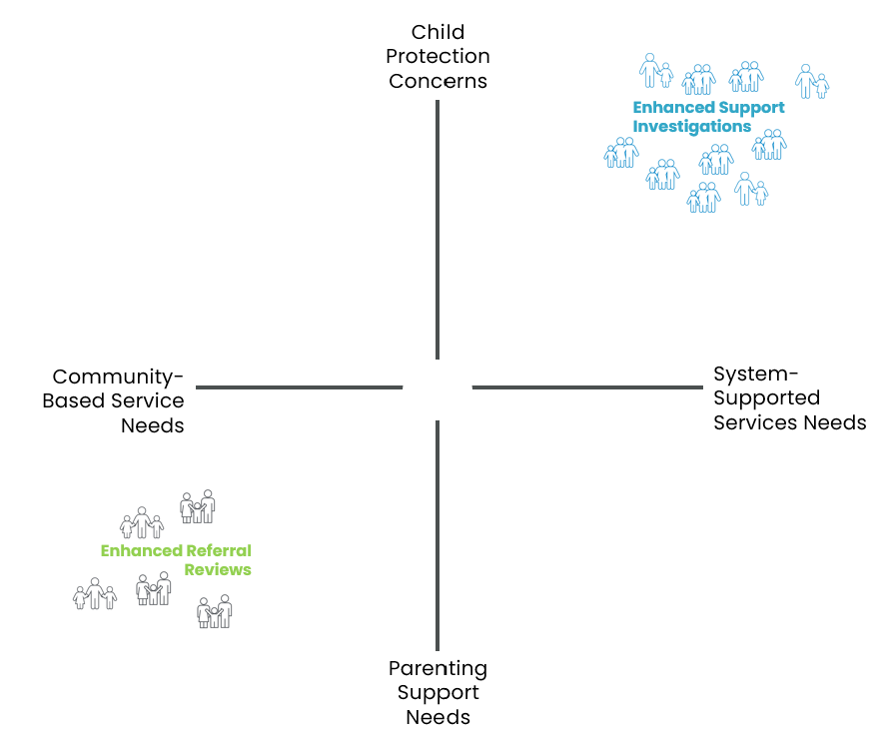
Not all investigations are the same

Slide 31

Risk Stratification Tool: Enhanced Referral Review

Slide 32
You know what’s scarier than predictive risk modeling to help make important decisions?
The way you are making those decisions right now.
Erin Dalton, Allegheny County DHS, May 2019

Slide 33
Q
eph@unc.edu

