Slide 1
Determining the What
Making systemic changes that support youth who are at-risk of or have crossed over
October 2, 2023

Slide 2
Systems Change Framework
Crossover Youth Practice Model
DuAl Status
Youth Model
Developed in 2010 by Georgetown University Center for Juvenile Justice Reform
Addresses improving how “systems” become aware of and respond to the needs of youth through creation of a collaborative case management process inclusive of Court, Child Welfare, Youth Legal System, and other youth serving systems
Over 120 counties nationwide, listed as a model program by OJJDP and ranked as having promising research evidence
Developed in 2014 by the Robert F. Kennedy National Resource Center for Juvenile Justice
A model that supports creation or enhancement of systemic infrastructure to support dual status youth

Slide 3
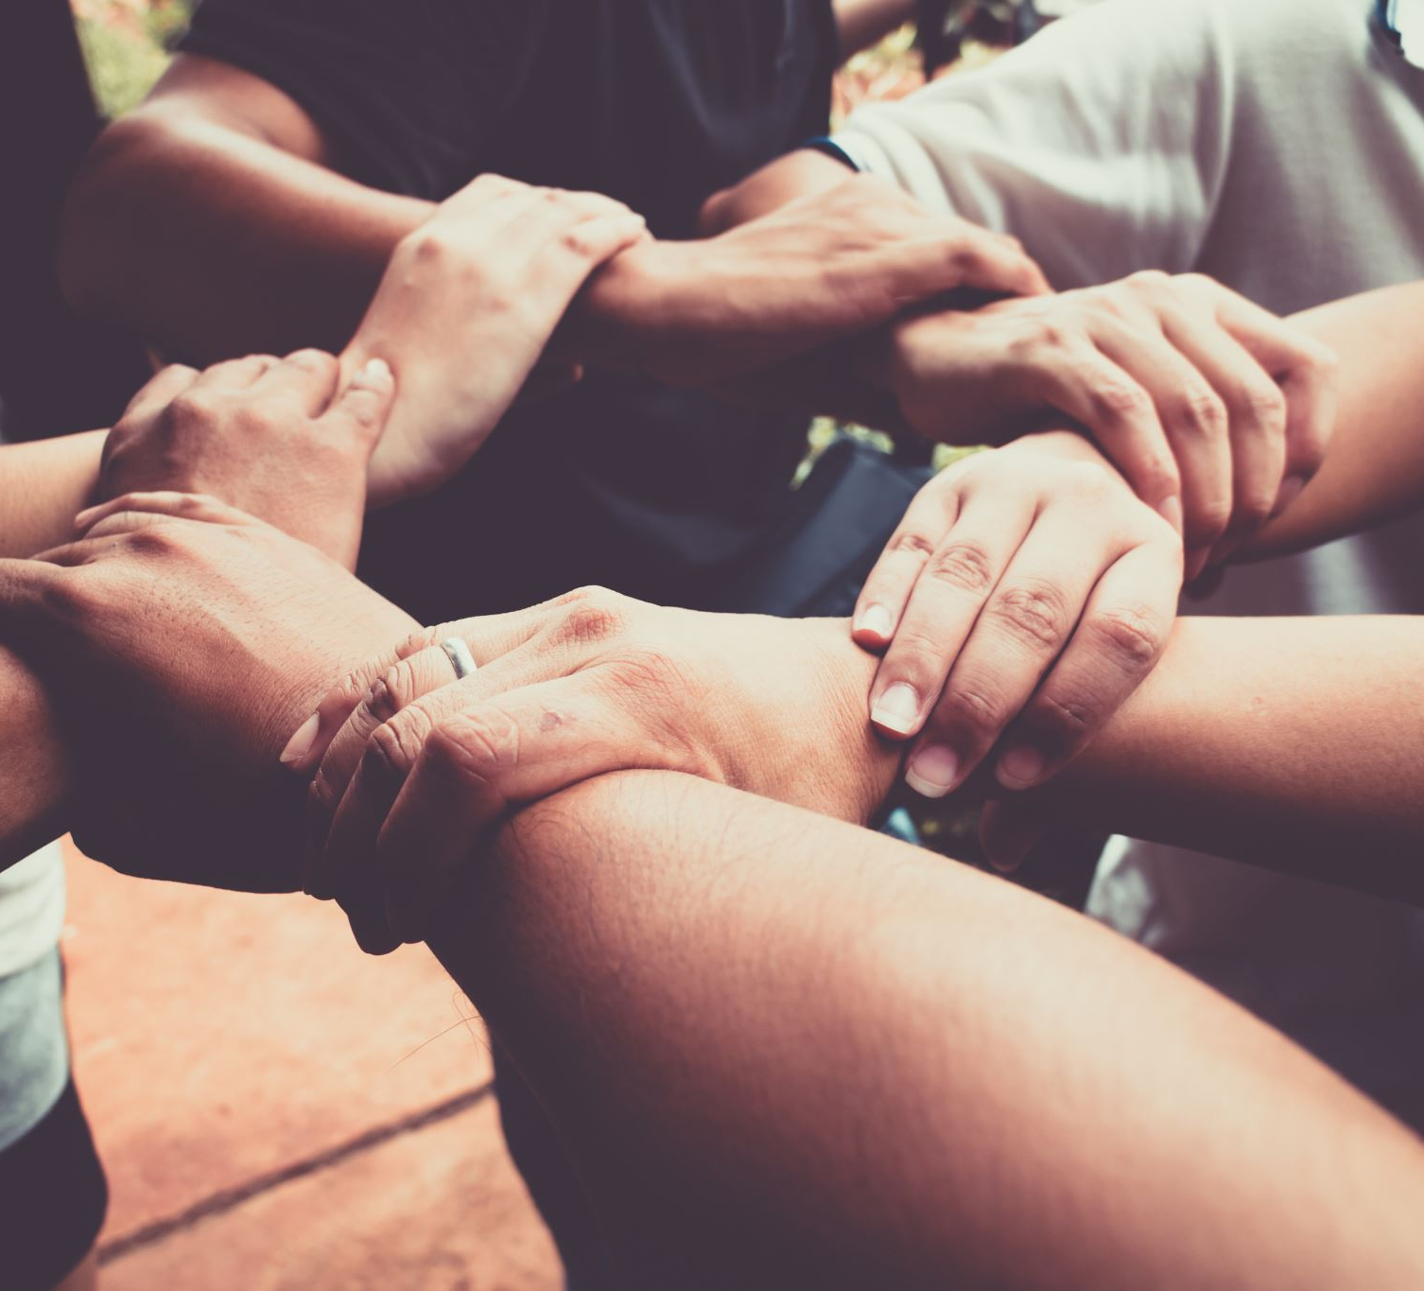
Childhood Needs
Safety: “the absence of threat, neglect, and violence” in which youths feel “free from harm within their social and physical environments.”
Stability: “consistency and predictability in the child’s development.”
Nurturing: “availability, sensitivity, and warmth in responding to a child’s needs.”
Source: U.S. Department of Justice, Office of Justice Programs, Office of Juvenile Justice and Delinquency Prevention, The Prevalence of Safe, Stable, Nurturing Relationships Among Children and Adolescents, Heather A. Turner, Melissa T. Merrick, David Finkelhor, Sherry Hamby, Anne Shattuck, and Megan Henly, September 2017, accessed January 7, 2019, https://pdfs.semanticscholar.org/4a27/1685d0ea76daf7efaa5629c8ad7b111fb682.pdf.

Slide 4
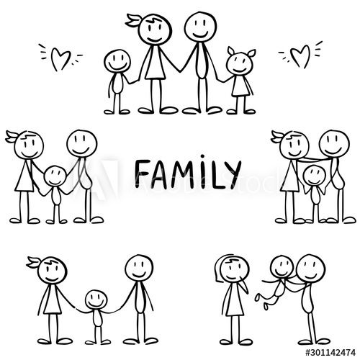
Varying Degrees of Change
Systemic
Direct Services
Human Behavior/Beliefs

Slide 5
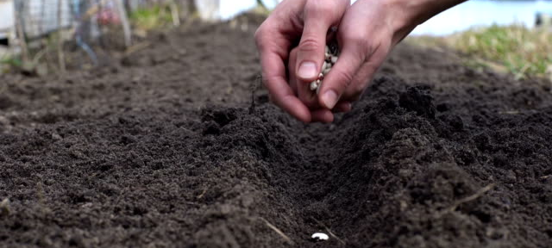
With every interaction or transaction are you
Planting
Watering
Uprooting

Slide 6
Systemic Change
Develop a Stakeholder Group
Inclusive of youth, families, community members, courts, child welfare, and youth legal personnel
Confirm your mutually agreed upon why
Set time limited goals based on the why
Every voice should have relevancy and power in the conversations
Set the vision, mission, and goals for the work
Notes:
Guiding Coalition
Implementation Team

Slide 7
Systemic Change
Educate and Create Awareness
Inform colleagues about the vulnerability's youth face when in care and how it may impact them
Offer training on risk factors for youth and how crossing over impacts them long-term
Ensure training is offered to every person within the organization whether they work directly with youth or not
Identify a play on words that will stick with people and make them THINK differently
Understand that SYSTEMS aren’t people, they aren’t relational, and they don’t serve youth well overall
Notes:
Staff within every agency/organization that works with youth need to understand the vulnerabilities the systems create for these youth
Identify key data points:
Vulnerabilities ----upwards of 30% of youth in the care of CW over the age of 10 is subsequently arrested
68 percent of the incarcerated adult male felons reported some form of early childhood victimization before age 12, either physical abuse, sexual abuse, or neglect Weeks and Widom 1998 (https://www.ojp.gov/pdffiles/fs000204.pdf)
Less home like = more likely to abscond (Dierkhising et al., 2020)
Nearly 80% of CSE victims in Florida who ran away from foster care fled group homes (Latzman et al., 2019)
CSE CW-involved females in LA were 4x more likely to live in group homes than their CW-peers who were not exploited (Dierkhising et al., 2022)
Homelessness, health issues, and financial challenges (CIDI, 2015)

Slide 8
Systemic Change
Analyze data to gain understanding
What are youth and families telling you about their experience
Identify the pathways youth are traveling
Determine where arrests are occurring most frequently or where CPS referrals are being made from most often
Data should be the driver to guide any changes

Slide 9
Direct Services Change
Court
Leading the Charge
Listen to youth and families and make changes accordingly
Supporting Courtroom Designs and Expectations
One Judge/One Family Model
Dedicated Dockets
Assigned State’s Attorney
Designated Public Defenders

Slide 10
Direct Services Change
Youth Legal System
Listen to youth, families, and line staff to make changes accordingly
Drill down into data to determine what needs change
Enhance support and resources for youth and families to prevent them from needing child welfare intervention
Create a strong collaborative case management process to support youth that are dually-involved case opening to case closing
Notes:
Supporting parents/caregivers while youth are placed in a juvenile facility. Ensuring community resources are in place prior to exit from placement and have begun as they transition back home. Extend your net of supports to not only biological parents but also other close relatives or fictive kin. Utilize family team models from CW as a way to bring everyone to the table.

Slide 11
Direct Services Change
Child Welfare System
Listen to youth, families, and line staff to make changes accordingly
Drill down into data to determine what needs change
Enhance support and resources for youth and families to mitigate involvement of the youth legal system
Create a strong collaborative case management process to support youth that are dually-involved case opening to case closing
Notes:
Understand that young people need human connections. The more transient they are the less likely they are to be connected. Determine what JJ has to offer that could benefit youth that are engaging in risky behaviors. Identify situations that may be exacerbated because a youth is in placement that otherwise may not be a JJ issue. A fight in placement results in a youth being arrested a fight at home results in people being punished.

Slide 12
Human Behavior/Beliefs
What we believe about a person impacts how we treat them
Connect with the humanness of each youth/family you support
Have empathy and compassion
Identify what can be done to support them having normal childhood/adolescent experiences

