Slide 1
The Power of Partnership: Advancing Care for Child Victims in Texas Kasey Jackson, MSSW, LCSW-S Vice President of Programs Childrens Advocacy Centers of Texas
Notes:
Wow, I’m honored to be here among some of the brightest minds in the child welfare space
My name is Kasey Jackson and I am the vice president of programs at CACTX
We are the membership organization for the 70 CACs in the state of Texas
I have been in the CAC world since I was a youth
Tell my story of learning about the CAC model and how it has gotten me to where I am today (all because my frugal parents invested in dial up internet!)

Slide 2
Training Objectives
Develop a foundational understanding of Children's Advocacy Centers of Texas (CACTX), including the strategic groundwork that has enabled the organization’s growth and the success of key initiatives.
Explore CACTX’s newly developed statewide strategic plan, collaboratively authored by the Texas CAC network, and examine current partner-driven initiatives aimed at advancing services for child victims across the state.
Cultivate strategic thinking among participants, encouraging reflection on the challenges they are currently addressing and identifying the critical factors necessary to advance effective problem-solving.
Notes:
My goal for this session today is….
This is not ground-breaking stuff, but we are so busy in our daily lives that we often don’t get the space we need to pull ourselves up out of the grind and identify strategies that will move our work forward in bigger and better ways
My hope today is that some of what I share might spark some ideas or even encourage you to go back to your grind and try to make space, even for small moments, to allow yourself to explore what could lead to big opportunities

Slide 3



Do not edit How to change the design
How familiar are you with CACs?
The Slido app must be installed on every computer you’re presenting from

Slide 4
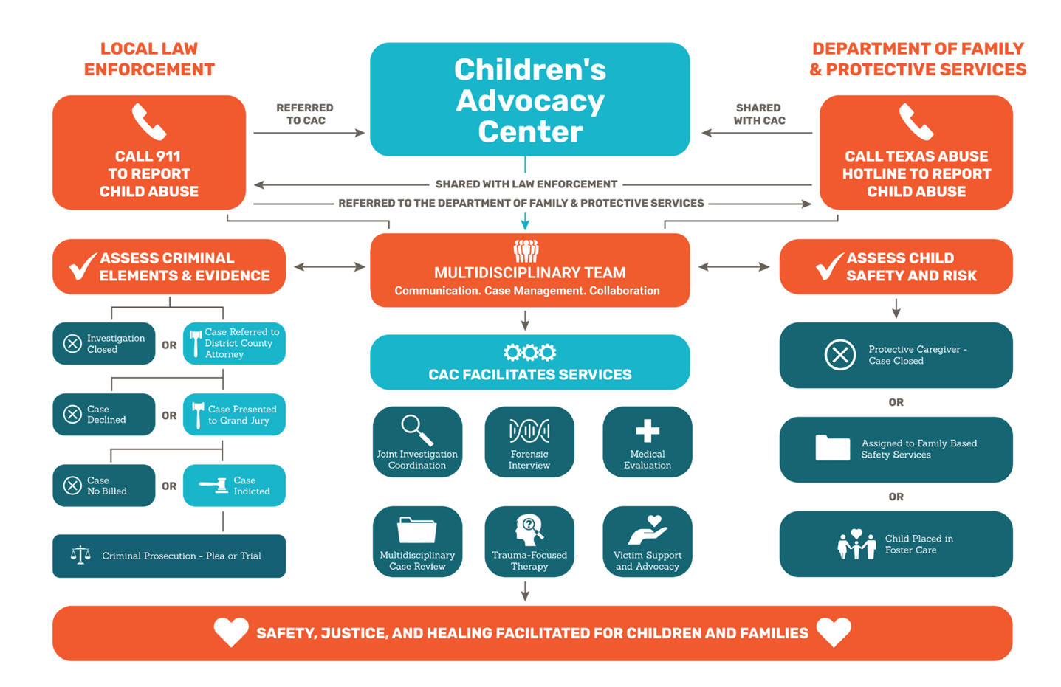
CAC Model
Notes:
Children’s advocacy centers (CACs) provide a safe, child-friendly environment that facilitates access to safety, justice, and healing for children impacted by crime. Through a coordinated multidisciplinary response.
The CAC MDT approach provides case coordination, forensic interviews, medical evaluations, mental health treatment, case review, and victim support and advocacy.

Slide 5
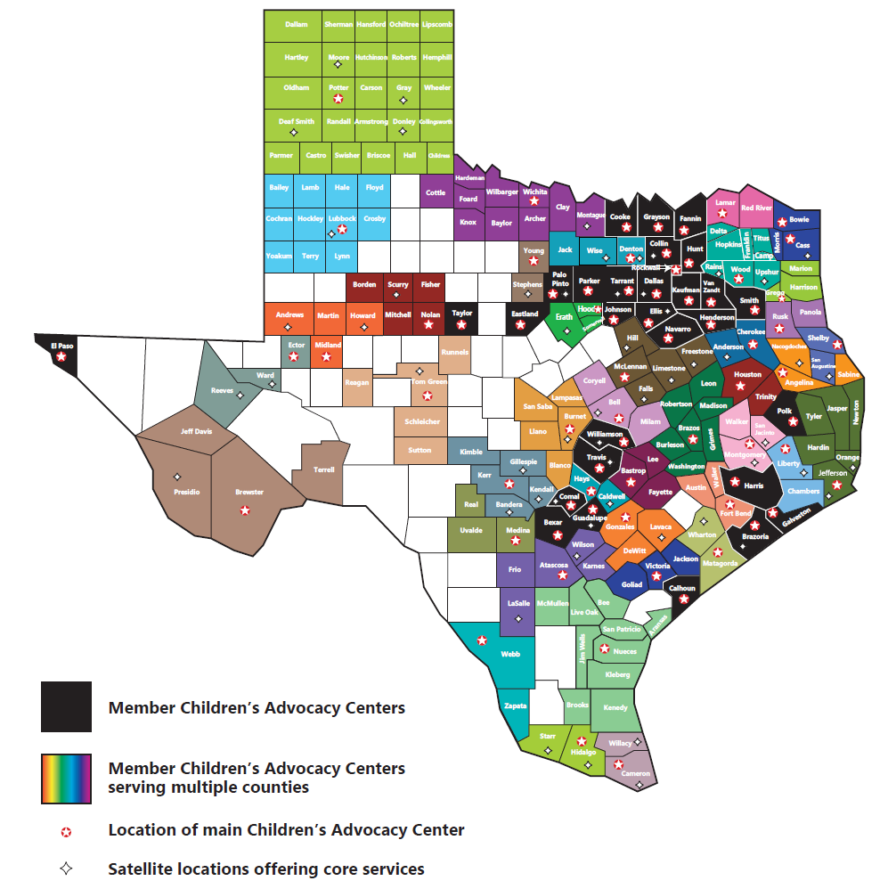
Children’s Advocacy Centers of Texas
Membership Association
Training
Technical assistance
Legislative advocacy
Grant Administrator
Pass-through entity
Contractual monitoring
Standard compliance
Notes:
I want to share a little bit more about CACTX, as we are a bit unique in comparison to most CAC state membership associations.
In fact, we have a dual role that does give us both a unique edge and unique challenges, as we try to be both/and for our membership centers.
So, like most CAC state chapters, we are a membership organization.
We provide training, technical assistance, and legislative advocacy.
CACTX, however, is also the grant administer for all Texas CACs.
This is the both/and.
We pass-through federal and state funding and monitor for contractual compliance
And, as a proxy of the National Children’s Alliance, we also monitor for compliance with CAC standards
We have to walk the line of being the supporter and the “big brother”
This is not the only thing that makes us unique, which you’ll learn about here in a few slides.
So, why does it matter that you understand this?
I believe that our uniqueness is cornerstone to the growth we have seen over the last 30 years.

Slide 6

How Do We Successfully Advance Care for Child Victims?
Notes:
So, it’s time for me to take you on a little tour of our long organizational journey to help you understand how we have achieved what we have and how we have had such success in advancing care for child victims in Texas

Slide 7

Establish Strong Roots
Notes:
Y’all, is that a fake plant!?
I’m just noticing that.
I guess it’s good that a real plant didn’t have to die from a very non-delicate toddler
Anyway…
Let’s talk about the importance of establishing strong roots as key to advancing care for child victims.
How they really are the keys to everything.

Slide 8
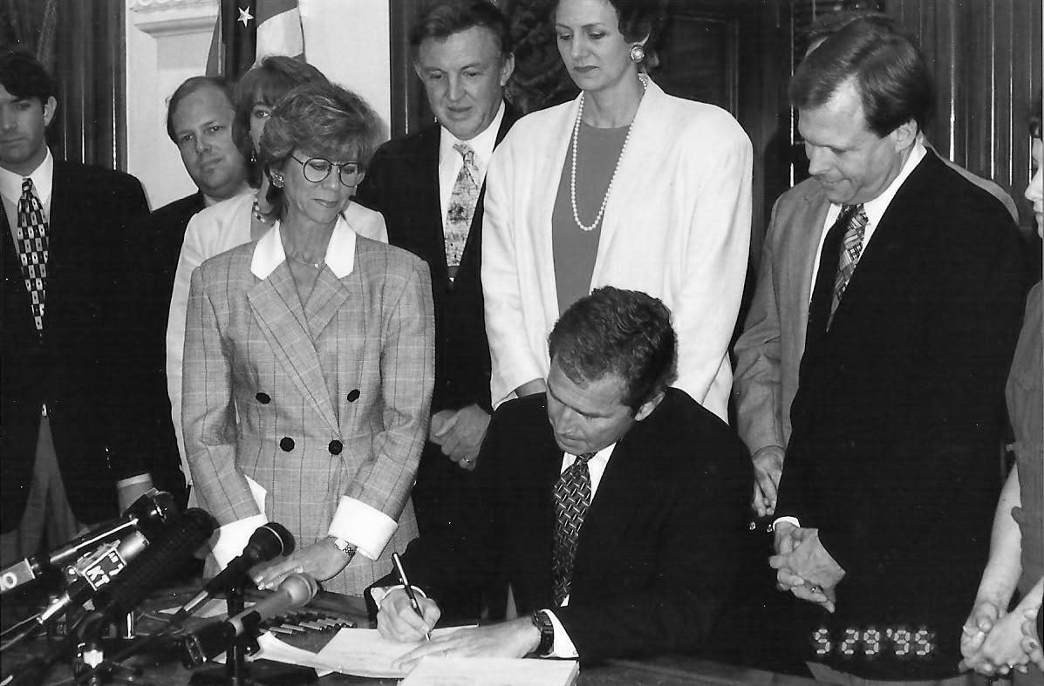
Our Founder’s Principles
A framework that supports CAC services for every child in Texas
“To go far, go together” (with the right people in the room)
Notes:
So, what are you looking at here?
Does anyone recognize the man signing this document?
Yes, that is President George W. Bush!
But no, he wasn’t President George W. Bush here – he was the governor of Texas
We are actually back in 1995 in the picture…When I was in braces and watching Guiding Light after school everyday with my mother (anyone???)
Meanwhile in Texas, George W. was signing this very important piece of legislation that changed everything for the CAC network in Texas
This was the day that CACs became part of Texas statute
Those that were part of the CAC movement here in Texas fought tooth and nail to ensure there was a framework established here in Texas that supported CAC services for every child in this state
How did we do this?
Our founders knew that to go far, we had to come together, and go together, with the right people in the room
And what this did for us was give us the momentum to establish FIRM CAC ROOTS that, we would eventually learn, got us exactly what we needed…
A solid foundation to grow from

Slide 9
Texas Family Code Chapter 264.401
Defines the CAC model
Allows for information sharing/Access to confidential case information
Limits liability
Defines standard of care
Grants CACTX determination of CAC eligibility
Creates state funding program for CACs
Designates CACTX as “general contractor”
Notes:
Now, let’s diver deeper into the legislation that George W. was signing there
Our founders wanted to ensure that…
The CAC model was clearly defined
That no one could just call themselves a CAC without being true to the CAC model
There was a designated leader, a guiding star, someone to hold the broad community accountable…
And thus, an organization designated to determine whether an organization can “BE” a CAC
All CACs had to meet a certain standard of care
Which, in statute, are aligned with the national standards for CACs
CACs were not fighting over resources
To go far, go together
That if we don’t fight….we align, we speak the same voice, and are then more likely to be heard
Establishing a state funding programs helped to ensure we our voice was LOUD and BUT NOT NOISY
CACs were protected
That the law approves of the sharing of information so that we can better collaborate for children – the core of what we do
So, we established this core statutory foundation…what happened next?

Slide 10

Feed and Nourish
Notes:
We fed and we nourished.
Who? The children? Yes of course. But that isn’t what I am talking about….

Slide 11
Key Players
Local CACs
Government Entities
Community Partnerships
Local MDTs
State Level MDT Partners
Notes:
We fed and nourished OUR KEY PARTNERS, key partners that are the KEY to advancing care for victims
The daily work was (and still is) to know who are key partners are and develop and maintain relationships with them – IT CAN NEVER STOP
Having strong roots and maintaining strong key partnerships helped to ensure…..
That the CAC voice was heard, that no one ever forgot the why
With statewide MDT partners
With legislators
With government entities
With the community
With our own CACs
That our partners voices were heard
With legislators
With government entities
With the community
With our own CACs
It’s what makes the CAC model work!
And we dreamed big – which I’ll give you a glimpse into in a few slides.

Slide 12

Watch It Grow
Notes:
But first, let me show you the bounty of what these roots and partner nourishment brought us

Slide 13
Progress, Expansion, and Growth
CAC Statistics | FY1995 | FY2005 | FY2015 | FY2025
Centers | 13 | 59 | 68 | 70
Counties | 44 | 144 | 183 | 209
Population | 52% | 90% | 96% | 98.6%
Children Served | 7,300 | 32,541 | 39,852 | 61,210*
Center Staff | 66 | 434 | 645 | 1561
Pass Through Funding | $1.5 million | $3 million | $32 million | $75.1 million
CACTX Budget | $100,000 | $1 million | $3.1 million | $12 million
CACTX Staff | 1 | 10 | 20 | 47
Notes:
In 30 years, we went from….
13 centers to 70 centers
52% of the population served to 98.6%
From 7,300 children serviced to over 60,000
From 66 CAC staff to over 1,500
From 1.5 million passthrough dollars to over 75 million
From an organizational budget of $100,000 to 12 million
This wasn’t just luck, it was HARD WORK
But it was the RIGHT hard work

Slide 14


Harvest
Notes:
Let’s dive deeper into some of the fruit of all of our labor

Slide 15
Collaborative Harvesting
Children falling through cracks
Solution: Integration of statewide child abuse reports
Solution: Expansion of statutorily required CAC case criteria
Inconsistent quality of care
Solution: Bring evidence based mental health training to CAC clinicians
Lack of statewide data to identify gaps and inform strategy
Solution: Statewide case management system
Notes:
We went about harvesting our fruit by identifying the largest issues that were getting in the way of advancing care for child victims in Texas
Here I have highlighted some of our earlier large-scale problems and creative solutions
Solutions that have helped our network make great strides forward
ALL of which we could not have done alone, without the support and commitment of our key (and hopefully nourished) partners
One of our largest consistent issues was children falling though the cracks
These are the children that were supposed to come through the doors of a CAC, but weren’t
Sitting in a room with statewide partners, this problem was being dissected
A DFPS partner said, what if CACs had access to child abuse reports?
Wouldn’t that help us learn exactly who wasn’t coming through the doors that should be?
It was this space, sitting with our partners and taking time to think outside the box, that created the opportunity for this idea
The rest was history – we were the first state to gain access to child abuse reports
We now knew what cases were and weren’t coming in
Which help us make recommendations for statute changes, requiring certain cases to require an MDT CAC response
Go back to slide 13 to show the child served growth between FY15 and FY25 (39,852 →61,210)
Another problem really rooted itself back in 2010
There was a national movement towards evidence-based practice
To improve quality and cost effectiveness
Commissioned a study with a key partner to evaluate CAC mental health services across the state
Your very own Dr. Brian Allen worked with Sam Houston State University at the time
Identified the barriers to quality mental health programming
Mapped out a model for how to implement evidence-based treatment statewide
This study helped us receive a grant to host our first TF-CBT learning collaborative
Flash forward today, we now provide year-round access to free training in three trauma-focused evidence based treatments
A plain as day problem was also that we did not have uniform statewide data to help us better identify gaps and inform strategy
This led to the commitment to get all 70 CACs on to one case management system
Can say today, that just two years back, we officially onboarded all 70 CACs onto one system
No system is perfect, and we are still working toward “apples to apples”
But we are now capable of so much more

Slide 16

Collaborative Harvesting
Lack of guiding star
Solution: Statewide Master Service Plan – The Blueprint to Reach Every Child
Notes:
But now let’s get into the meat of this presentation – the development of a CO-AUTHORED statewide master service plan

Slide 17

Blueprint to Reach Every Child
Strategic plan for CACs and CACTX
Shared roadmap for improving the response to crimes against children cases
Common agenda → collective impact
Used to inform CACTX strategic focus areas
Benefits:
A shared commitment
Defined mutual problems
An ongoing practice that inspires communication
Provides a method to track progress
Notes:
Because we believe in collaboration and our motto “to go far, go together”…we needed a guiding star
A guiding star that was representative of all of our partner voices
Hence the development of a shared statewide strategic plan
Which is a roadmap for improving the response to crimes against children cases
The belief is that having a common agenda will lead to bigger overall collective impact
This is now what guides our organization strategic plan and helps to ensure we are zeroed in on our vision of every child, every service, every effort
Through identifying strategic priorities
To ensuring a communication and feedback loop
To tracking our progress in advancing care for victims
So how did we do this?

Slide 18
Blueprint to Reach Every Child
Communication of concept
Development process
Summit Impact Café
Focused workgroups
MDT survey
Statewide Multidisciplinary Task Force input
CAC council sign-off
Ongoing updates provided to network on Blueprint initiatives and progress
Revised collaboratively every biennium to ensure network input
Notes:
First, we communicated the concept to our CAC Council
The CAC council is a group of 11 CAC executive directors who are meant to represent the voice of the network
With their approval of concept, we then articulated the plan at one of our bi-annual summits
Then we got to work with the development of the Blueprint
Summit Impact Café
Focused table topics with questions that helped identify gaps and challenges
98 leaders from Texas CACs participated, moving from table to table
We received 1,000 pieces of feedback
5 focused workgroups with representation from 19 CACs
Core service areas and emerging issues
Problem and solution identification
MDT survey
800 responses
Statewide Multidisciplinary Task Force feedback
28 professionals involved in child welfare, criminal , and civil justice systems
Catalogued, identified key issues that rose to the top
Developed blueprint draft, identifying strategic focus areas and potential solutions
CAC council sign-off and presentation to the network
Ongoing updates to network on Blueprint initiatives and progress
Revised collaboratively every biennium to ensure network input and buy-in

Slide 19

What Fruit has The Blueprint Yielded?
Notes:
So, let’s get to the “juicy” part (see what I did there?!)– what has been the outcome of our blueprint thus far?

Slide 20
Blueprint Mutually Identified Problem
Children and families served by CACs should have access to high-quality, effective, evidence-based treatment
Specifically, highly skilled and specialized providers are needed
Trauma (ongoing training in trauma-focused EBTs)
Needs unique to CAC population, such as addressing PSB
Notes:
We all believe that children and families served by CACs should have access to evidence-based treatment relevant to our population
Our providers need specialized skills to be able to effectively treat trauma and to address other unique needs that children coming to CACs often present with
We have invested a significant amount of our funding to provide access to free training in trauma treatments
CFTSI, TF-CBT and EMDR
Where there is a significant gap is for children who are presenting with problematic sexual behavior
And we want for these kids, who can very effectively be treated without entering into the system, to have access to treatment
This is also key to the prevention of sexual abuse, as treatment can help reduce the likelihood that children will sexually harm additional children

Slide 21
Partnership with PSB Experts
Continue partnership with Penn State University – Dr. Brian Allen, Psy.D.
Phase-Based Treatment of Preteen Problematic Sexual Behavior
New partnership with National Center on the Sexual Behavior of Youth (NCSBY)
Problematic Sexual Behavior – Cognitive Behavioral Therapy for Adolescents
Preceded by MDT readiness activities
Development of PSB Guide for MDTs
Notes:
A century ago…back in 2020….
We partnered with your very own Dr. Brian Allen to bring Phase Based Treatment training to our CAC clinicians
The program evaluation data is very promising, and our clinicians LOVE this model
Plan to continue this partnership to ensure all 70 of our CACs have access to this training
However, we have an age gap
We also know, though a unique population, that adolescents with problematic or illegal sexual behavior are also treatable
Partnering with NCSBY to
Bring PSB-CBT for adolescents training to Texas
Inclusive of MDT readiness support, as we know this is a new population for CACs
We look forward to learning and growing through this process to ensure CAC MDTs have what they need to successfully work with this population
We also developed a PSB Guide for MDTs that will be released next month
Input from these PSB expert partners was pivotal to its creation
Special thank you to Dr. Allen for his help along the way!

Slide 22
Blueprint Mutually Identified Problem
No seat at the table – children’s mental health in Texas
Largest provider of specialized trauma treatment in Texas, but not largely recognized as such
Need to develop a pathway for elevating the footprint of CAC children’s mental health programming statewide​
Notes:
We came to the realization that our CAC network is the largest provider of specialized trauma treatment in Texas, however, we are hardly recognized as such
As a network, we identified that we really need at the big kid’s table here in Texas
You know, the table where the power sits and information is shared that impacts state level decisions and funding streams
Thus, not sitting at this table has an impact on the resources we receive, and thus the access child victims of crime have to specialized trauma treatment by highly trained individuals
We need to develop a pathway for elevating the footprint of CAC children’s mental health programming statewide​

Slide 23
Partnership with Meadows Mental Health Policy Institute
Leveraged relationship with key player in the children’s mental health space in Texas
Developed roadmap for elevating the footprint of CAC children’s mental health programming statewide
Identified the priority players and made connections
Potential pathways for partnerships and resource sharing
Articulated how to communicate the work of CACs in the mental health space
Notes:
To make progress in this space, we new we had to partner with someone who
Knows the system
Knows the key players
Went to our friends from MMHPI
With their support, we developed a roadmap for elevating the footprint of CACs in this space
They helped us identify priority players
They made connections
They identified potential pathways for collaboration and resource sharing
They even helped us determine how to communicate the work of CACs in a more successful way, which has been HUGELY beneficial

Slide 24
Blueprint Mutually Identified Problem
Advocacy programming varies significantly across the state
Need to further define the “core framework” of victim advocacy
Establish best in class services for all CAC clients
Need to better identify children that need specialized trauma-focused treatment
Core shared belief:
Engaging Families
Full Array of Services
Better Outcomes
Notes:
And now my favorite fruit from the blueprint!
We a CAC network, we collectively identified that
Advocacy programming varies significantly across the state
Resources specific to advocacy also varied significantly
Related to the mental health space, we also identified that we needed to better identify the children that needed our specialized trauma-focused treatment
So, we pitched to the legislature a 21-million-dollar request to support the development of a best-in-class advocacy model
In a tough legislative session, we still received a 12-million-dollar appropriation to rollout this new model!
Testament to the power of a CO-AUTHORED strategic plan

Slide 25

Partnership with CAC Network
Development of the Comprehensive Case Management (CCM) model
Process
Network survey
Identification of core domains
Focused workgroups
Development of best practices
Expert consultants
Workgroup feedback loop
Summit feedback
Notes:
In partnership with the network, leading up to the legislative ask, we developed a new model for advocacy
Coined - Comprehensive Case Management
Wanted to continue to ensure the network’s voice was represented in the development of this model
Our process was
Survey network and identify the core, most impactful services that need to be provided to CAC families
Survey helped to identify 5 core domains
Domain workgroups then helped to identify best practices within each domain
Expert consultants brought in to help ensure integrity of best practices for our more complex service areas
Once developed, feedback loop with workgroup members
Introduced model at summit and collected feedback at tables to ensure all CACs had the opportunity to review and provide feedback

Slide 26
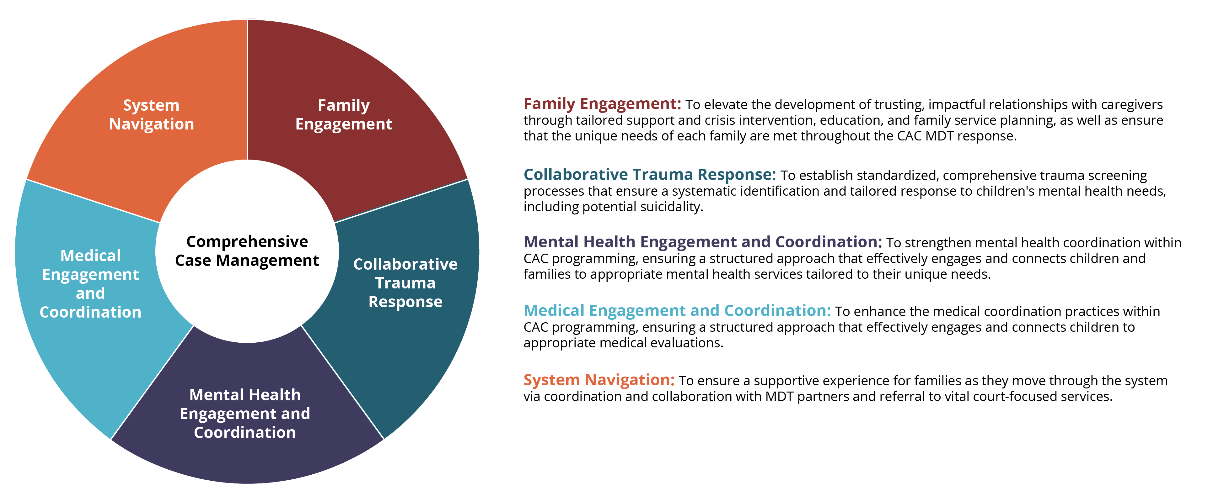
Comprehensive Case Management Model
Notes:
And here is the result of our collaborative work
Funding will be used to rollout the Collaborative Trauma Response and Mental Health Engagement and Coordination Domains
Specifically, all 70 CACs in Texas are committing to rolling out trauma and suicide screening
It’s going to be a huge year of training and consultation with CACs
But we couldn’t be more excited about the impact this will have for child victims of crime in Texas
We will be so much more likely to identify the kids who need our services, and these practices will help foster caregiver buy-in related to the need for trauma treatment

Slide 27

Can’t We Do It Alone?
To reach goals, resources of the collective are required
Collective resources bring
Expertise
Innovation
Funding
Influence
To go far, go together!
Notes:
What do I hope you all took away from the last 40 minutes or so?
Notice that partners were ever present
In laying the foundation
In problem identification
In solution building
In MAKING IT ALL HAPPEN
It’s about so much more than money
Collective resources bring
Expertise
Innovation
The foundation and influence that can bring funding
Truly, to go far, we have to go together

Slide 28

What Will You Grow?
What problem do you need to solve?
What roots are necessary to establish?
Who needs to be at the table?
How will you make space to innovate?
How will you nourish those relationships over time?
Notes:
So, take a few minutes to ask yourself these questions…jot some things down that come to mind so you are more apt to remember them ☺
If time….
After today, what is one step you can take to make your vision come to life?
Thank you for your time today, and may you bring change to your little corner of the world
A seed that will bring a forest one day for our children

Slide 29
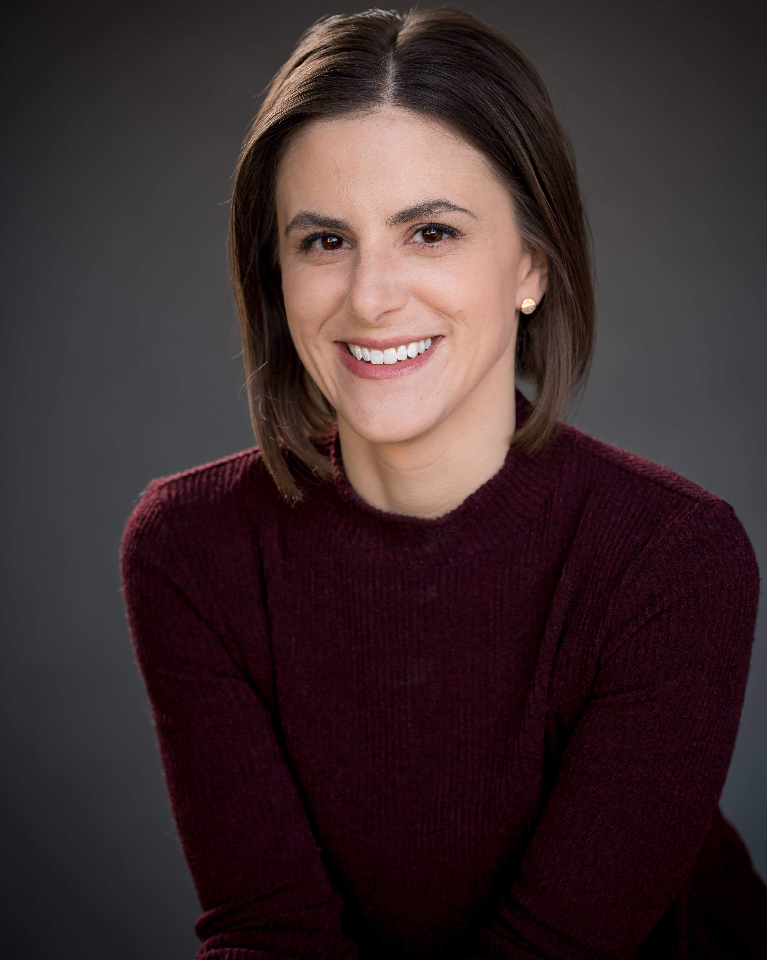
Kasey Jackson, LCSW-S Vice President of Programs Children’s Advocacy Centers of Texas kjackson@cactx.org

