Slide 1
Leveraging administrative data to understand the scope and impact of maltreatment
Joseph P. Ryan, Ph.D.
September 2018
Notes:
Individual intros
acknowledge Andrew & Terri
Introduce Data Lab

Slide 2
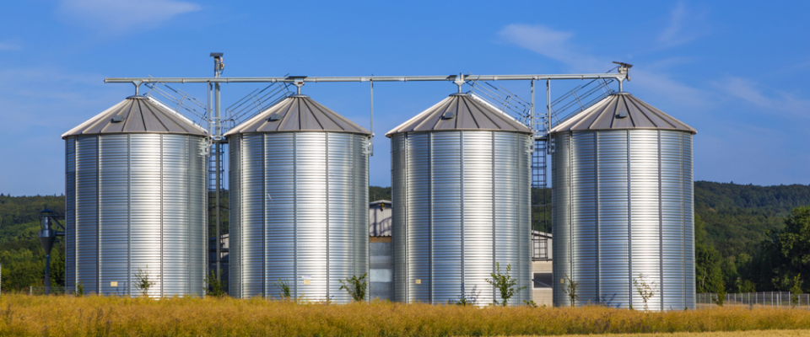
Silos are the preferred unit for storage………in agriculture
Notes:
Preferred unit for the storage of high moisture grains
And unless you signed into the wrong conference – the storage of wheat and saw dust is of little value to anyone in this room

Slide 3
Harnessing the Power of These Data Require Bridges/Links
Child Welfare
Juvenile justice
Education
Health
Adult corrections
Notes:
Truth be told, silos are not bad for the storage of data, but we seek to use data – turning it into information to solve complex problems
At the data lab, we have been working to build a (near live) linked data system – developing data sharing agreements with child

Slide 4
Universities focus a great deal on the WHAT. We need to focus some attention on the WHY.
90,000 investigations for abuse & neglect
More than 12,000 children in foster care today, only 31% return home in 12 months
About 10,000 formal delinquency petitions, another 9,000 informally processed
61% of juvenile offenders involved with adult system by age 25
Less than 60% reach proficiency in reading
Obstacles and disadvantage disproportionally experienced by the poor
Racial disparities observed throughout systems of care
The answers to these challenging issues will not come from a single agency

Slide 5
Examples from Child Welfare, Education and Juvenile Justice
As a result of linking data from separate systems:
Scope of CPS involvement
Variation
Relationship with early educational outcomes
High School graduation rates for child welfare and justice involved youth
Available online, Child Maltreatment, 10.1177/1077559518786815
Notes:
Matched 730000 records

Slide 6
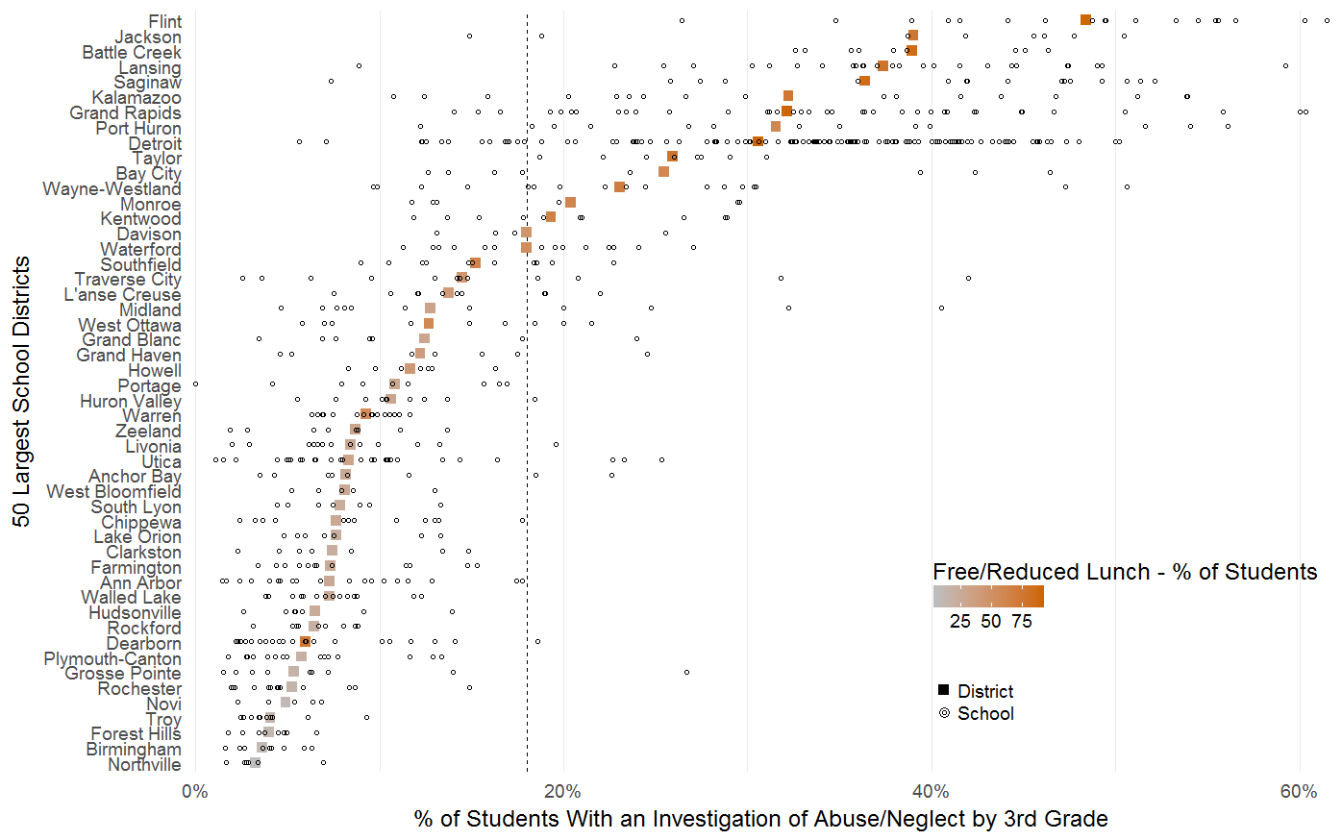
November 20, 2017

Slide 7
Statewide average
18.5% associated with formal investigation
November 20, 2017

Slide 8
Wide variation, strong correlation with poverty
November 20, 2017

Slide 9
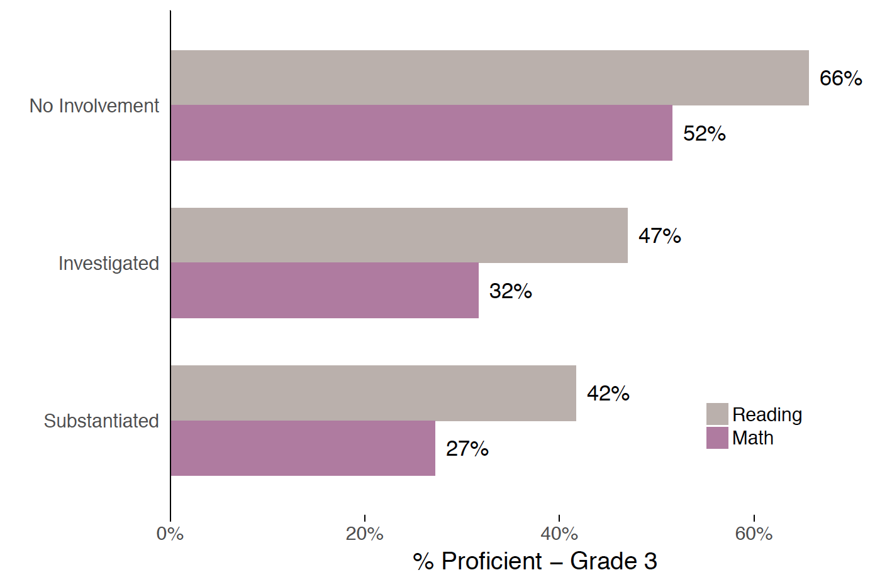
Math and Reading Proficiency at Grade 3

Slide 10
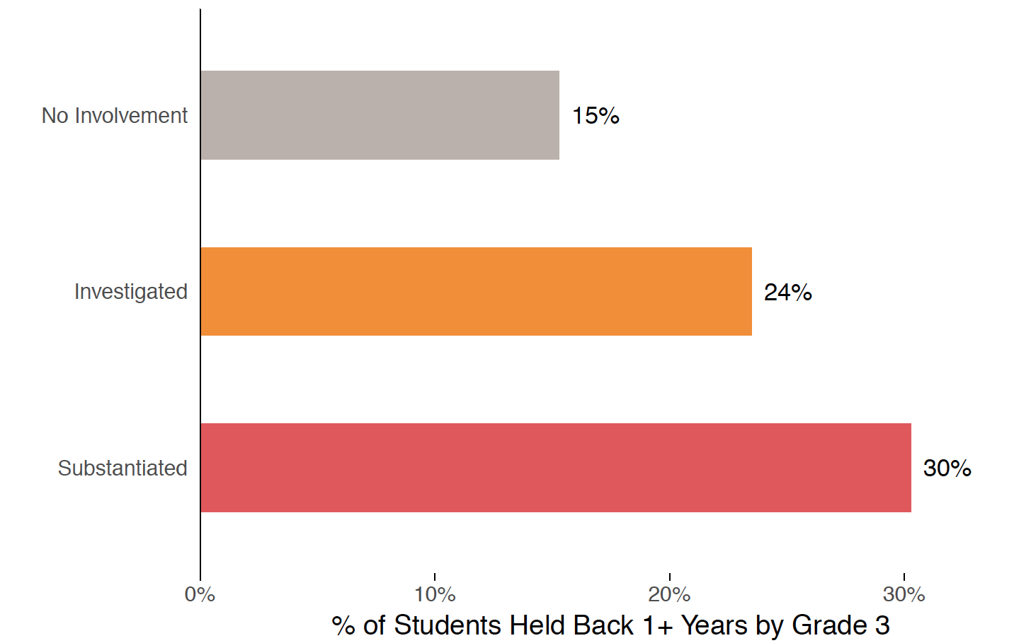
Grade Retention by Grade 3

Slide 11
Findings and Implications
Involvement with child protection is not a rare event
Impact in critical areas observed early in life
Michigan policy on 3rd grade reading proficiency
Fail to reach proficiency – repeat 3rd grade
Disproportionally hits poor students, African American students, students involved with CPS
Is this really the best strategy for increasing reading proficiency?

Slide 12
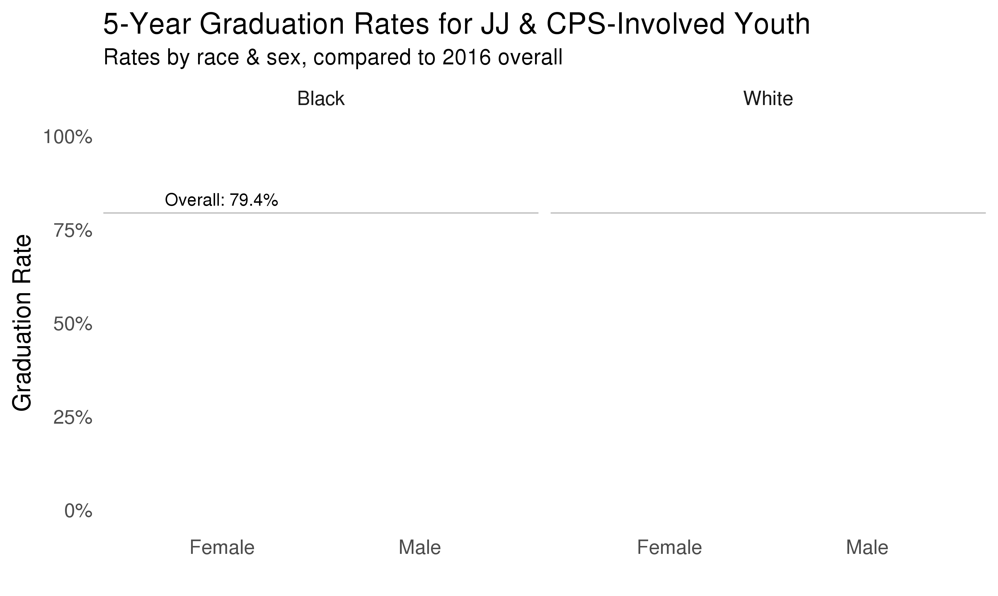
September 26, 2017
Notes:
High school graduation for JJ youth

Slide 13
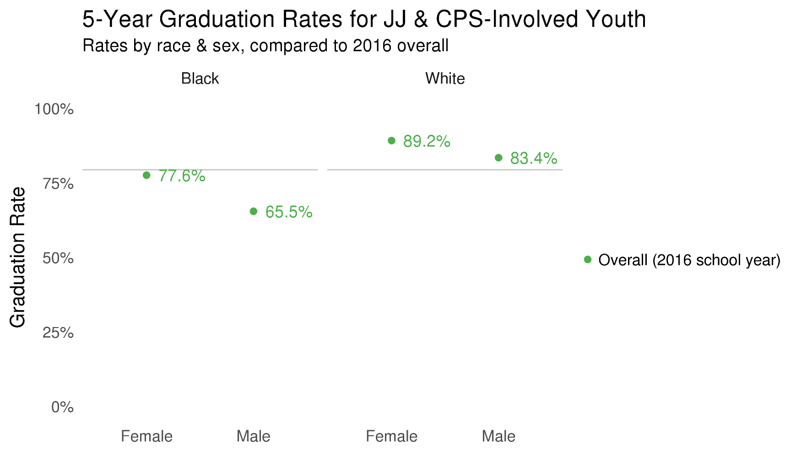
September 26, 2017
Notes:
High school graduation for JJ youth

Slide 14
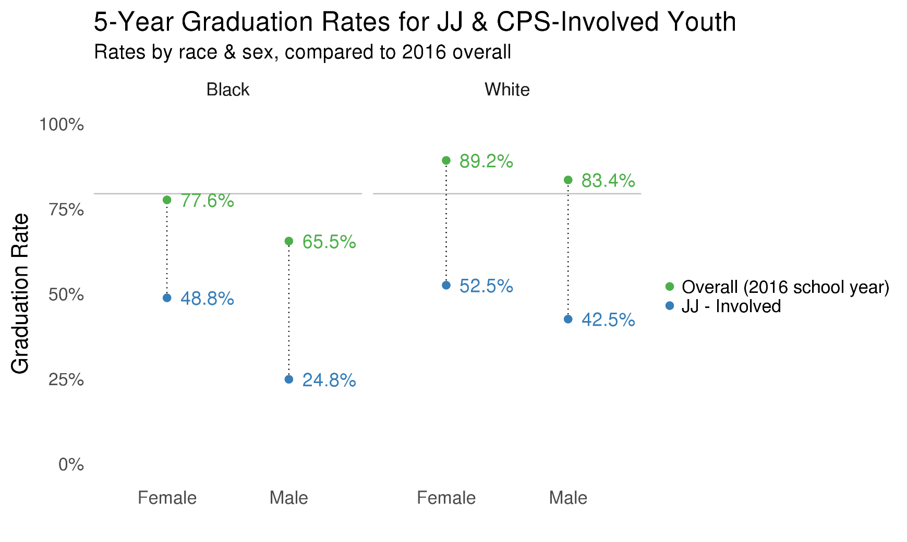
September 26, 2017
Notes:
High school graduation for JJ youth

Slide 15
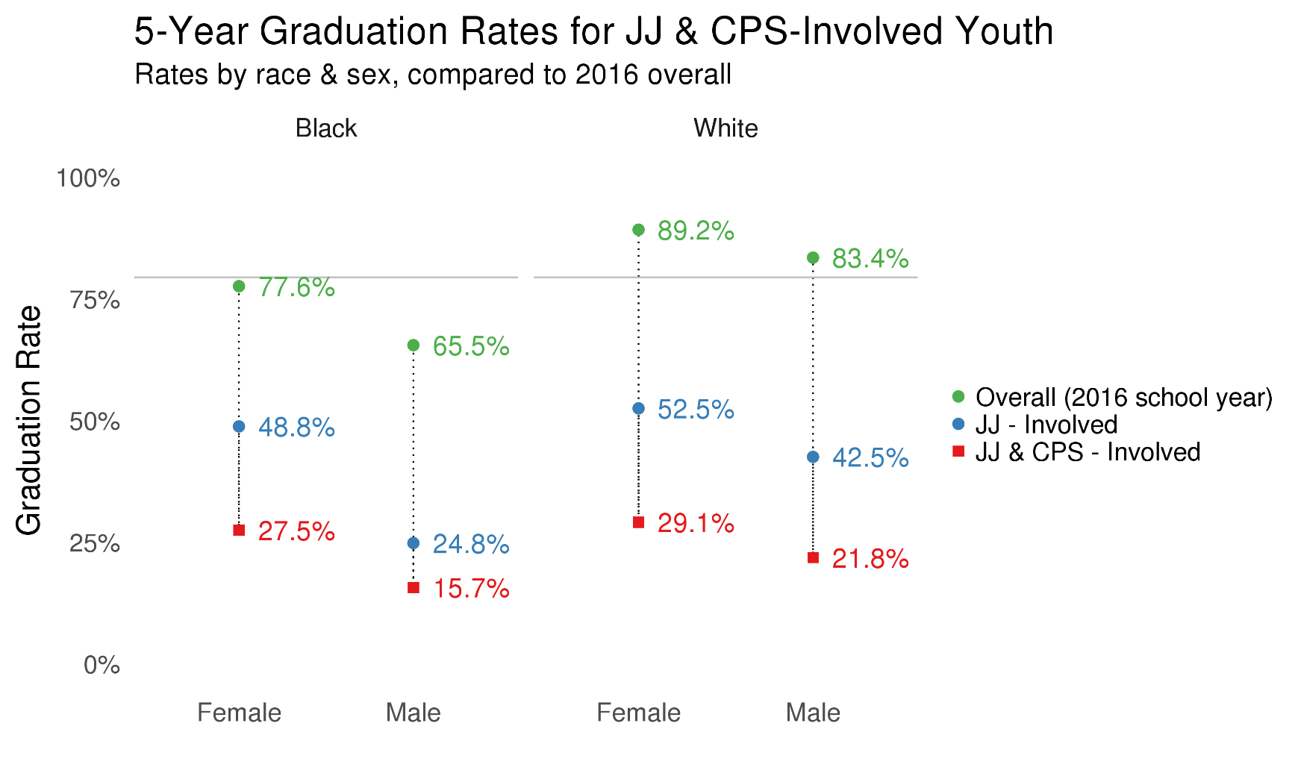
September 26, 2017
Notes:
High school graduation for JJ youth

Slide 16
What’s Next? Opportunities and Challenges
Policy and Interventions – put these data to work in the field
Proposed educational policies?
Extended foster care services?
Age of juvenile jurisdiction?
Changes to SNAP benefits and child neglect?
Early warning systems (contact systems at different developmental stages)
Put unstructured data to use
State directed research agenda? Is there one?
Need to get data/information consumption into the day to day business of state government (data cabinet, data viz)

Slide 17
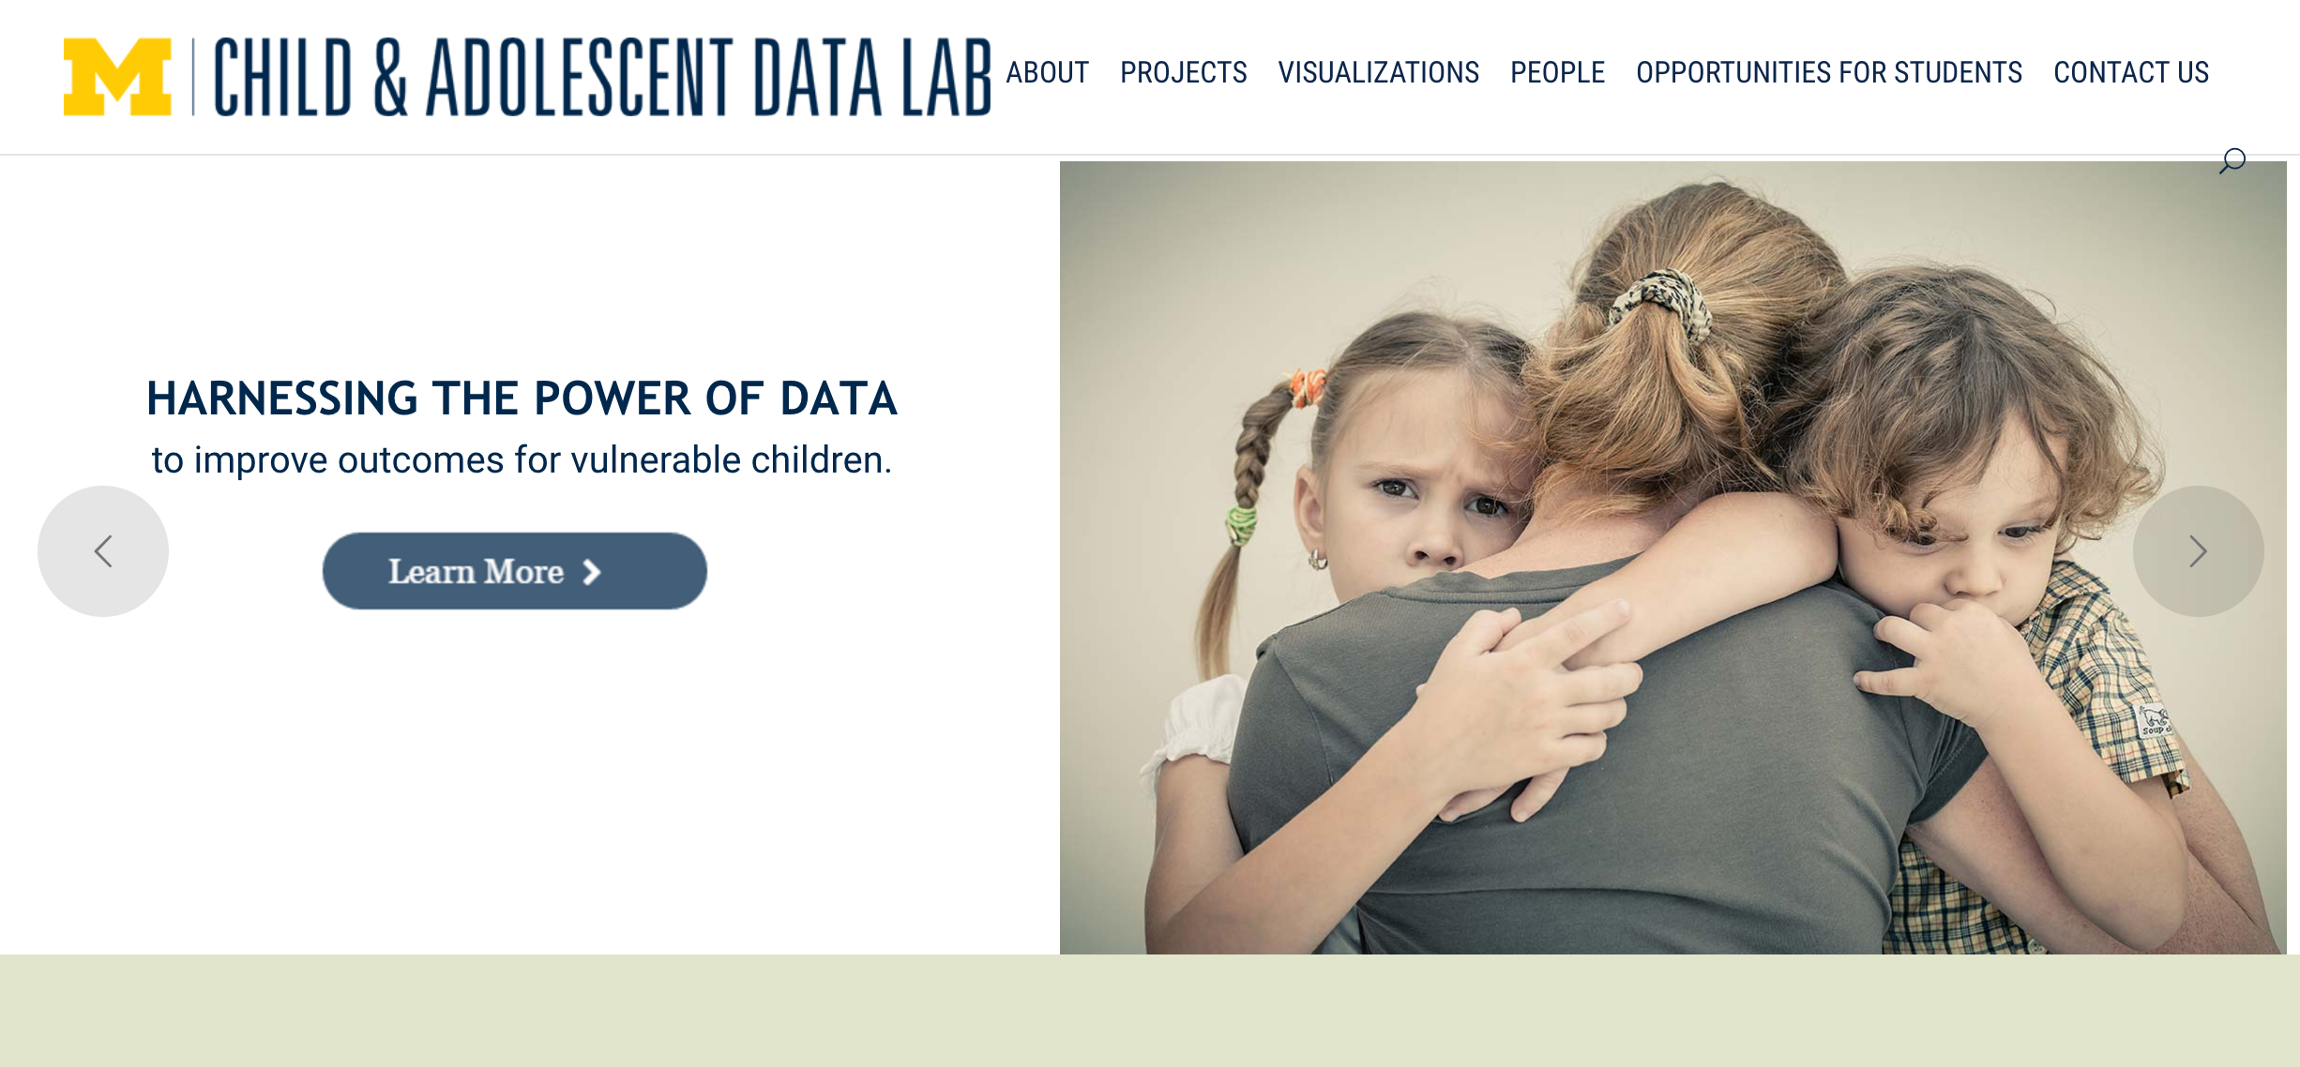
Contact information
ssw-datalab.org
joryan@umich.edu

