Slide 1
Building a collaborative multi-system team to develop practice and a plan to support youth and families
Jacki Hoover, LSW
Jacki.hoover@outlook.com
(412)737-8076

Slide 2
Bringing change makers to the table The Implementation team must be decision makers
Attorneys from all systems
Leaders from CYF and JPO
Families/Lived experience
Judges and Court Administration
Parent and Youth Support Partners/Advocates
Education Partners
Law Enforcement
Community Leaders
Committed Providers
Managed Care Organizations
Behavioral Health
State Partners

Slide 3
Looking deeper into the data
Intersections of crossover
Placement
Family Connections
Education
Communities
Mental Health
Treatment
Diagnosis

Slide 4
Utilizing community and family resources
Families are experts in their own lives
Nothing about me, without me
Children and Youth do best in - and deserve - safe, permanent families
Where are the resources
There is strength and value in families' cultural practices and traditions
Plan for the barriers

Slide 5
Leading with equity to reduce system involvement and build connections
Consider the source
Does practice have trauma lens
Connections to cultural considerations
Authenticity

Slide 6
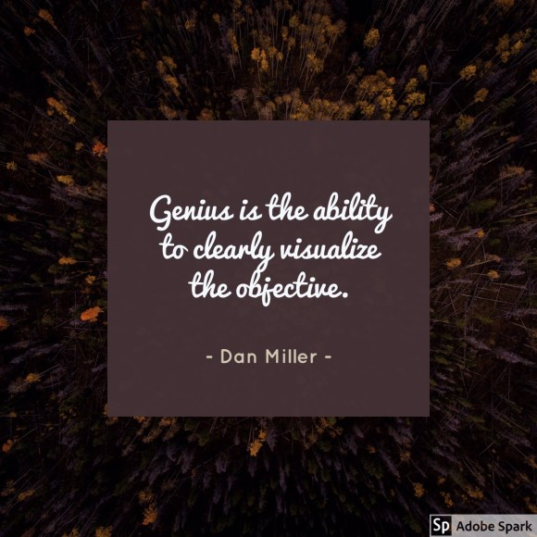
Make a plan: Today Tomorrow (Monday) January June

Slide 7
Questions
Namaste
Jacki Hoover
Jacki.hoover@outlook.com
(412)737-8076

