Slide 1
Going Beyond Residential Neighborhood: Innovative Uses for Spatial Data Using Linked Child Welfare Datasets
Bridget Freisthler, Ph.D.
September 27, 2018
Notes:
In this presentation, my goal is to discuss how to think about using linked data to look beyond the risks a person experiences where he or she lives and to focus on do the risks differ if you look at where a person goes and spends time.

Slide 2
Neighborhoods:
Traditional Approach
Notes:
Traditional approaches to understanding risks for families at the ecological-level are place-based and focus on residential neighborhoods when identifying and addressing problems like child maltreatment.
While this is can be good because it identifies specific geographic areas that are extremely high risk (particularly those that are and have been entrenched in problematic parenting practices) over time, it may not adequately address overall rates of maltreatment if the identified areas are too small geographically or may dilute the effects if the geographic areas are too big.

Slide 3
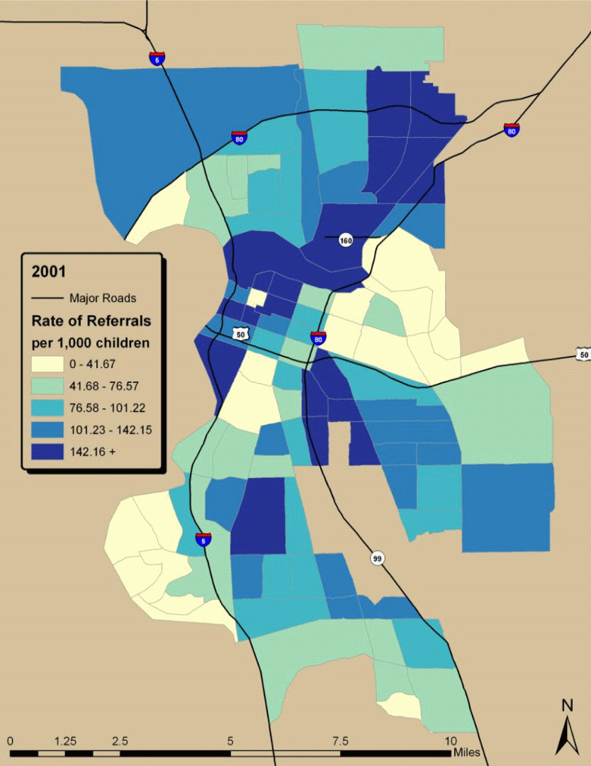
Rate of Referrals per 1,000 Children
Sacramento, CA
2001 – 2008
Notes:
In this particular map, using administrative units at the Census tract level, rates of referrals are based on the underlying population of children within each Census tract as displayed by this map. You can see that over time, rates of referrals are decreasing over the study period, but that areas with high rates of referrals continue to have higher rates of referrals than other areas and may benefit from a place-based community intervention.
I’ll draw your attention to two of those areas: one in the north/northeast area of the map and the second in the middle section of the map where these areas tend to have high rates of referrals over time. We can see that these rates of referrals remain high, even as rates are decreasing across the city.
While this is can be good because it limits intervention activities to specific geographic areas that are extremely high risk (particularly those that are and have been entrenched in problematic parenting practices) over time, it may not adequately address overall rates of maltreatment if the identified areas are too small geographically or may dilute the effects if the geographic areas are too big.
Finally, we generally operationalize these spaces using arbitrary administrative boundaries that may or may not reflect what a person views as their environment or accurately represent those contexts in which a person spends the most time.

Slide 4
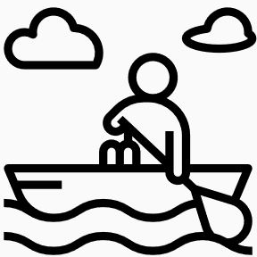
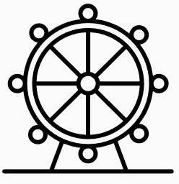
However. . .
Notes:
However, if you think about a regular day for you, throughout the day, we are likely to go through a range of places that represent where spend time inlcuding, where we buy groceries, shop. . .for clothes, for bulk items we probably don’t need, where our kids go to school, our doctor’s office, where we get coffee, where we exercise
When you think about your daily activities, do they all occur in the place that you live: your ‘residential neighborhood’?
If not, what does that mean for how we traditionally measure ‘neighborhoods’ effect on social problems, such as child abuse and neglect.

Slide 5
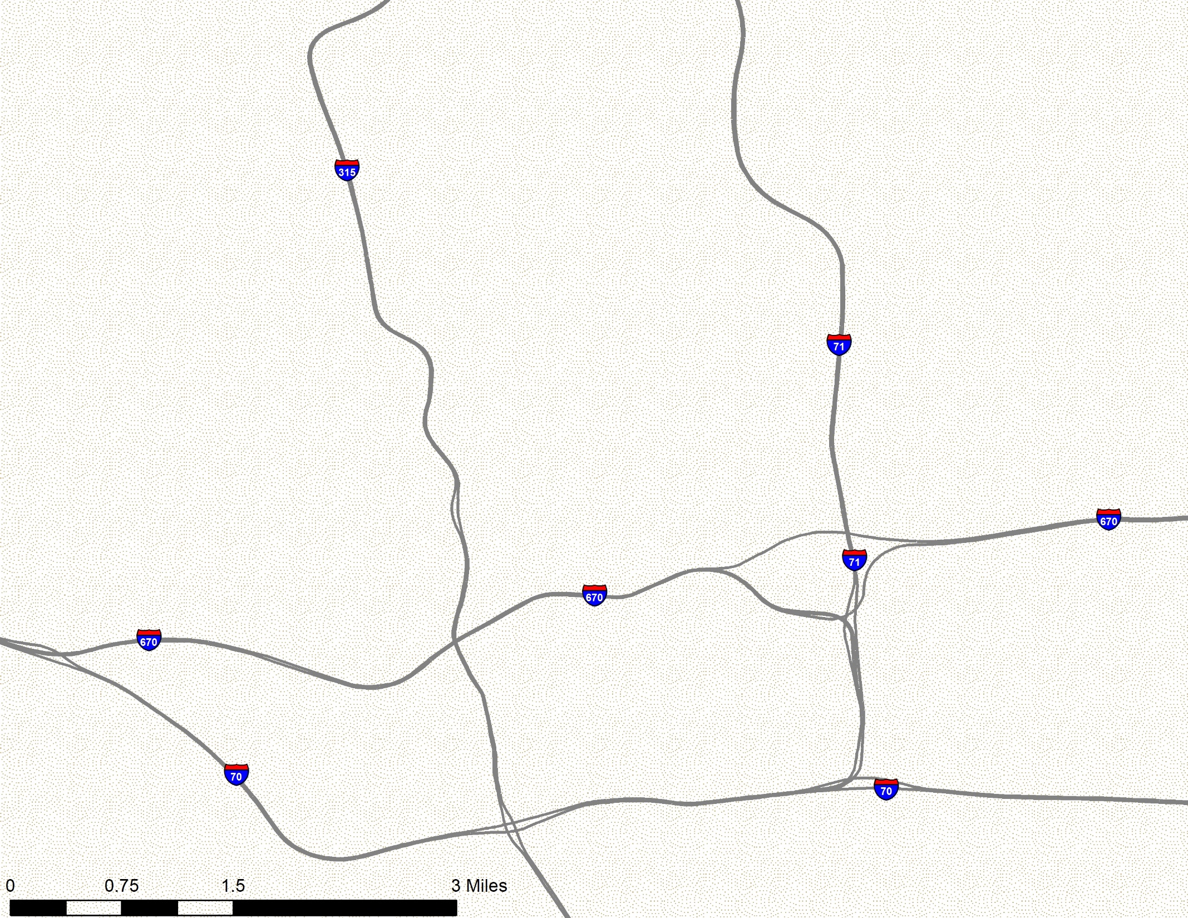
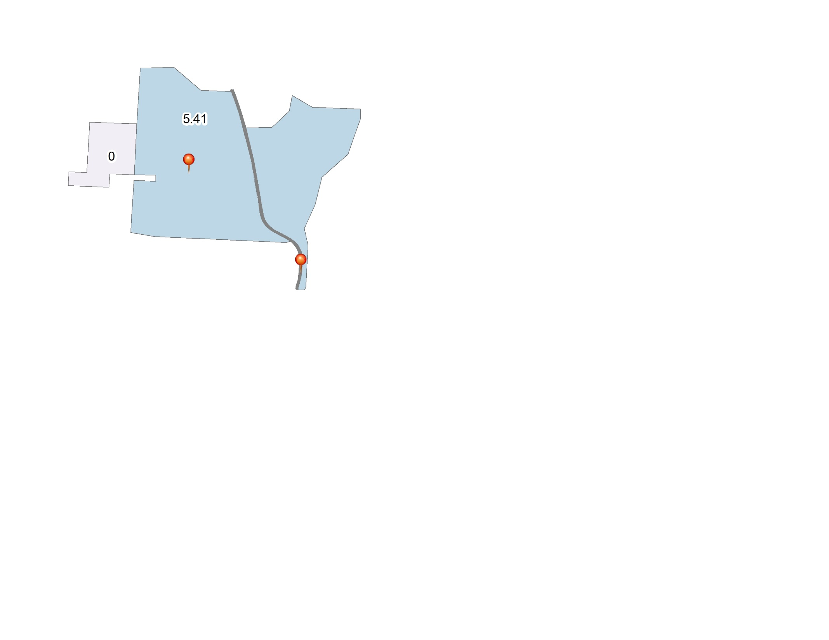
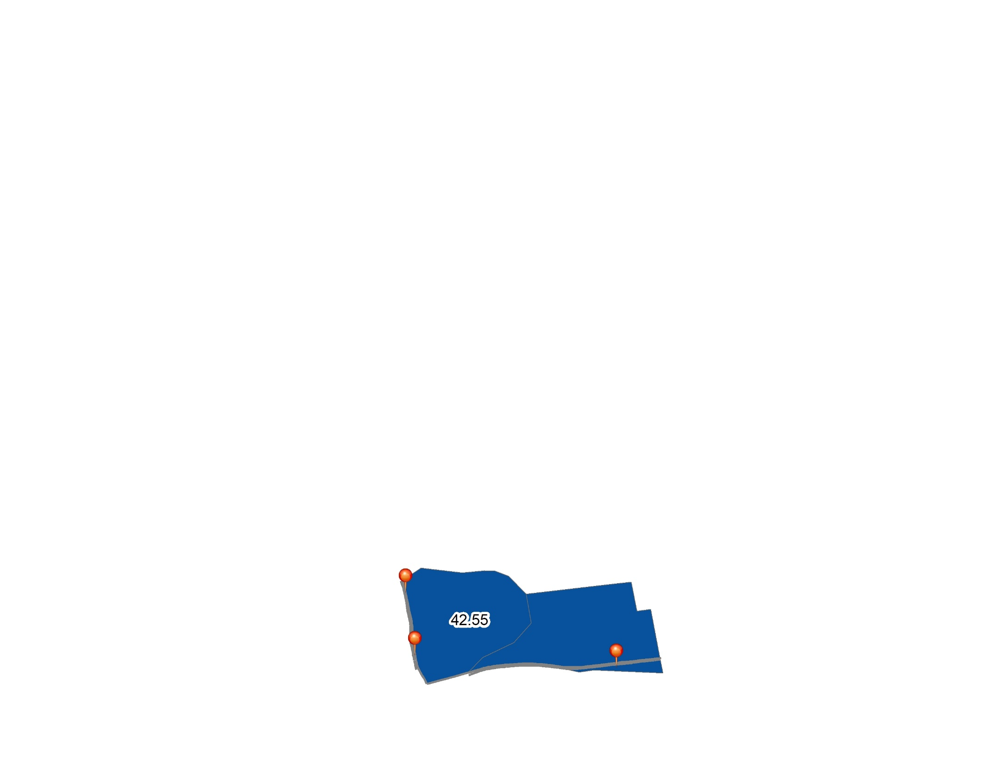
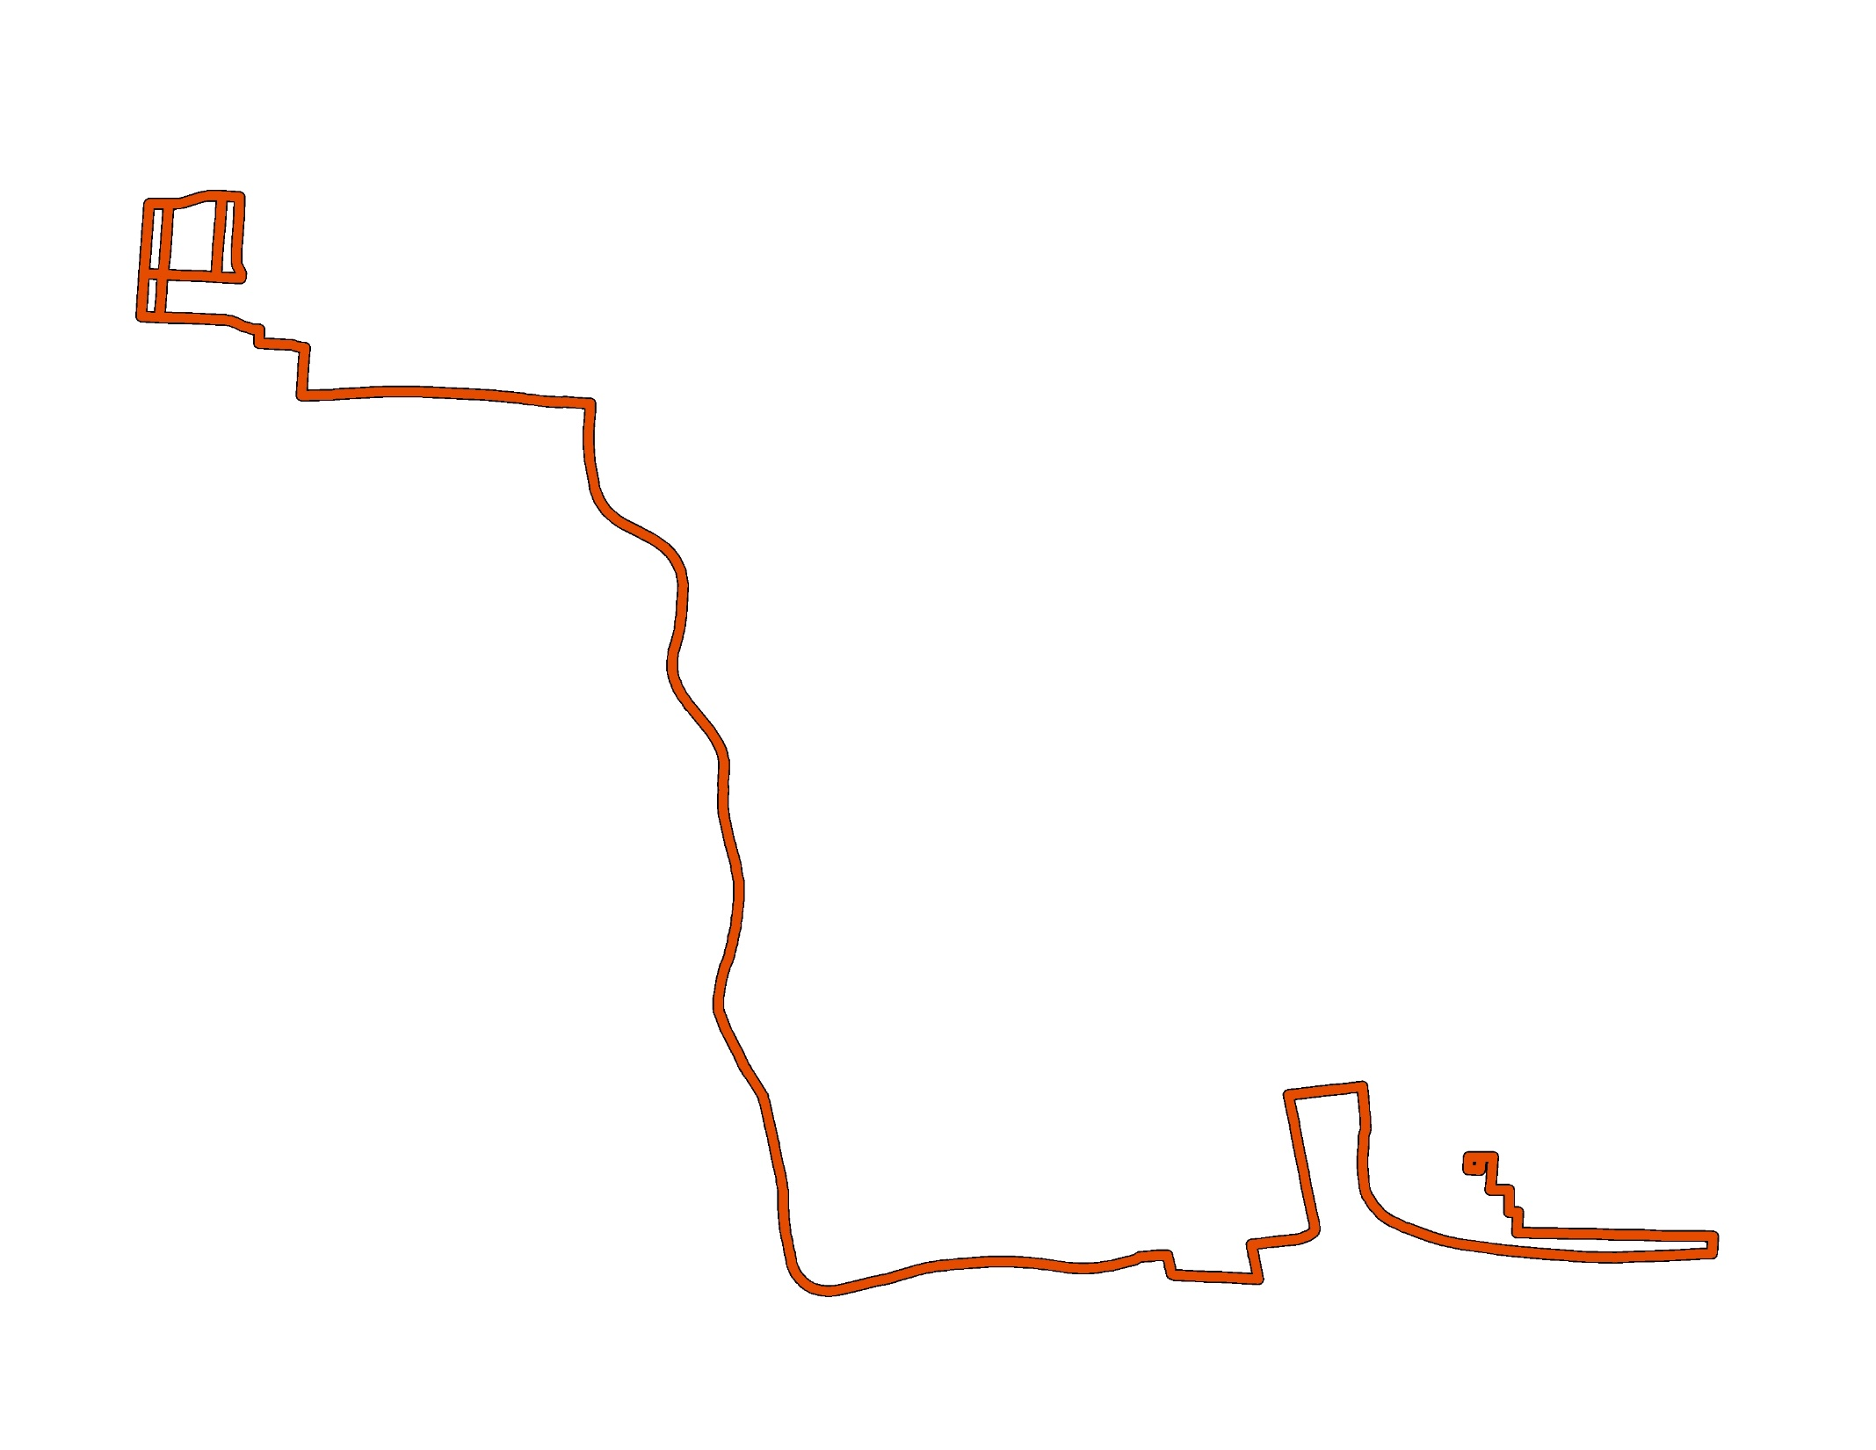
Notes:
As illustrated here, parents are likely to visit places that have a range of child abuse and neglect rates while conducting their daily life activities.
In this example, the parent lives in a place where the rate of substantiations is a little higher than the rate for the county writ large. However, where she works, the rate is 2.6 times the rate of maltreatment for the county and more than double that of where she lives.
Do we really know which environment is most likely to influence parenting practices?

Slide 6
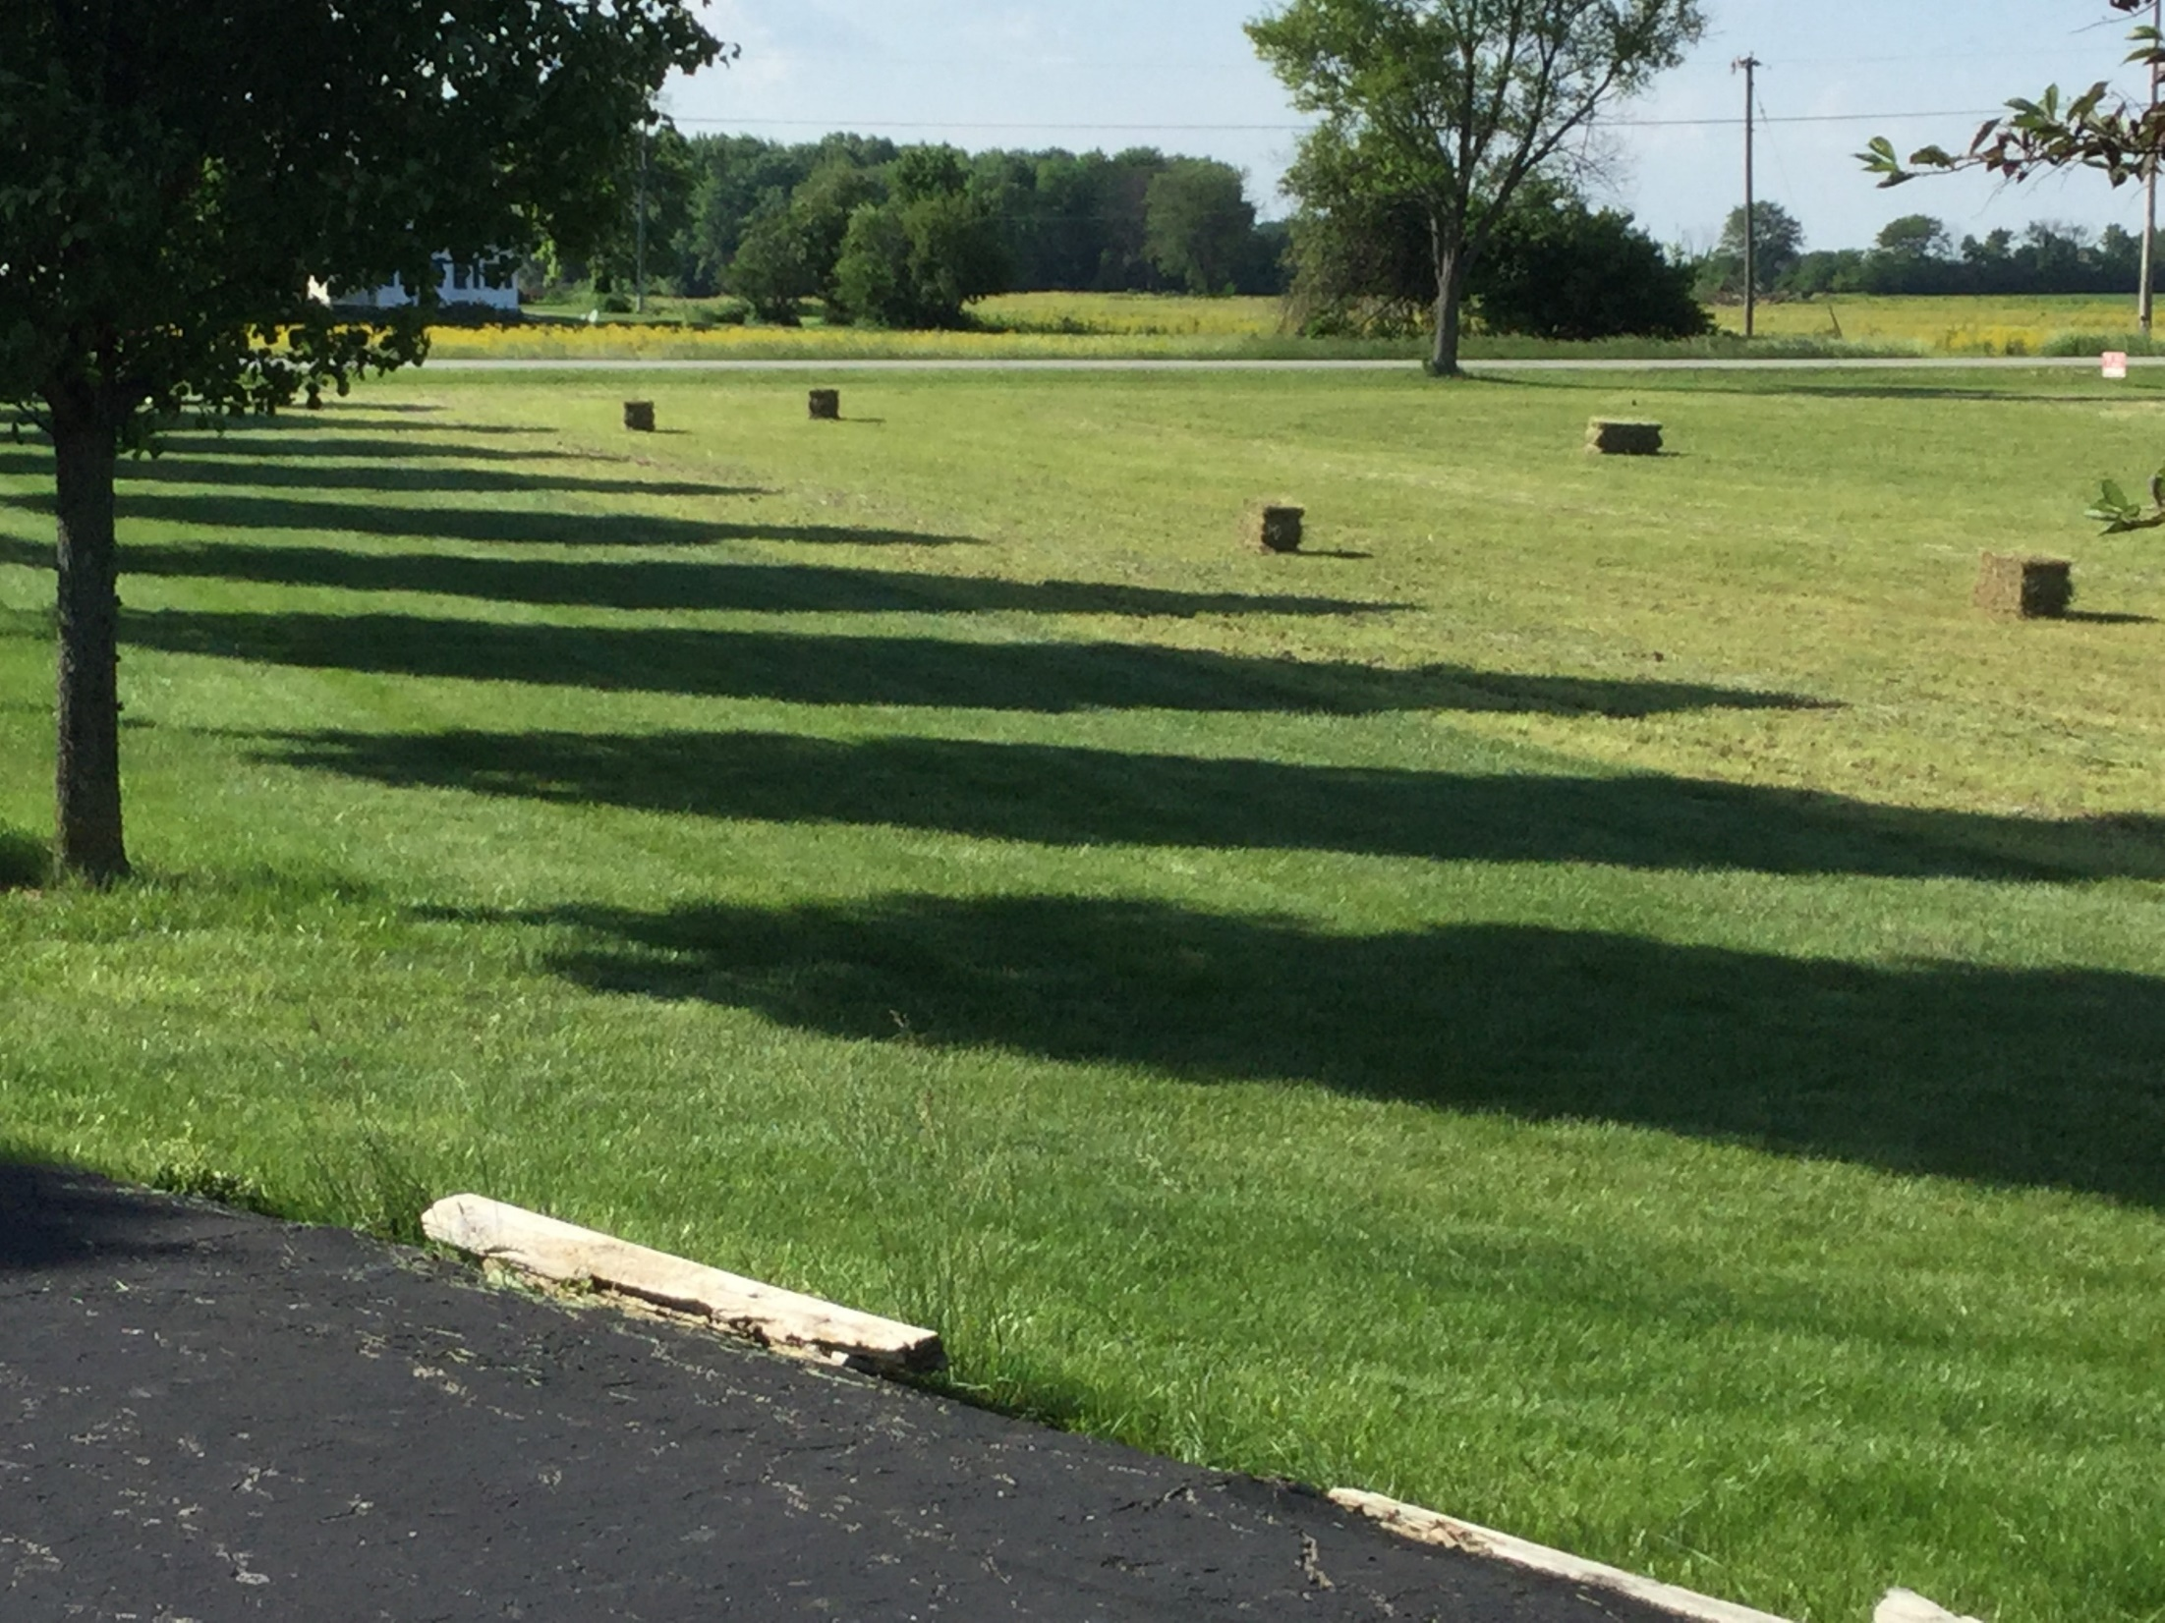
Notes:
Finally, what if your residential neighborhood is relatively devoid of risks and/or resources? Or what if those risk or resources look different from what we typically measure?
Much of the research on neighborhood context as it relates to child abuse and neglect has been conducted in primarily urban areas. Do these same risks and resources translate to the same social problems when we move outside of cities? Or do they look different?
For example, rural areas may be high in poverty (one risk factor) but close social connections where everyone knows everyone. Do these social connections buffer the effects of poverty in these rural areas when material resources are low?

Slide 7
Moving from Neighborhoods:
Activity Spaces
Notes:
Activity spaces are environments where parents do spend time, such as at work, at their child’s school, or with friends and family.
Therefore activity spaces are unique to each individual and reflect those places where people spend time.
Examining activity spaces, as opposed to residential neighborhoods, could vastly change how we characterize the risks a person is exposed to or the resources available to him or her.

Slide 8
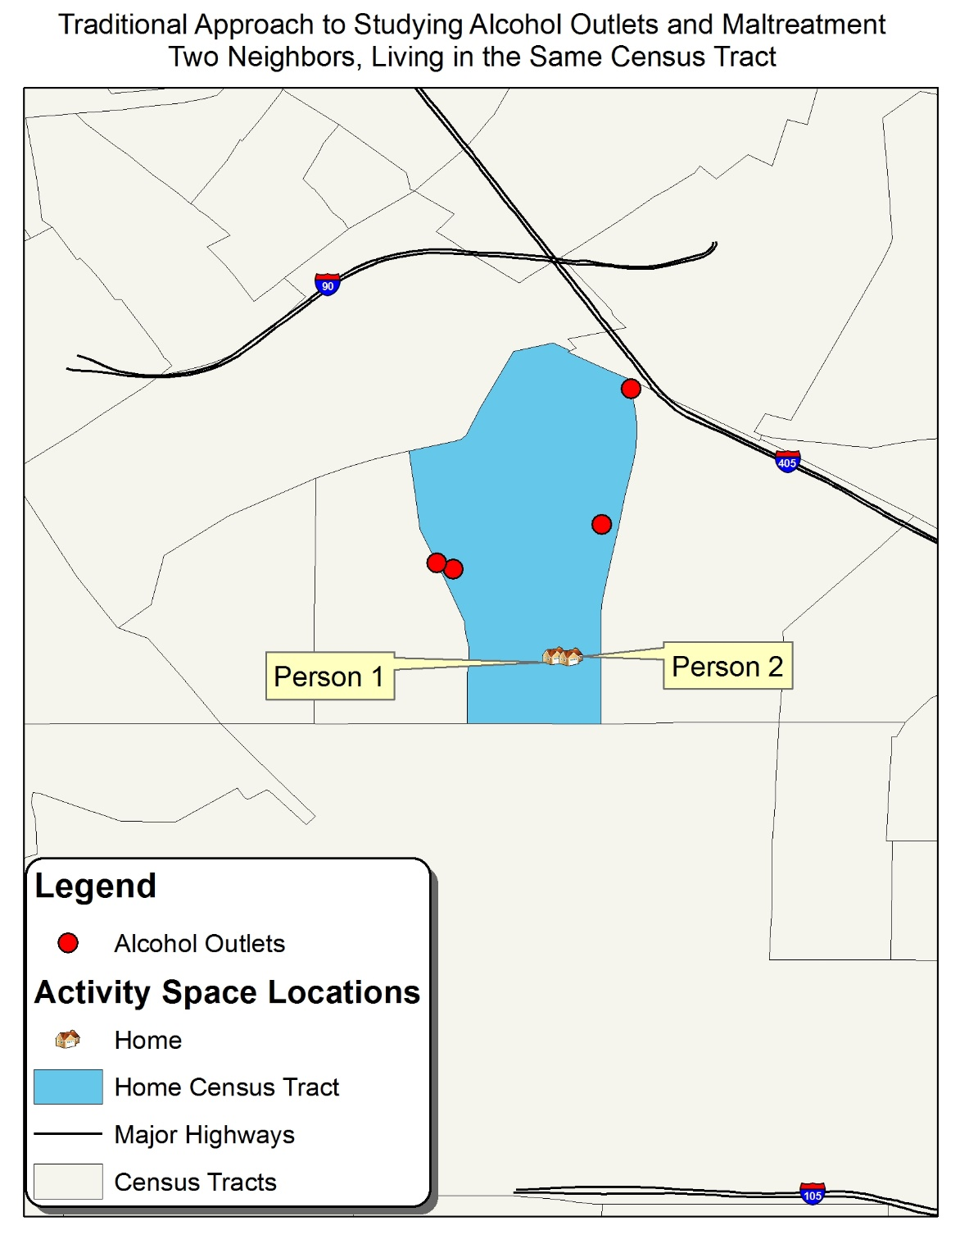
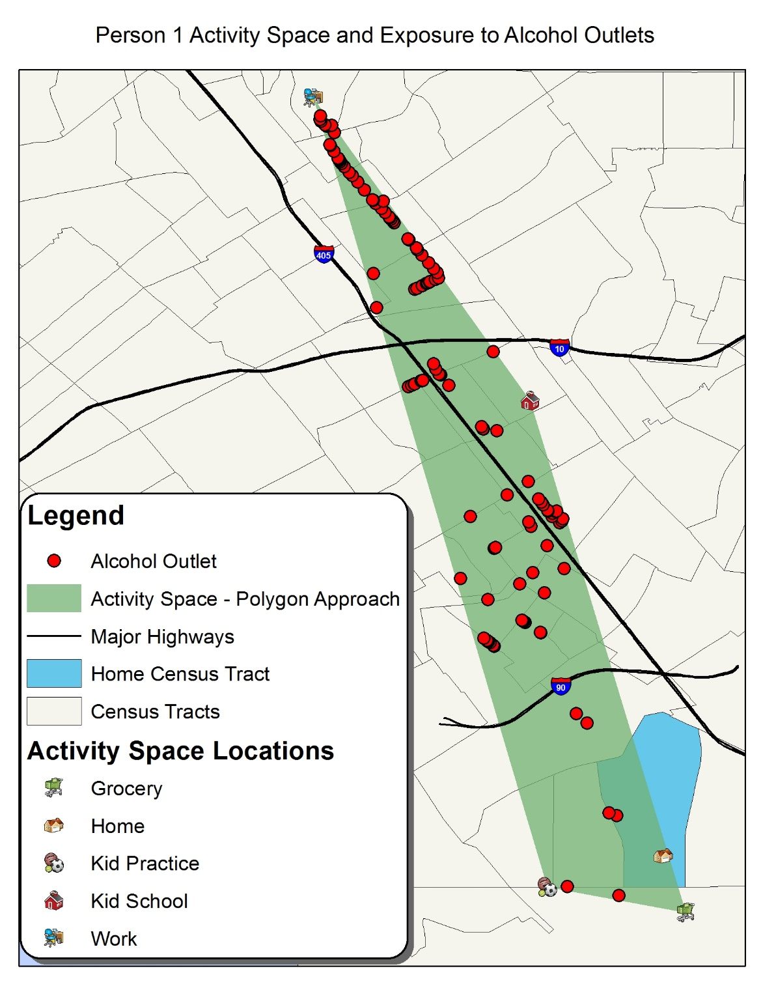
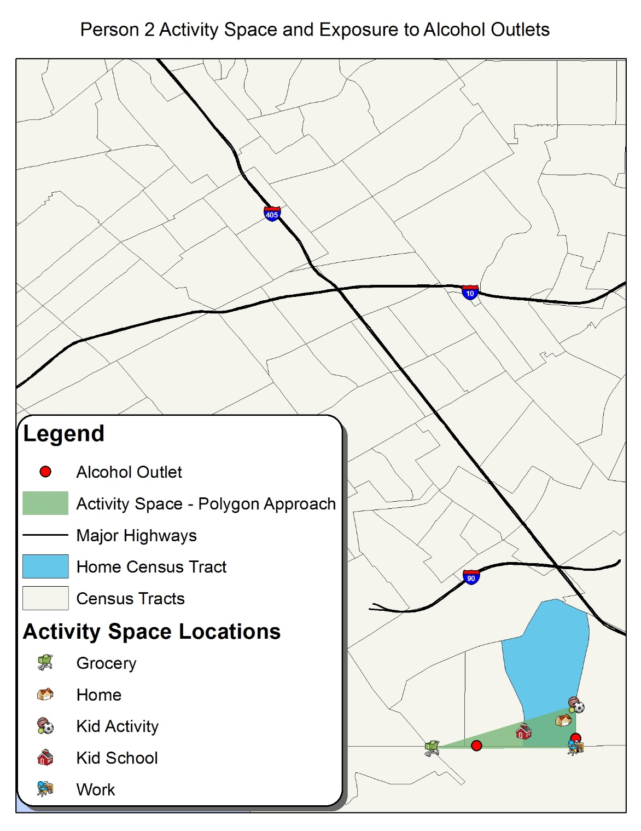
Maladaptive Parenting, Activity Spaces, Alcohol and the Substance Use Environment
Traditional approaches to measuring population exposures to alcohol outlets only look within specific ‘neighborhood’ areas like Census tracts.
But the parents living within these neighborhoods may travel quite a bit and be exposed to many opportunities to drink . . .
. . . Or few opportunities to drink.
The assessment of activity spaces appears critical to the measurement of alcohol exposures.
Freisthler, Lipperman-Kreda, Bersamin, & Gruenewald, 2015
Notes:
Traditional approaches to measuring population exposures to alcohol outlets only look within specific ‘neighborhood’ areas like Census tracts.
But the parents living within these neighborhoods may travel quite a bit and be exposed to many opportunities to drink . . .
. . . Or few opportunities to drink.
The assessment of activity spaces appears critical to the measurement of alcohol exposures.
Importantly, the same activity space map could represent resources, such as child-friendly venues like parks or social service agencies, as well.

Slide 9
Activity Spaces
Survey-Based
Notes:
We can measure activity spaces in a variety of ways. Survey-based activity spaces often distill an activity space to some of the most common places people are likely to go. In the case of parents, this could include the home, work, children’s schools or day cares, grocery stores, other retail stores, pharmacy, parks or playgrounds where a child does sports.s
When asking about addresses, we might ask for an exact street address, which includes a house number and street name or we might ask for the street the place is located and the nearest cross street.
These addresses are then geocoded so that we can create activity spaces/

Slide 10
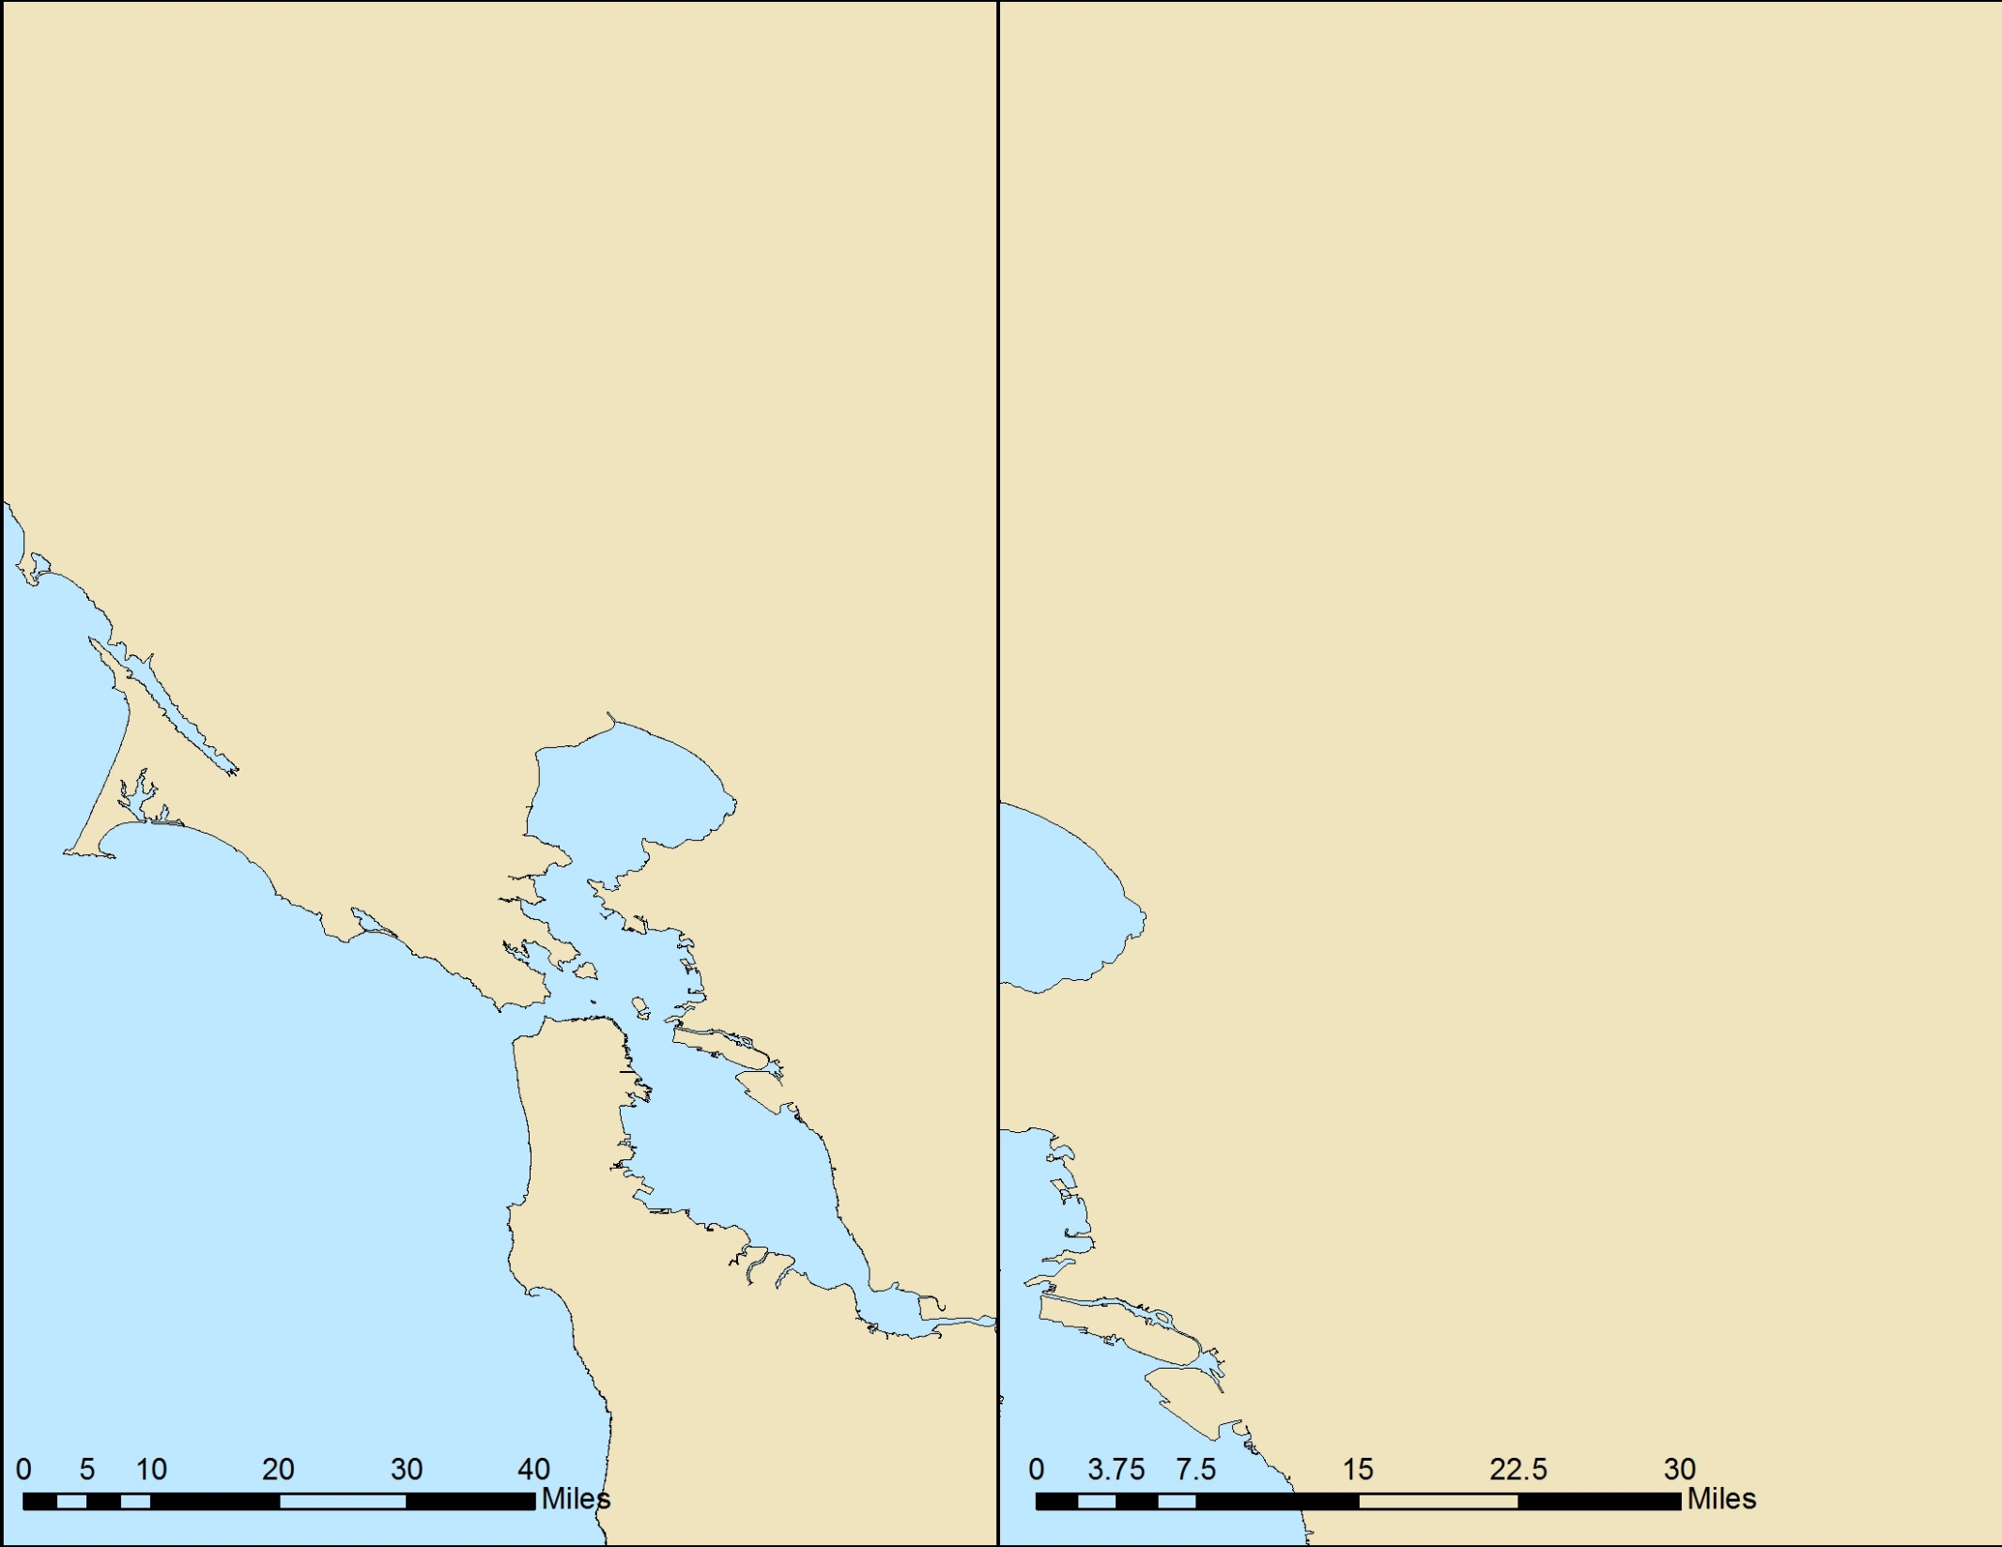
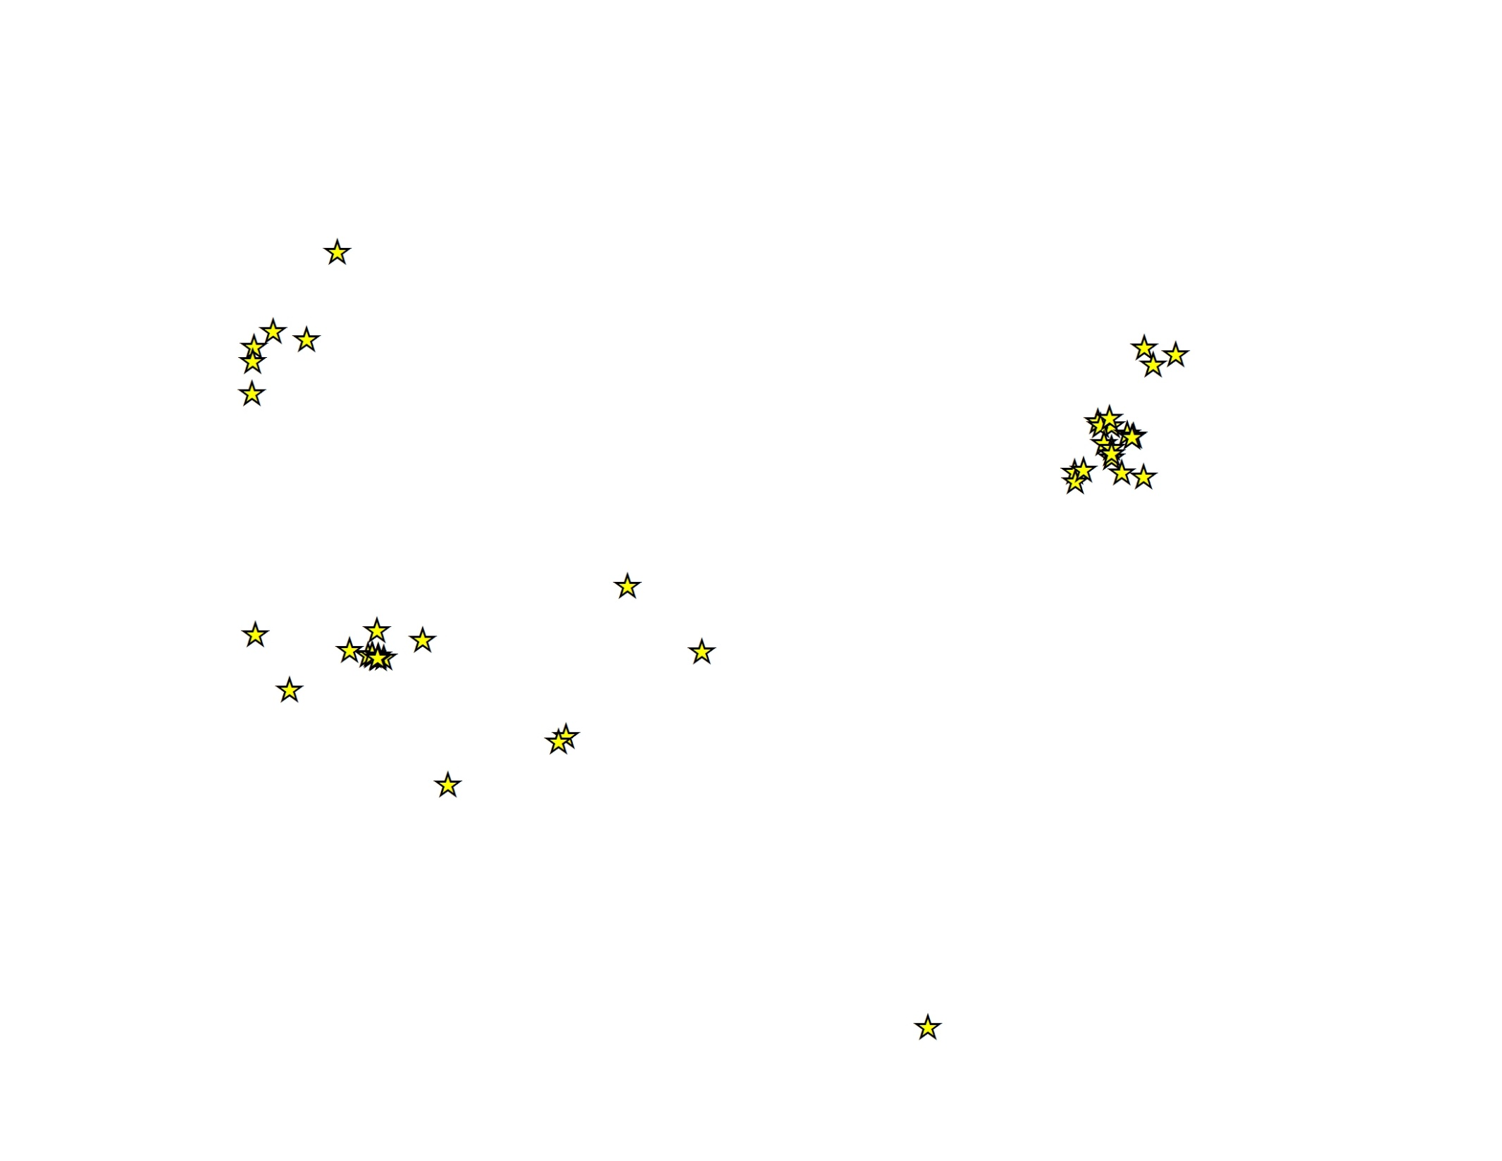
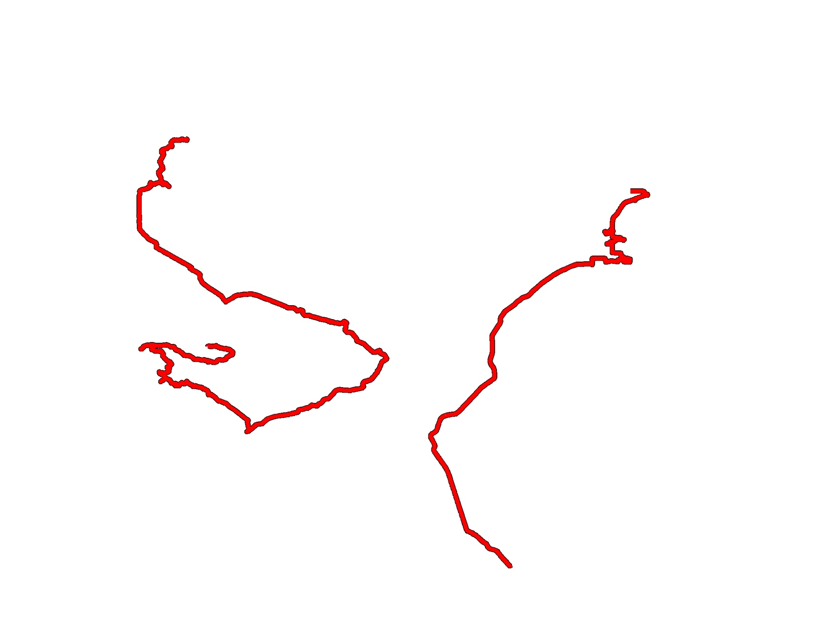
Notes:
Let’s delve a little more into these activity spaces.
Here I show the home addresses of two of those respondents. Their residential neighborhoods are in purple and as you will see later, only represent a very small portion of where they spend time.
These are all the regular/routine places these parents stated they went during the past week. Just by looking at these locations, you can already see that where each person spends time looks very different. One has very clustered activity locations, while the other is much more diffuse.
Here are destination nodes. Essentially, these are the Census tracts where all of those activities occur. Nodes are used under the assumption that people tend to ‘bundle’ activities. For example, you are likely to go to the gas station near to where you go shopping or your work location. As you can see, in some cases, the Census tracts appear to be fairly good representations of where the parent is spending time. But in others, the Census tract is actually much larger than where the parent spends time. This depiction of activity space allows you to continue to use many administrative data sets to examine the environmental context of where a parent spends time.
Here are spaces identified through shortest network distance. For this, we use network analyst to create the shortest path between all of the points using the local roadway networks. We limit the network by having it begin at the home but let the end point vary. As with destination nodes, the idea is that people are likely to bundle activities and errands along their regular travel patterns. Generally, a buffer (e.g., 500 meters) is drawn around the network.
Note: we don’t know if this is actually the route the person takes to go to these places, but is based on the shortest distance. The algorithm can be changed to take into account public transportation routes and could be ordered based on the sequence of locations a person attends.
The difficulty, in all of these measures, is that for the person on your right who regularly attends football and baseball games, it is difficult to fully estimate the effect of the travel patterns on possible risks and resources.

Slide 11
Notes:
Now we transition from point-based approaches to polygons. Here are the home location and locations of all the activities.
These represent the 2 standard deviational ellipse. It is as you might expect – an ellipse that covers, on average, 95% of activity points. Due to the spread of the ellipse, for the points on the left, all of the points are included in the polygon. However, it doesn’t encompass the coliseum.
Next, we have the 1 standard deviational ellipse. As you may have guessed, this ellipse only encapsulates about 2/3rd of the points. For the more diffuse activity points on the left, this means that you see several points that fall outside of the polygon, while on the right, the same number of points are included, it is just the size of the ellipse that differs.
Finally, we have the convex hull activity space. This polygon uses the shortest distance to encompass all of the points included as part of the activity space. This has been one of the most common depictions of activity spaces in the social science (non geography) literature.
These types of polygons are good for showing the range of areas a person may visit through their daily activities; however, it can be difficult to use these spaces with many of the administrative data sets we use to describe environmental context. Further it is often best to have more than three useable locations when creating these polygons. The convex hull polygons cannot be created with fewer than 3 points, and the ellipses work better with more, rather than fewer, points.

Slide 12
Activity Spaces
GPS-based
Notes:
Although surveys are nice to obtain information from a large number of people, you can see how it limits the number of locations we can identify. We also run into problems of being able to geocode those locations because people are not always able to provide us addresses or cross streets reliably. This can affect the size and shape of the activity space polygon.
An alternative to a survey-based approach is to use GPS monitoring to identify a person’s activity spaces.

Slide 13
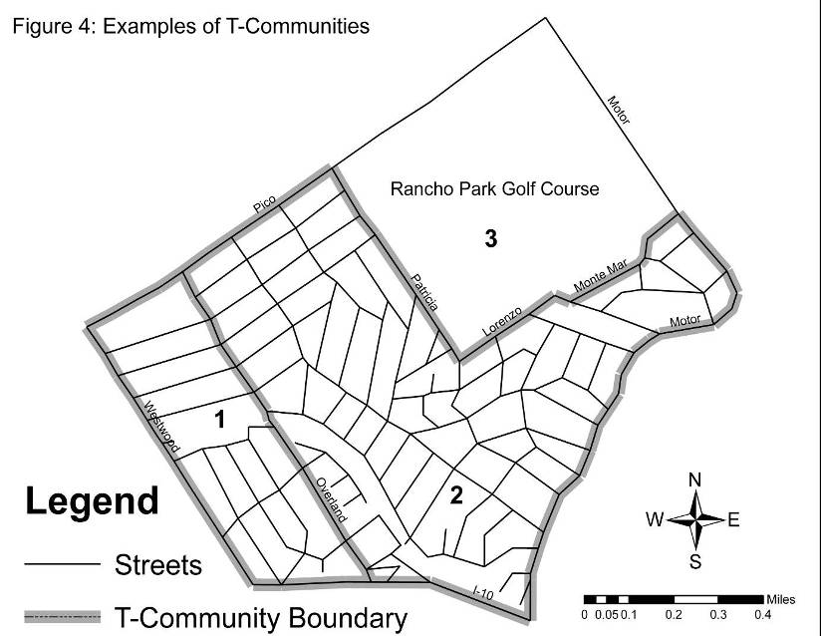
Notes:
Using GPS monitoring, you can have a device – GPS enabled cell phone, fit bit – to ping a persons location at specific intervals and provide x, y coordinates for mapping. These GPS devices also show the location and provide a much better indication of

Slide 14
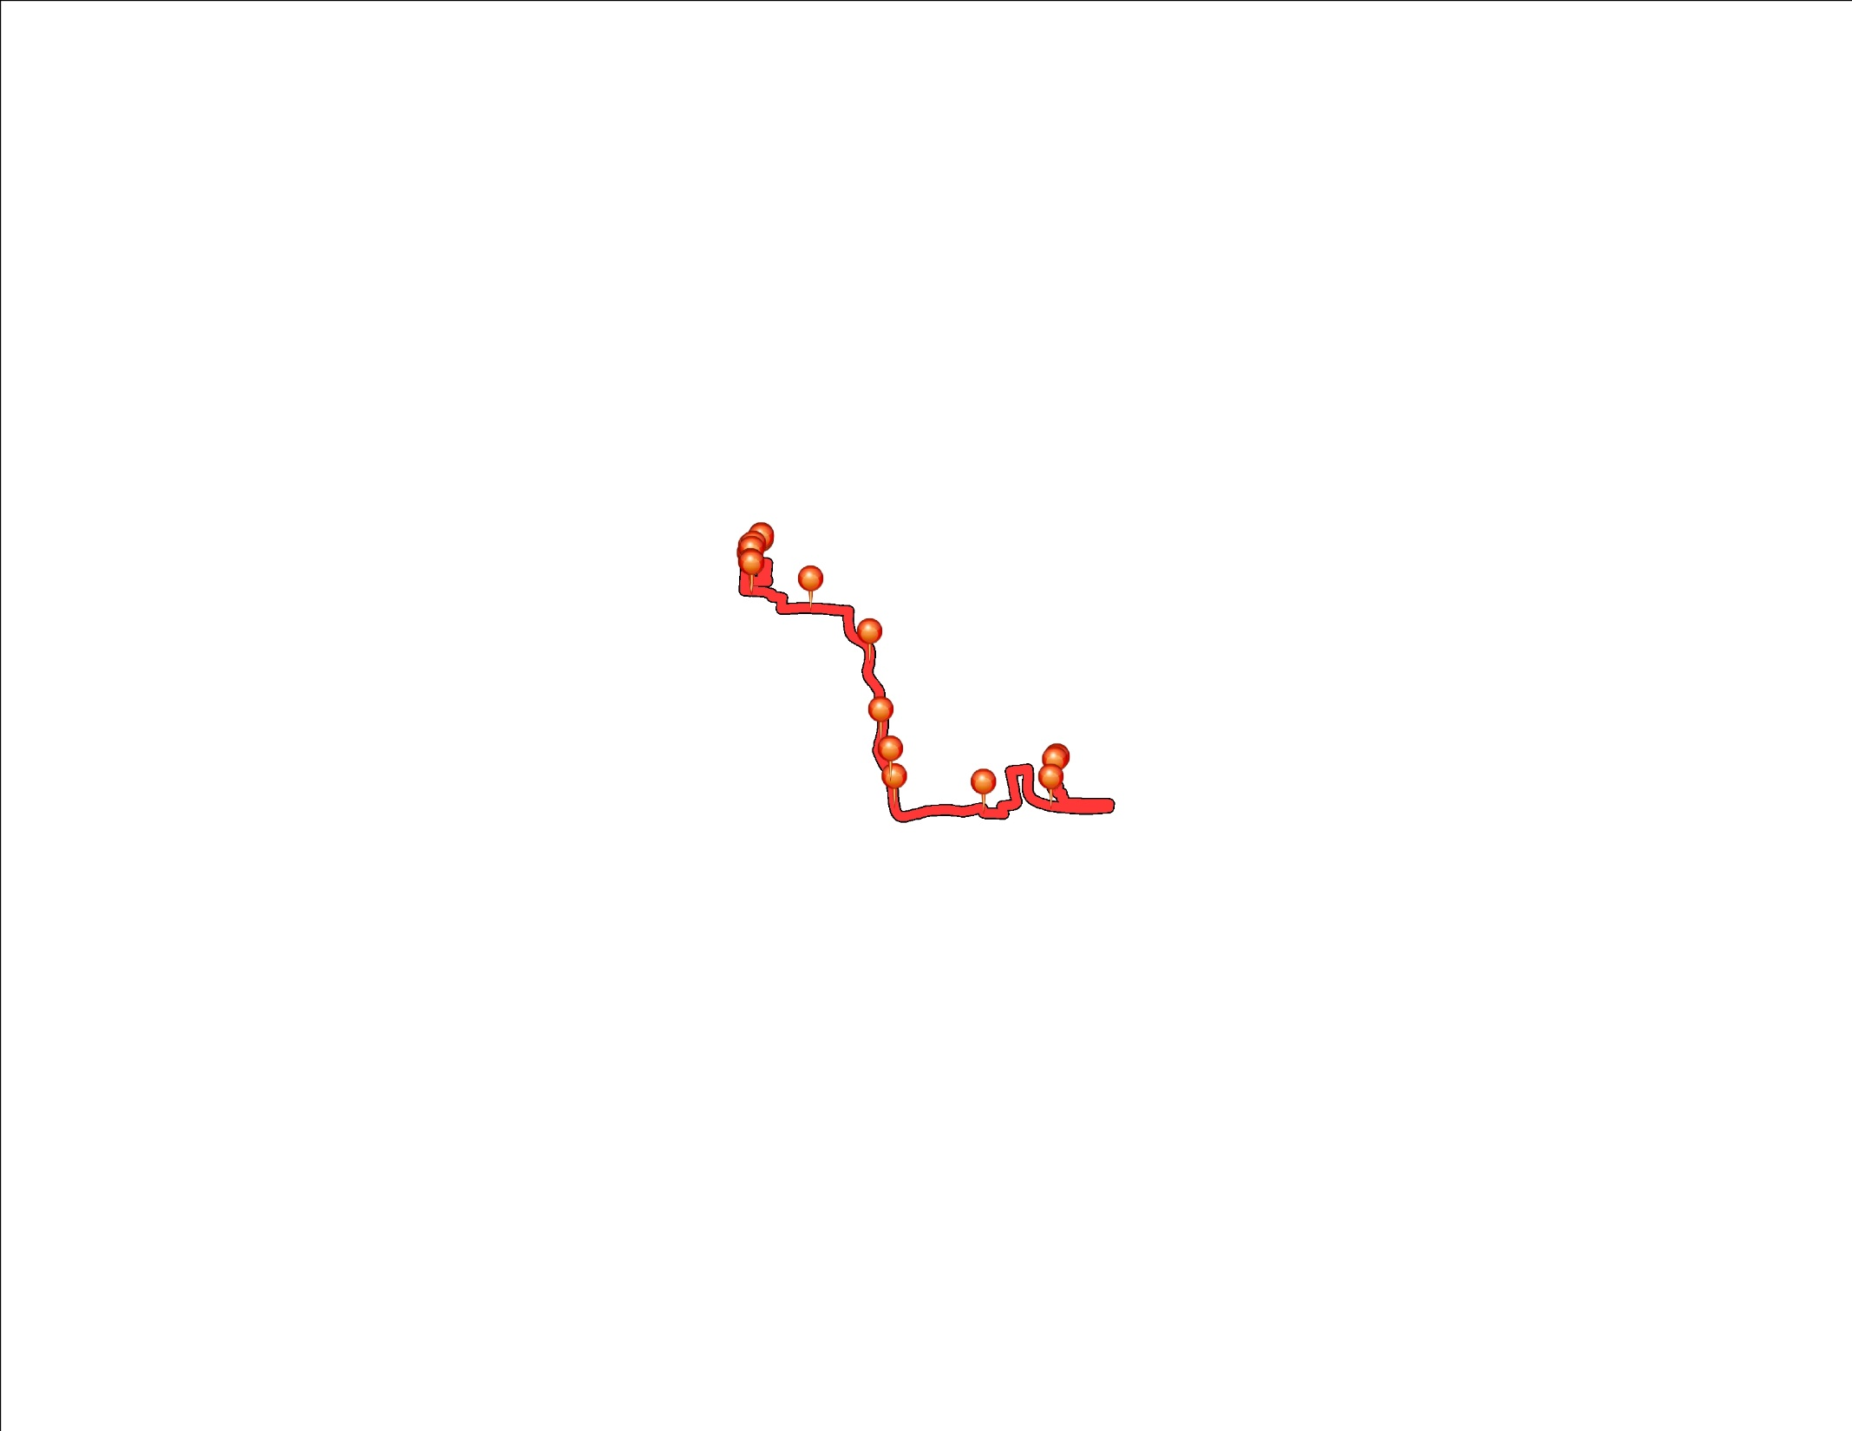
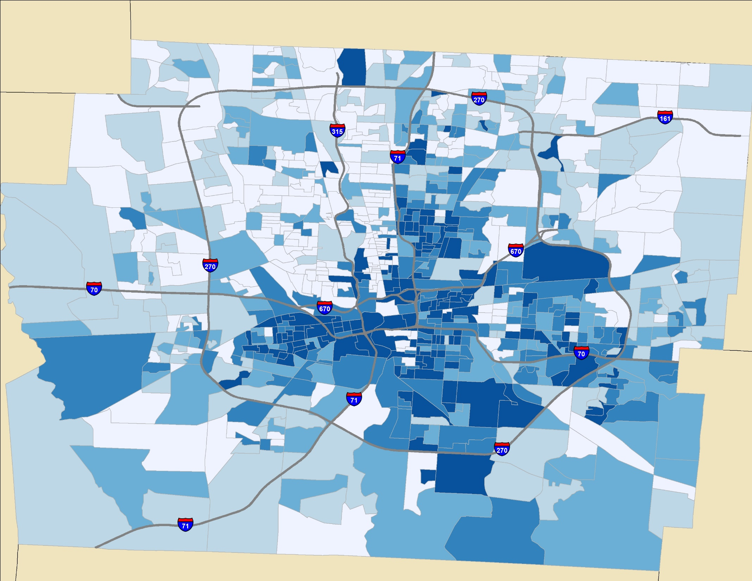
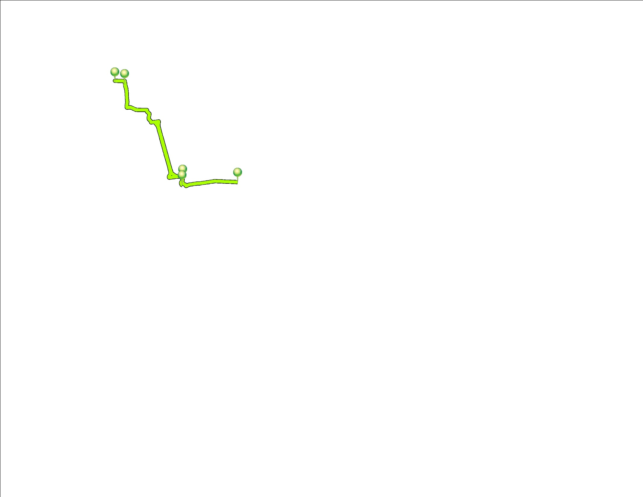
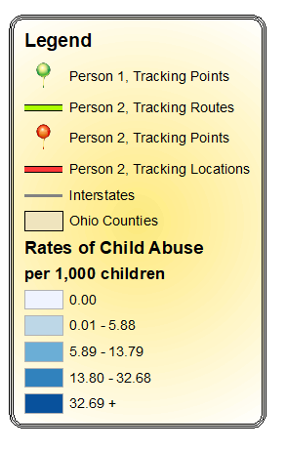
Notes:
To illustrate what we might learn using GPS-based activity spaces, here is a map of Franklin County, Ohio and the substantiated rates of child abuse and neglect by Census block group.
Now, here is a gps-activity pattern for one person and for another person. What you can see is that throughout the day, they are spending time in ‘neighborhoods’ with a wide range of child abuse and neglect rates.
What might this mean for parenting? If we think parenting is transmitted through social norms and networks, is the place that you live the most relevant location for assuming that is where your parenting behaviors have been learned or honed?
We will talk about this more in a few minutes.

Slide 15
Activity Spaces
Using Linked Data
Notes:
I’m sure some of you are sitting here saying, this is interested, but what does it really mean for linked data and do we even have enough information to do it?
Recently, I’ve been working with a county in Ohio that wants to use an app to assist with recovery from substance use. The user programs into the app any places that may trigger substance use. If he or she is in the vicinity of those triggers, an alert is sent to his or her caseworker that can be discussed during group or individual therapy appointments. Thus, some agencies are already beginning to collect more geographic data on their clients in order to prevent future problems.

Slide 16
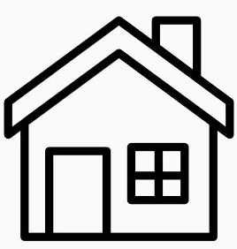
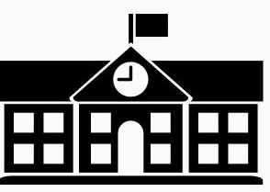
For children
Child Welfare Records
School/Education Records
Medicaid Records
Electronic Health Records
Birth Records
Notes:
Child welfare records will tell us the location of where a child lived at the time of the abuse or neglect, where they live if they are in foster care.
School records will allow us to track where children are going to school. Early education or day care locations may be available for those participating in federally funded programs like Head Start.
Medicaid records may tell us about where a child received mental health services (if Medicaid billable) and locations of doctors offices that they visit.
Electronic health records may provide better information about locations of doctors offices when children don’t have Medicaid.
I should note that, so far, all of these records could be used to develop activity spaces across the lifetime. EHR will have dates of visits, where the child was living at the time. School records will also show what schools a child attended each year. This would allow us to recreate a yearly activity space for these children to assess their exposures to risk and resources.
If we know the activity spaces of siblings not placed together, we may be able to identify better locations for joint visits to maintain those connections.

Slide 17
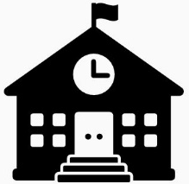
For parents
Child Welfare Records
Court Records
Employment/School History
Medicaid Records
Electronic Health Records
Birth Records
Notes:
Many of the same records are available for parents. These include:
.
.
.
And birth records of where children are born. Activity spaces may be useful for identifying which service providers fall within where a person regularly spends time, helping to ensure that a parent can more easily make appointments.

Slide 18
Activity Spaces
for Parents

Slide 19
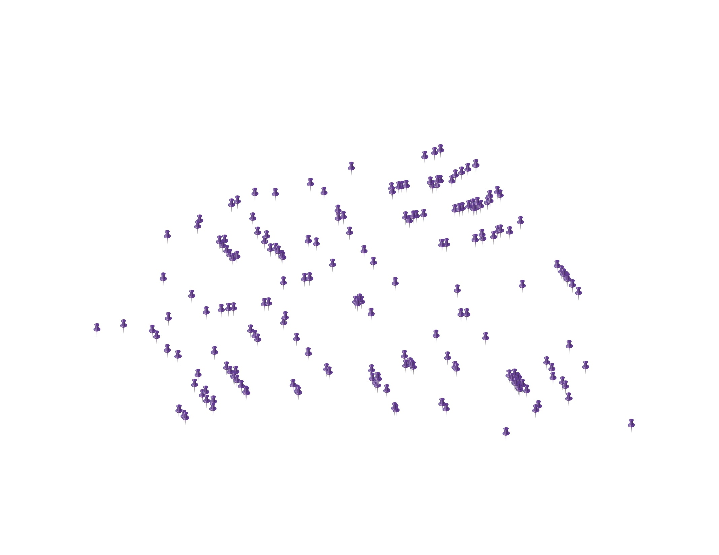
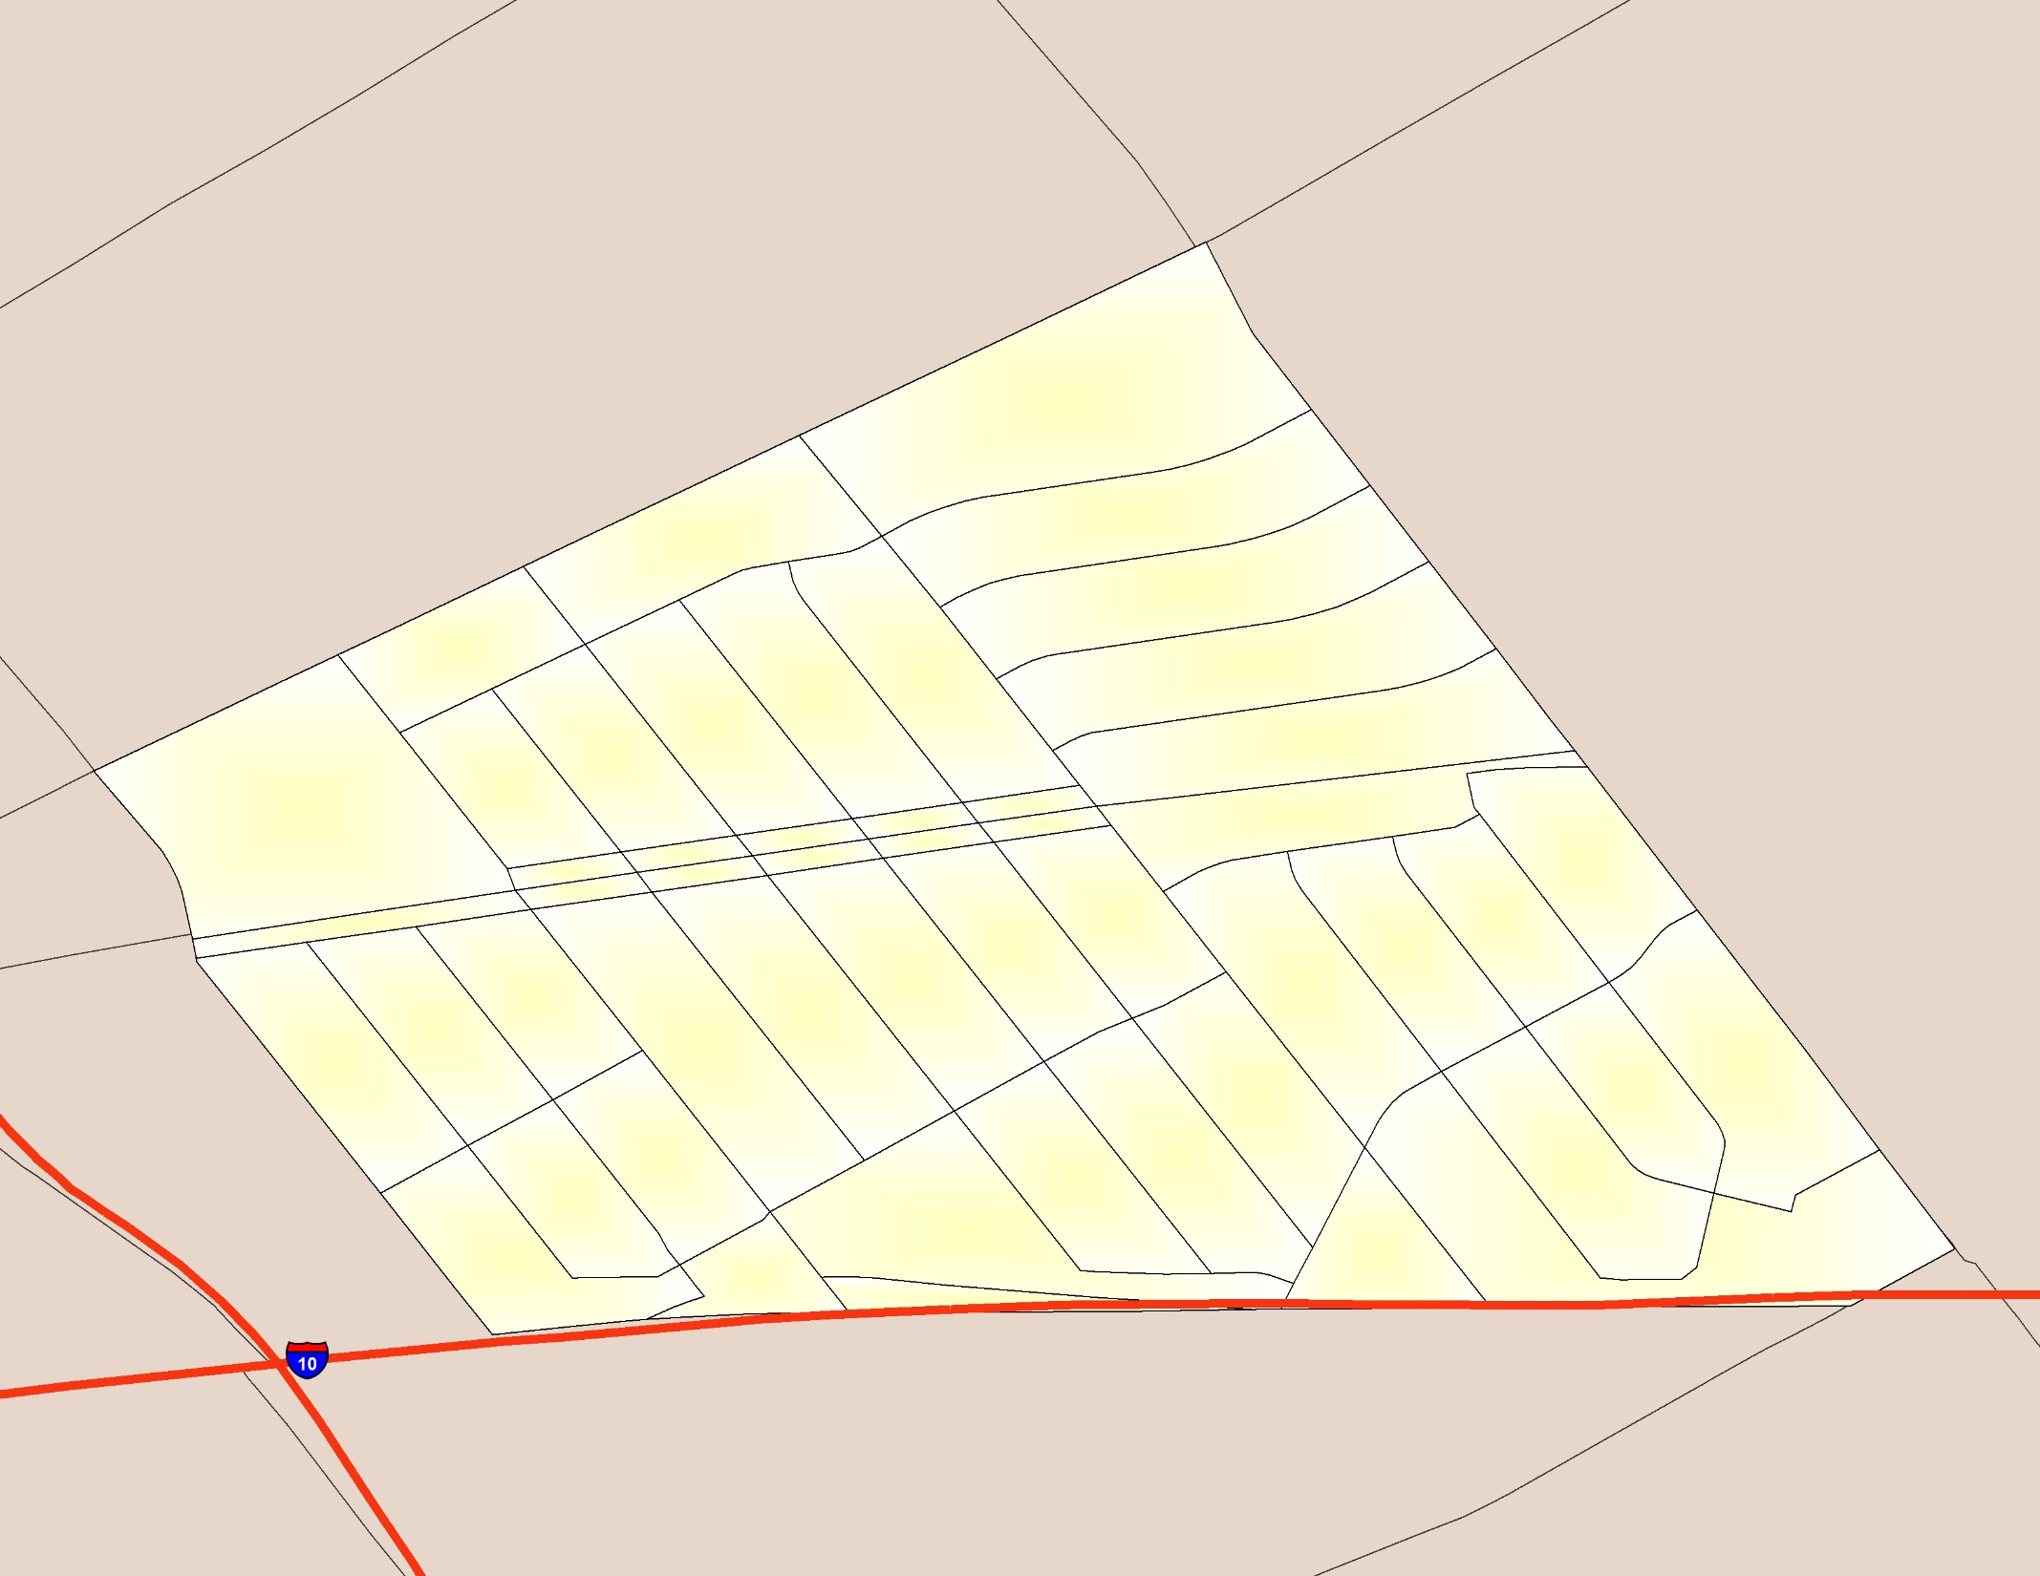
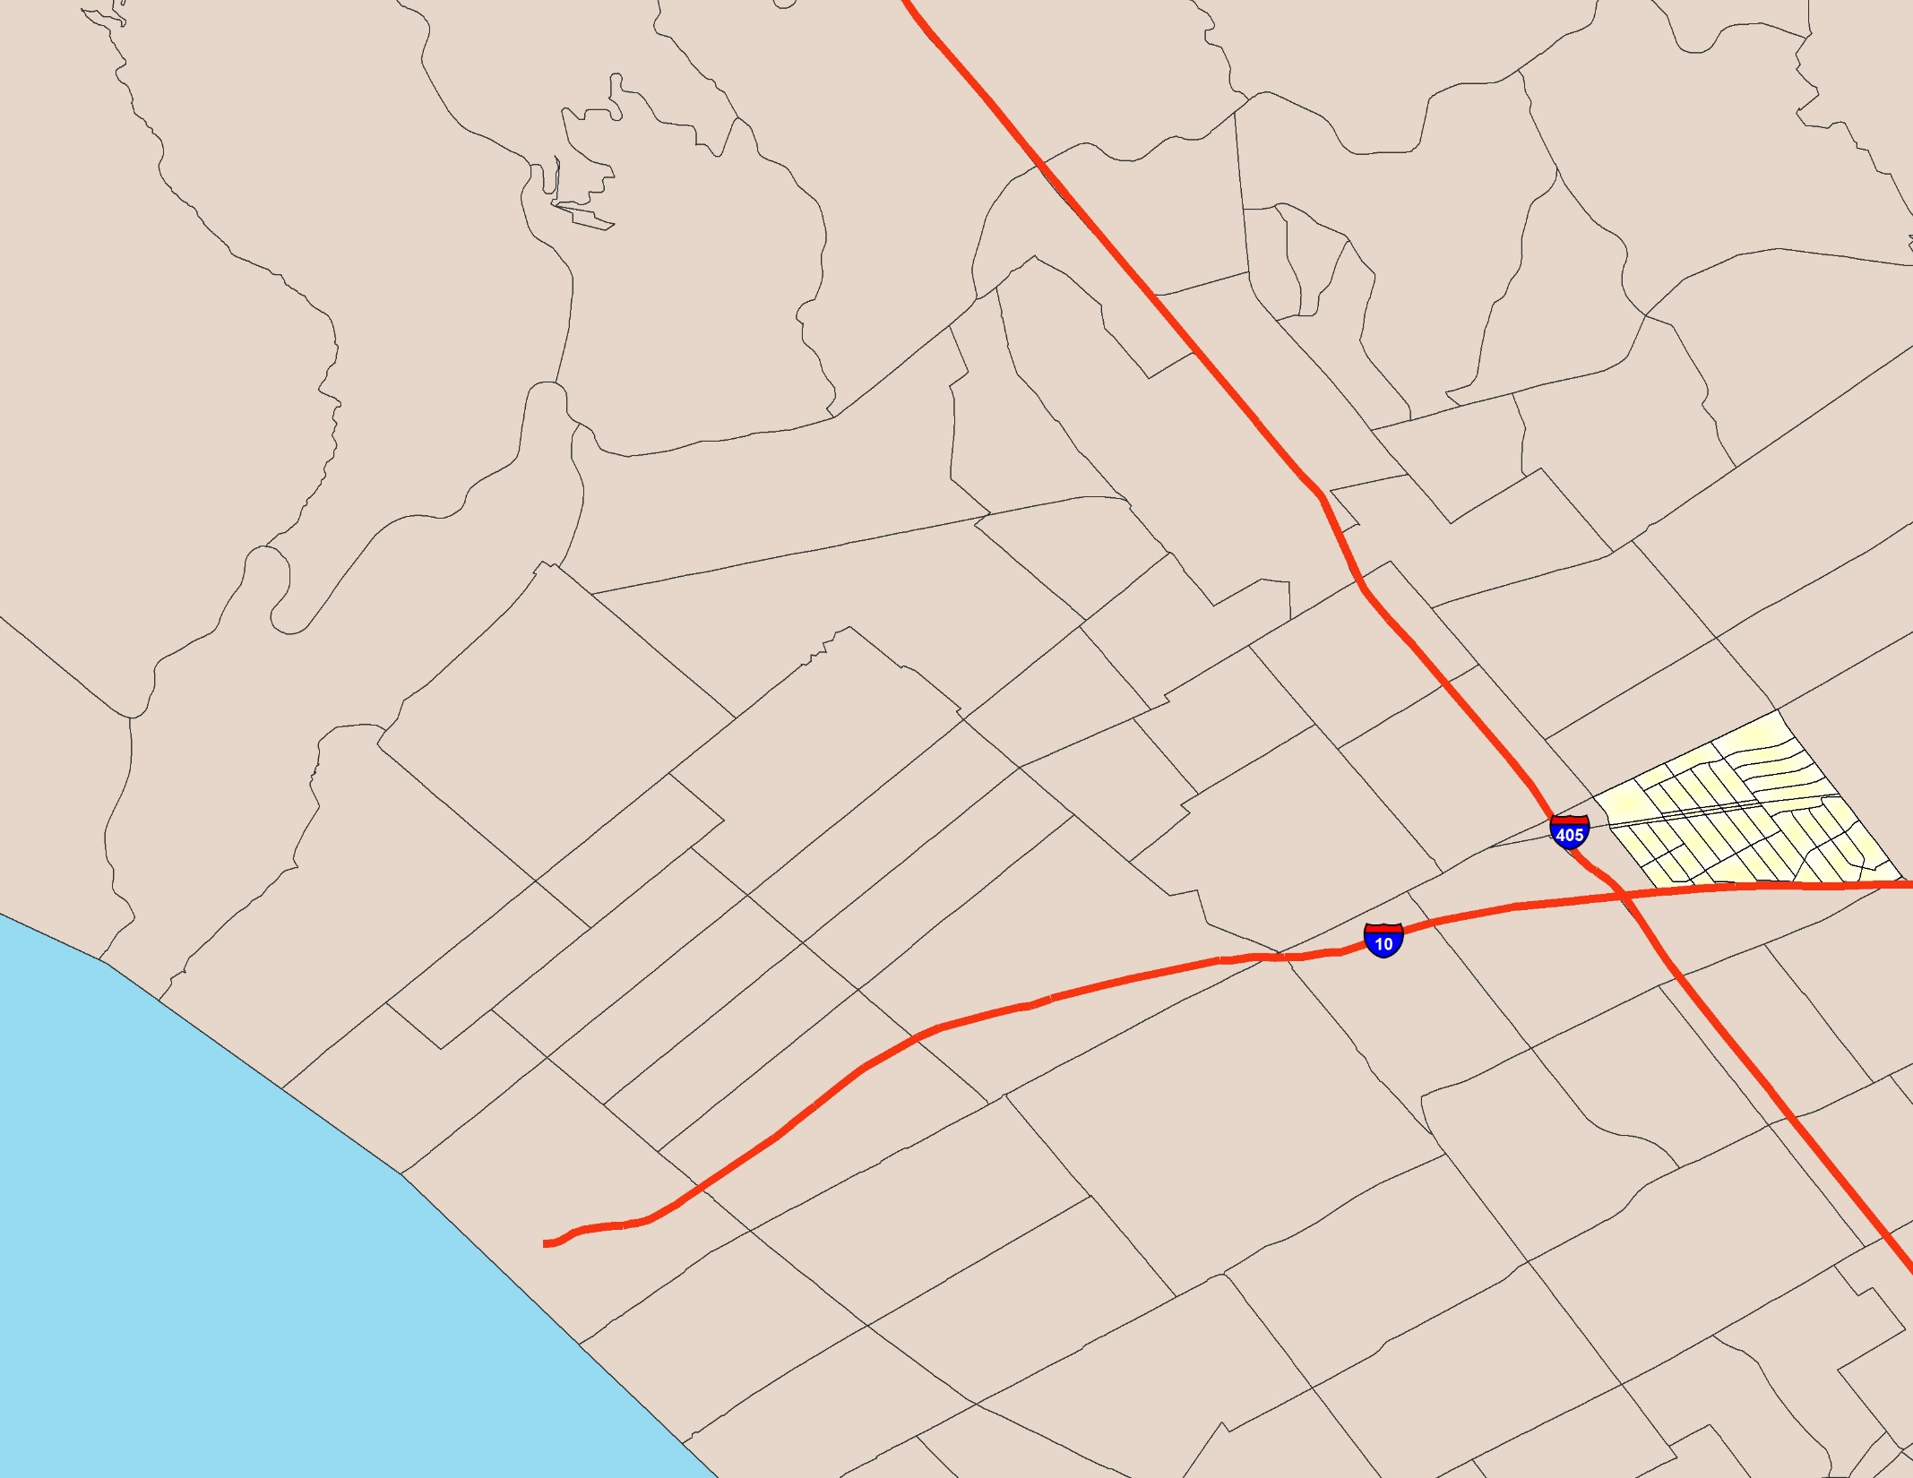
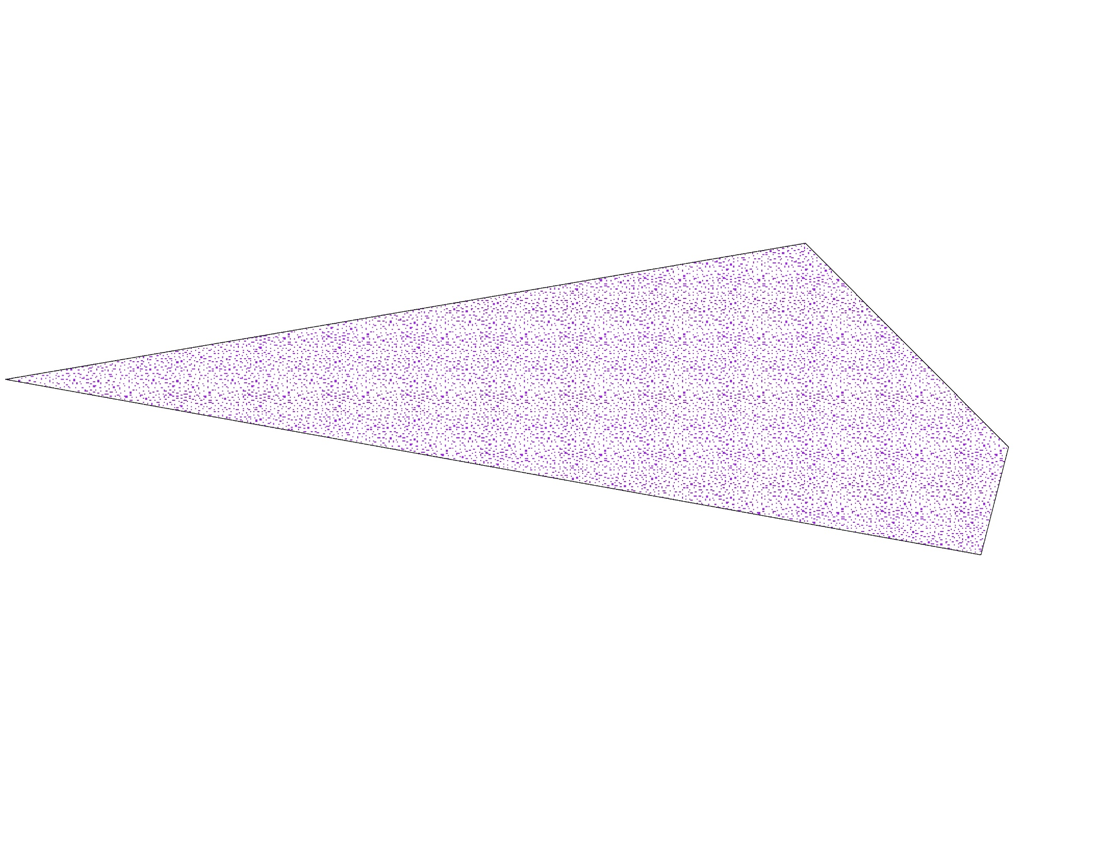
Does size matter?
↓ activity spaces
↑ punitive parenting
Why?
Isolation?
Contagion?
(Freisthler, Thomas, Curry, & Wolf, 2016)
Notes:
We conducted a small study in Los Angeles where we looked at parenting behaviors in relation to the size of activity space. What we found was the larger the activity spaces, the less the parent used punitive discipline practices.
Why might this be?
It may be that these parents are more isolated and we know social isolation is a risk factor for child maltreatment.
However, as we argued in our 2016 paper, what this might be showing us is how social norms are parenting are transmitted across spaces.
If we view parenting behaviors as “contagious”, like the measles or the whooping cough, a larger activity space may expose you to more individuals who use the current “normative” parenting behaviors. In the U.S., these normative behaviors tend to be non-punitive types of parenting.
In other words, having a larger activity space means that a parent is more likely to come in contact with parents using healthier parenting practices and who may be likely to censure punitive parenting either through nonverbal communication or by contacting Child Protective Services to report abusive and neglectful parenting.
Another public health analogy might be does going to places where non-punitive parenting is practiced by more people, does it result in ‘herd immunity’ that inoculates families who may be struggling in other was. Thus, in this case the benefits would actually be the spread of positive parenting norms through more exposure to more non-punitive types of parenting behaviors or guardians who will censure punitive parenting practices.

Slide 20
Do risks differ?
Correlating Density of Alcohol Outlets by Activity Space
 | Residential Tract | Nodes | Shortest Network | One SD Ellipse | Two SD Ellipse | Polygon
Residential Census Tract | 1 | --- | --- | --- | --- | ---
Census Tract Nodes | .135 | 1 | --- | --- | --- | ---
Shortest Network Path | .192 | .679* | 1 | --- | --- | ---
One SD Ellipse | .009 | .542* | .510* | 1 | --- | ---
Two SD Ellipse | -.065 | .452* | .638* | .677* | 1 | ---
Convex Hull Polygon | .037 | .539* | .770* | .822* | .824* | 1
*p < .001
Notes:
However, before we go too far down the rabbit hole of activity spaces. Do we even know if risks (or resources) differ when we look at residential neighborhoods vs. activity spaces.
Here I correlated the density of alcohol outlets using residential neighborhood and the six activity space types. Although the activity space measures are all correlated with each other, but none of them are correlated with the density of alcohol outlets in residential areas.
Did you just hear that? That’s the sound of my entire research agenda for the past 20 years imploding.

Slide 21
Challenges
Address:
123 Main St.
456 First St.
Notes:
Now this approach is not without challenges.
One of the biggest challenges we have in using linked data is understanding how address data are stored.
Imagine you have just moved. You go for yearly doctor’s visit and the receptionist ask if they address they have on file ‘123 Main St’ is correct. You say no, I just moved.
They go to update the address and. . .the unthinkable happens. They use the delete button. . .when they enter the new address. If they replace the data fields and don’t save the historical records, then obviously it makes it harder to recreate historical or lifetime activity spaces.
One of the first questions you want to ask when you look into using addresses in linked data is: When were those data collected (intake, last known address), how often they are updated, are historical addresses saved or are deleted forever. And if you receive data downloads, can you retrieve that historical data?

Slide 22
Notes:
Another challenge is the lack of GIS ability among practitioners, social service agencies, and social work educators.
For example, Ohio child welfare agency automatically includes x, y coordinates when it enters an address. However, these data are rarely used, nor are there plans to use them in a systematic way.
Part of the reason we do not mine geographic data to their fullest extent may be that we do not provide training in their use. Very few social work programs provide GIS as a regular part of their curriculum. Thus GIS is seen as a black box that is too difficult to master or not relevant to the day-to-day practice of a social worker. Nor do we teach our doctoral students how to conduct analyses correctly using spatial data.

Slide 23
So, activity spaces. . .now what?
Are activity spaces developmental?
Should they be time-weighted?
How does segregation affect movement across space?

