Slide 1
Do Foster Youth Face Harsher Juvenile Justice Outcomes?
Christian Connell, Sarah Font, Ezra Goldstein, Reeve Kennedy, Allison Kurpiel

Slide 2
The results presented and derived in this study do not represent the opinions or views of the Pennsylvania Department of Human Services, Juvenile Court Judges’ Commission, or Office of Medical Assistance Programs. This research was funded with help from the National Institute of Child Health and Human Development R01 HD095946 and P50HD089922.

Slide 3
More motivation
Foreign audiences may not know too much about why processing bias may matter as a legal outcome in US JJ. Spend time on the theory/motivation

Slide 4
Introduction
Scholars and policymakers alike concerned with outcomes of foster youth, particularly high rates of delinquency; up to 24 percent of youth in foster care come into contact with the juvenile justice system and more likely to receive court sanctions (Cutuli et al., 2016).
Justice system contact and juvenile court sanctions particularly concerning due to the link between juvenile justice and adulthood crime (Baron et al., 2023; Aizer and Doyle, 2015).

Slide 5
Introduction
The juvenile court’s decision-making captures both delinquent behavior and the system’s response to the case. Since foster placement is a legal status, court officials may respond differently.
Foster care may lead to worse case outcomes if youth face processing bias: differentially harsh treatment based on being in foster care.
Prior research found evidence that dependent youth at the time of juvenile justice contact were treated more harshly by the court, resulting in higher rates of court-ordered detention (Conger and Ross, 2001; Ryan et al., 2007; Tam et al., 2016).
Notes:
Foster youth may experience different outcomes due to selection, causal effects, or differential treatment.
Concerned that foster care placement signals particular risk for harsh outcomes, several jurisdictions have implemented programs to target the needs of foster youth as a form of diversion from formal juvenile justice proceedings.

Slide 6
This Paper
Tests for processing bias by examining differences in juvenile case outcomes based on concurrent foster care placement.
How?
  Collected data on over 10,000 delinquency cases (roughly 1,500 in foster care during the case), linked to rich records of prior behavioral health diagnoses and socioeconomic background.
  Compare cases involving youth in foster care to some counterfactual set of cases.
  Test for processing bias defined as youth in foster care experiencing worse case outcomes.
  But what is the right counterfactual?

Slide 7
Data
The core set of data includes linked, administrative sources that span of child welfare services, foster care, juvenile justice, and healthcare systems for over 10,000 adolescents between 2015 and 2020.
Pennsylvania’s Child Welfare Information Solution provides substantiated investigations of child abuse or neglect. The state’s Adoption and Foster Care Reporting System file provides foster care placement dates and settings.
The state’s Juvenile Court Judges’ Commission data system includes juvenile court data for youth with prior CWS contact. Case data include relevant filing dates, decision dates, as well as key details regarding charges and court-ordered sanctions.
The Office of Medical Assistance Program’s Medicaid claims data allows us to collect prior diagnoses of behavioral health conditions (ADHD, depression, mood or disruptive disorders, etc.)
We also collect socioeconomic conditions of the youth based (e.g., share of neighborhood in poverty) off of their child welfare services location.

Slide 8
Data
Over 10,000 Juvenile Justice cases between 2015-2020 involving youth with prior or ongoing child welfare services. Roughly 1,500 cases involve a youth concurrently placed in foster care.
Court data are quite rich and include detailed charges and associated court decisions.
Medicaid claims data allows us to collect prior diagnoses of behavioral health conditions (ADHD, depression, mood or disruptive disorders, etc.)
We also collect socioeconomic conditions of the youth based (e.g., share of neighborhood in poverty) off of their child welfare services location.

Slide 9
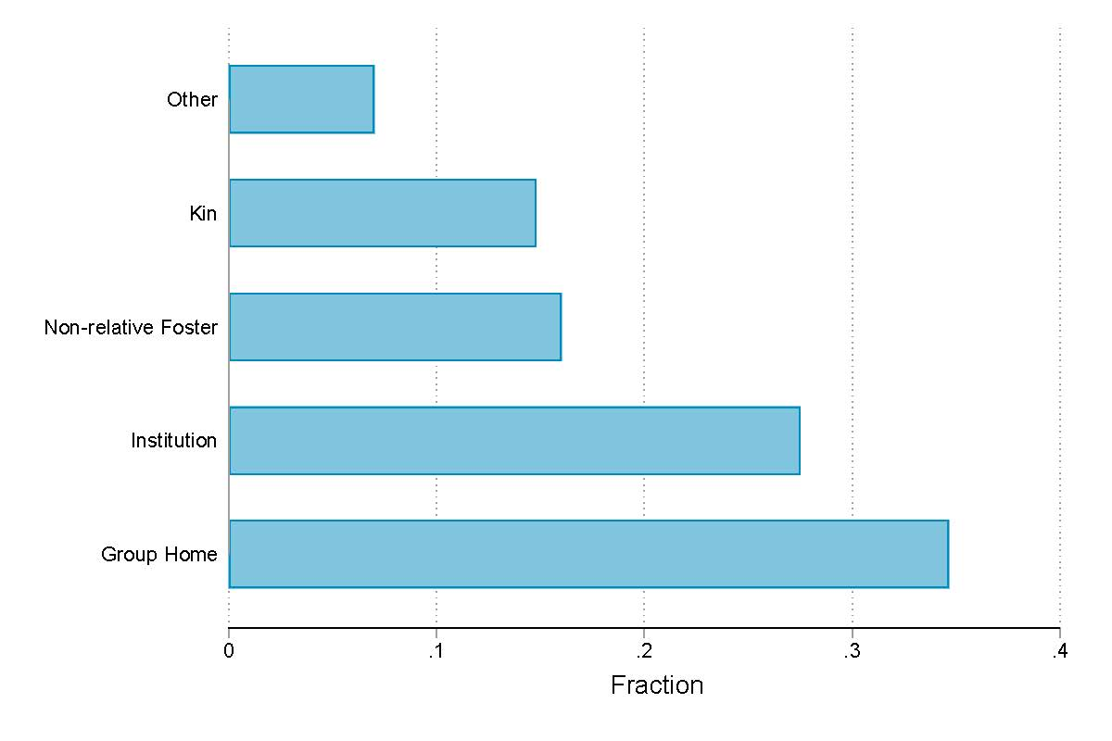
Characteristics of our foster youth sample
More than half of cases involving youth in foster care are concurrently placed in congregate care.

Slide 10
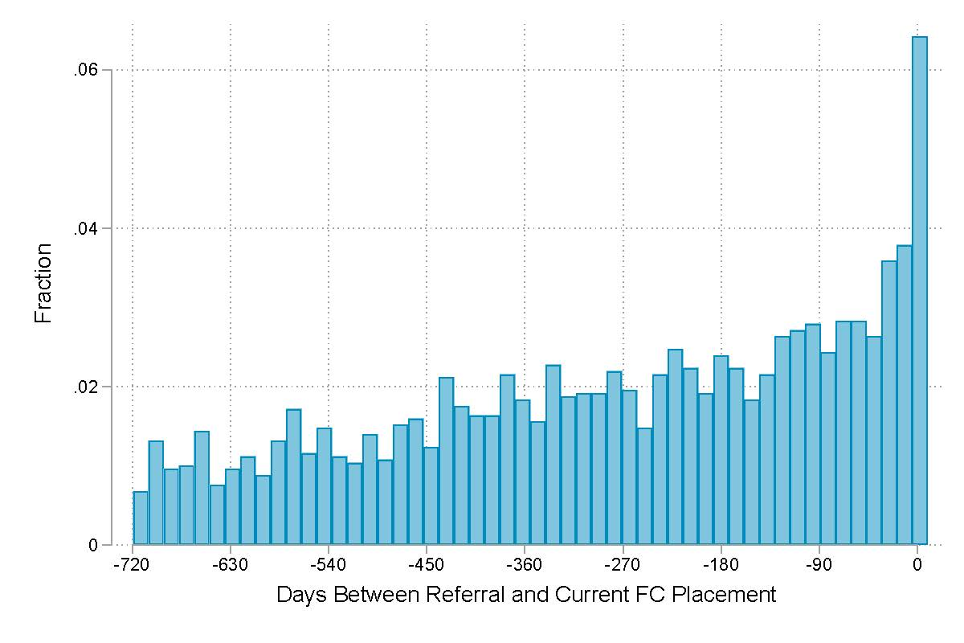
Characteristics of our foster youth sample
More than half of cases involving youth in foster care are concurrently placed in congregate care.
The timing between foster care placement and juvenile justice contact is typically within one year.
  Though roughly 6 percent co-occur

Slide 11
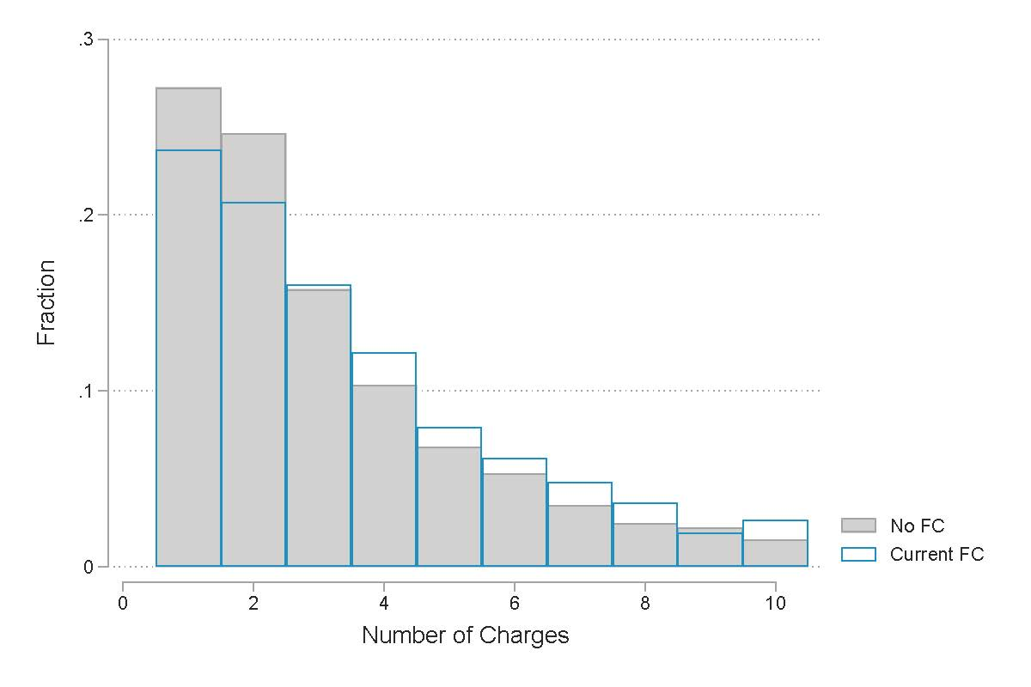
Characteristics of our foster youth sample
More than half of cases involving youth in foster care are concurrently placed in congregate care.
The timing between foster care placement and juvenile justice contact is typically within one year.
  Though roughly 6 percent co-occur
Foster youth tend to have more charges per case, and more serious alleged crimes.

Slide 12
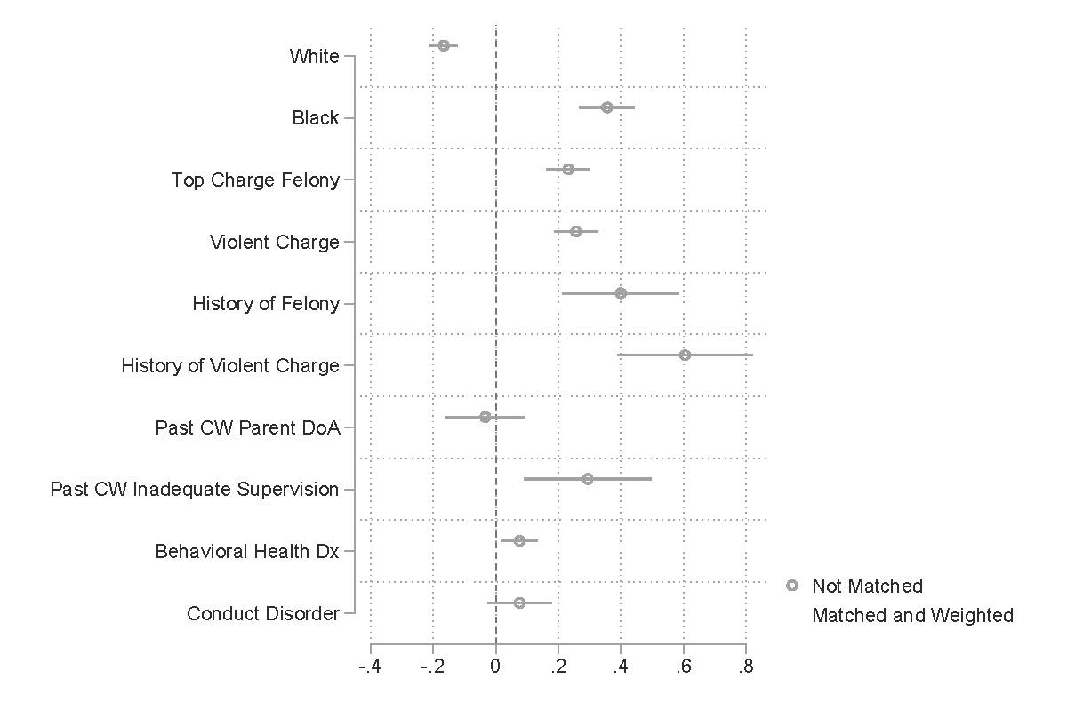
Apples to Apples?
Simply comparing cases involving youth in foster care to those where the youth is not in care is difficult.
Youth in foster care are nearly 40% more likely to be Black, 20% more likely to have a felony charge, 60% more likely to have a past violent charge, about 10% more likely to have a MH Dx before age 10.
Without accounting for these differences, we would worry our conclusions may be biased.

Slide 13
Methodology
A selection-on-observables design
  Make sure we restrict comparisons to exactly-matched groups.
  Predict propensity score of concurrent foster placement.
  Weigh the matched counterfactual by propensity weights.
The main assumption we have to make, is that there are not large differences in unobserved characteristics between the two groups.

Slide 14
Apples to Apples?
Implementing our selection-on-observables design forces an apples to apples comparison.

Slide 15
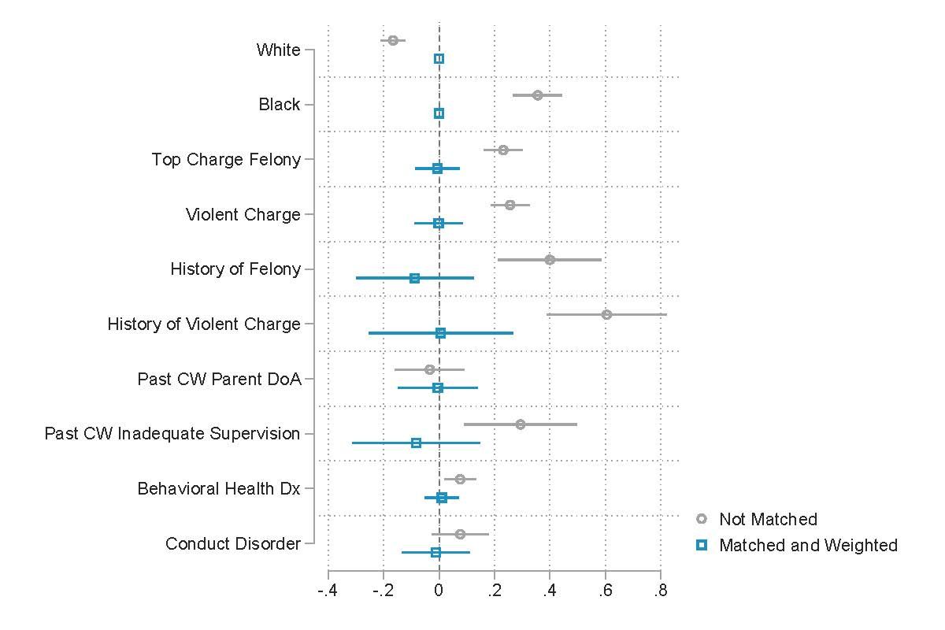
Apples to Apples?
Implementing our selection-on-observables design forces an apples to apples comparison.
Matching and weighting results in a counterfactual group that closely resembles cases involving youth in foster care.
On average, cases involving youth in foster care and our design-generated counterfactual are observationally equivalent.

Slide 16
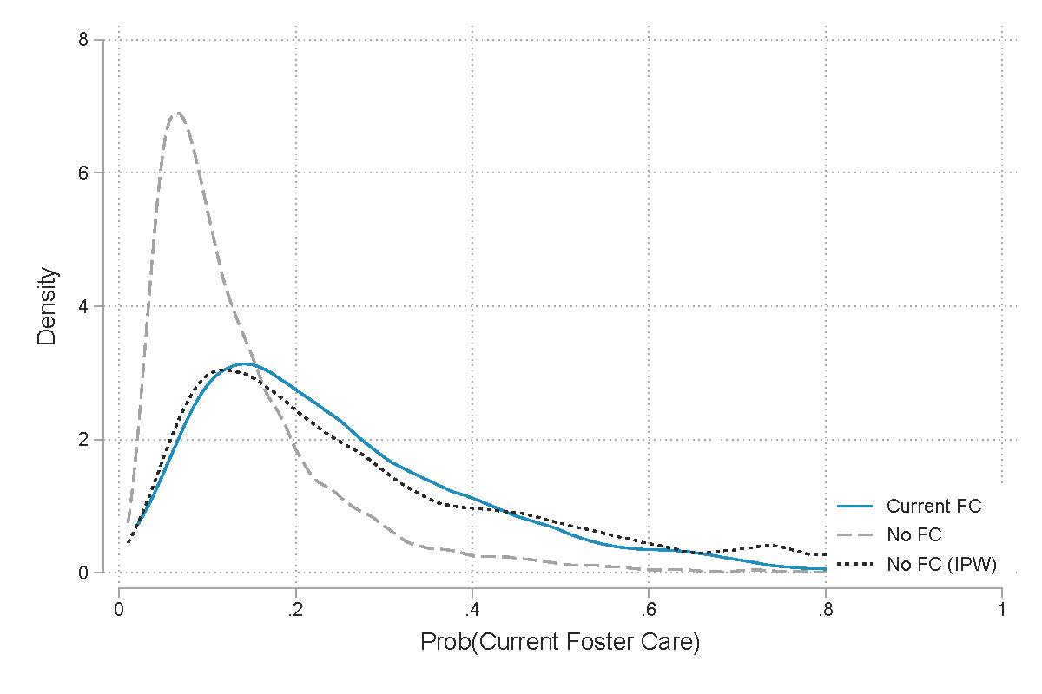
Distribution of predicted propensity score
Solid line plots a distribution of the estimated propensity score for concurrent foster care placement at the time of the JJ case for cases where the youth was concurrently in foster care.
Dashed line does the same, but for the group that is not concurrently in foster care.
Dotted line does the same for the group that is not currently in foster care, but after implementing our selection-on-observables design.

Slide 17
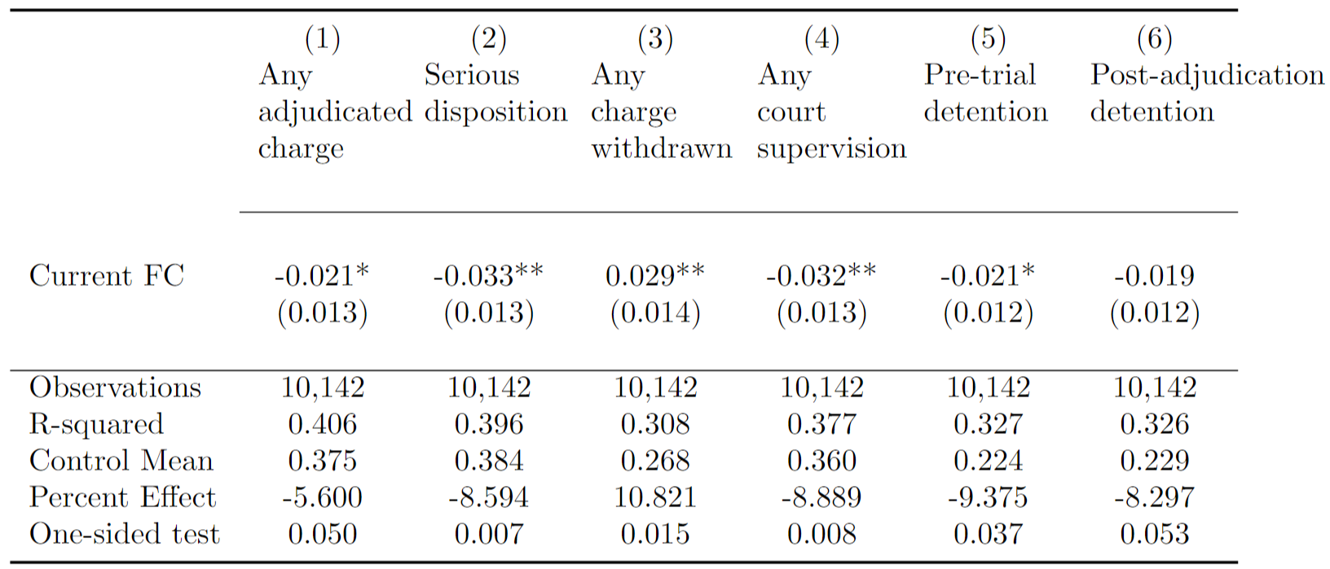
Results: Little differences in adjudication or serious court sanction

Slide 18
Results: Modestly better off across case outcomes

Slide 19
Results: Can rule out more punitive treatment

Slide 20
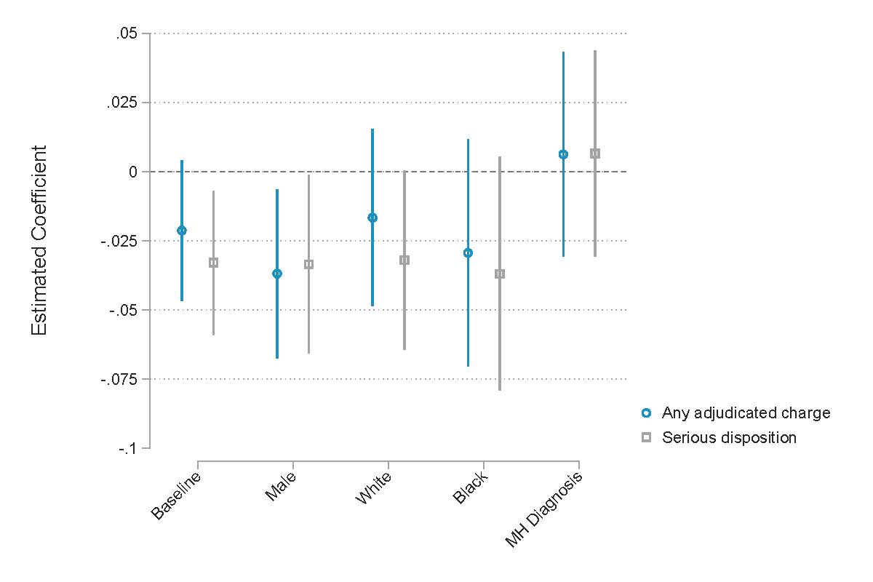
Heterogeneity tells the same story
Break up the analysis sample by subgroups of the alleged delinquent youth (gender, race, behavioral health diagnosis).
Re-run analysis for specific subgroups, comparing coefficients relative to the baseline estimate.
Resulting subgroup estimates are similar in magnitude to baseline, not statistically different.

Slide 21
Other results in the paper support the conclusion
Heterogeneity by case characteristics
  Splitting the sample by violent charges, felony charges, or first charges does not change our conclusions
Oster bounding exercise
  One way to test our assumption of unobserved differences. We can rule out that omitted variable bias is causing us to miss harsh outcomes.
Alternate matching methods
  If we exactly match based on case characteristics, conclusions remain.

Slide 22
Conclusion
We find no evidence that youth in foster care at the time of their juvenile justice case experience processing bias. If anything, cases involving youth in foster care are have modestly more lenient outcomes.
Findings help inform pathways of FC to JJ contact; processing bias may not play a pronounced role.
Moreover, juvenile justice programs that expressly target youth in foster care may be better suited in locations where processing bias is present. Child Welfare services cannot sufficiently replace JJ programs.

Slide 23
Thank you!

