Slide 1


What happens when justice contact precedes substantiated child welfare concerns?
The effects of ‘reverse crossover’ on the child welfare response
Christian M. Connell, PhD
Child Maltreatment Solutions Network &
Translational Center for Child Maltreatment Studies
Pennsylvania State University
October 5, 2023

Slide 2
Collaborators
Ezra G. Goldstein, PhD, Assistant Research Professor, Social Science Research Institute, Penn State University
Sarah A. Font, PhD, Associate Professor, Sociology and Public Policy, Child Maltreatment Solutions Network, Penn State University
Allison J. Kurpiel, MA, Doctoral Student, Sociology and Criminology, Penn State University
State Partners:
Office of Children, Youth, & Families (OCYF)
Office of Medical Assistance Programs (OMAP)
Juvenile Court Judges Commission (JCJC)
Notes:
I want to acknowledge my co-authors and our state partners in this work.

Slide 3
Disclosure Slide
This research was supported by grants from the Eunice Kennedy Shriver National Institute
of Child Health and Human Development (NICHD):
  Translational Center for Child Maltreatment Studies (2P50 HD089922; Connell & Jackson, MPIs), Dissemination and Outreach Core (2P50 HD089922; Connell & Font, MPIs)
  System and Social Determinants of the Health of Foster Children (R01 HD095946; Font, PI)
The results presented as a part of this study do not represent the opinions or views of the Pennsylvania Department of Human Services; Office of Children, Youth, and Families; Juvenile Court Judges’ Commission; or Office of Medical Assistance Programs
Notes:
Also, I want to disclose our funding source and indicate that findings reflect our own views, and may not reflect the opinions of our state collaborators

Slide 4
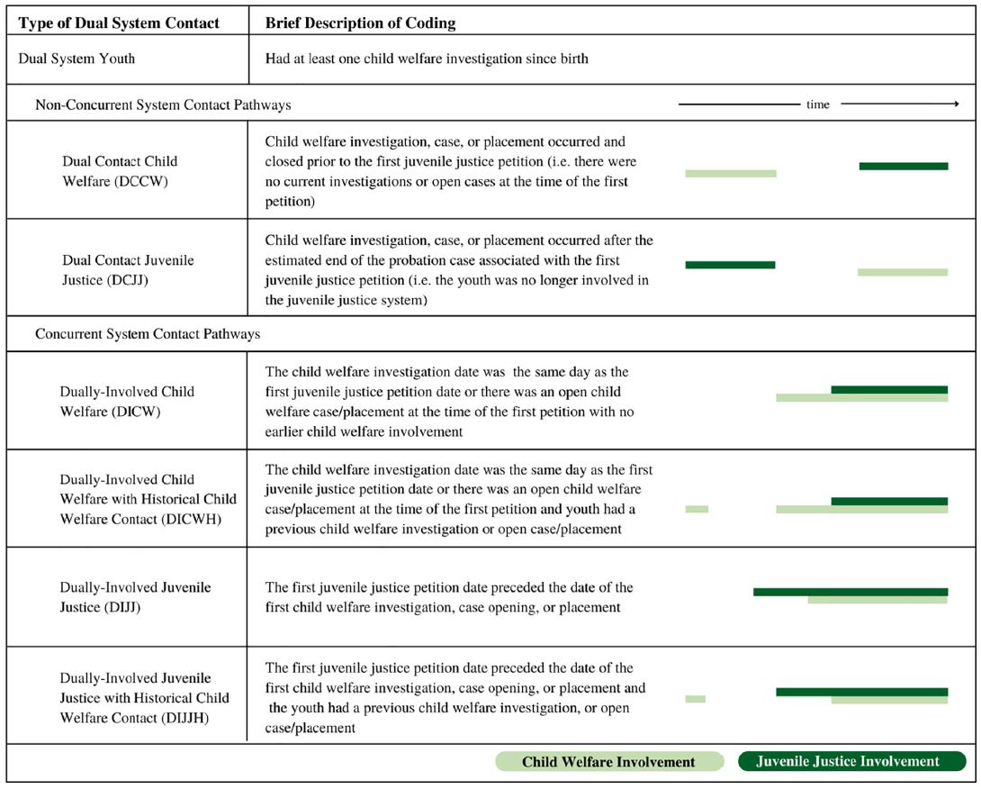
Conceptual Framing of Dual System Contact
Dual Contact – Youth involved with both CW & JJ, but not concurrently (CW→JJ or JJ→CW)
Dually Involved – Youth concurrently involved with both CW & JJ (CW+JJ or JJ+CW)
Dually Adjudicated – Youth concurrently adjudicated with both CW & JJ (CW+JJ or JJ+CW)
* Youth with concurrent involvement may have prior history of CW contact
Adapted from Herz, Eastman, Putnam-Hornstein, & McCroskey (2021), p. 3
Notes:
So, I want to begin by grounding this work, to some extent, in the existing research on youth with dual system contact, or ‘crossover’ system trajectories.
Fortunately – Denise and Joe covered a fair amount of this, so let me just highlight a couple issues.
Studies of crossover youth vary in their terminology and operationalization of different patterns and degrees of contact:
Dual System contact is a general term that reflects youth involved with both CW & JJ (broadly defined)
Dual Contact youth have involvement with both systems, but not concurrently.
Dually Involved youth are concurrently involved with both systems
Each of these patterns can be further distinguished by whether CW contact precedes JJ contact, or vice versa, but
[click] – even among cases where JJ precedes CW, there often is an indication of historic involvement with CW, given that earlier contact with that system is the modal pattern.
[click] Research studies have primarily focused on the issue of CW→JJ contact to focus on the effects of earlier CW involvement on future JJ contact or on decision making among cases that become involved in JJ – Ezra’s paper on this panel is an example of this work.
[click] Fewer studies have examined the effects of ‘reverse crossover’ cases in which JJ precedes CW contact.

Slide 5
Research on Prevalence and Outcomes
Findings from 4 large counites (Chicago, Cleveland, New York City, & Los Angeles)
(Herz et al., 2019; Herz et al, 2021)
  Variability in dual system rates (44 - 70%)
  Dual contact (non-concurrent) most frequent pathway
    48-70% of dual system cases
    CW most often preceded JJ
  Dually involved rates varied, as did pathway (CW→JJ vs. JJ→CW)
  Over-representation of minority (esp. black) and female youth in dual system and dually involved populations, relative to JJ-only involved youth
Michigan JJ sample: 26% have later CPS investigation; 3% have later foster placement
(Ryan & Moore, unpublished)
Notes:
I’m going to skip this slide, as Denise and Joe provided a great overview of this issue. I do want to say that across localities, there is some variability in rates of dual system, dual contact, and dual involvement patterns – but very little research on the pathway from JJ to CWS.
Unpublished data by Ryan and Moore of 52,000 processed juvenile offenders in Michigan indicates that 26% had a subsequent CPS investigation and 3% had a subsequent foster care placement.

Slide 6
“Reverse Crossover” and CW Outcomes
No research on case-related outcomes for youth entering CW involvement following JJ contact
Possible CW pathways (Cullen, 2021)
Relevance of comparing both active JJ (dually involved) and prior JJ (dual contact) to CW-only
Caregiver Refusal
Caregiver Unavailable
Youth Requires Services/Treatment
Court adjudicates ‘Dependent’
Notes:
THUS, there is limited information about the prevalence of youth experiencing subsequent contact with CW following JJ involvement, and little-to-no research on the effects such patterns may have on the experiences or outcomes of youth later substantiated within CW.
There is some anecdotal evidence to explain the JJ → CW pathway (Cullen, 2021). These include
Caregiver refusal to care for youth due to behavior (or the lack of caregiver to receive a child for community placement following JJ contact)
Second, youth may require services/treatment that the family unable to provide without CW support
Finally, some state systems (including PA) allow for delinquency court judges to adjudicate as ‘dependent’ to avoid unnecessary incarceration or detention or access CW placement services
We also think it may be important to contrast effects of prior vs. concurrent JJ involvement on CW Outcomes
Both groups reflect youth that demonstrate a pattern of delinquency and/or behavioral challenges
HOWEVER, youth with concurrent involvement may differ in that this formal dual involvement provides either a mechanism to motivate a CW response or an opportunity to use that system to provide services or placement external to the JJ response

Slide 7
Research Questions
What is the prevalence of JJ Involvement among youth indicated by CW, and what differences exist among these groups?
What is the effect of JJ Involvement on post-substantiation CW service and placement outcomes?
How do the effects of JJ Involvement on CW outcomes
differ based on child characteristics and CW case factors?
Notes:
This brings me to our particular study, which seeks to answer the following questions:

Slide 8
Study Methods
Data Sources:
  Child Welfare: Statewide CWIS Records & Foster Care Placement Records
  Juvenile Justice: Court Filing, Charges, Adjudication, and Sanction Decisions/Timelines
  Medical Assistance: Youth behavioral health diagnosis (Past Year)
Sample Selection
  ~39K youth, ages 12-16 yrs @ CW contact
  Substantiated/valid case with CPS or GPS case from 2015 thru 2019 (~51K Cases)
  Linked with statewide JJ records to classify dual system groups
    No JJ (CW-only)
    Prior JJ (Dual Contact JJ → CW*)
    Active JJ (Dually Involved JJ → CW*)
* May Include historic CW contact but data limitation
Notes:
Describe data (same extracts as Ezra paper, but sample selection process differed)
Essentially, this involves linked statewide data from child welfare (CPS/GPS and foster care records) and JJ (court records), as well as Medical Assistance (Medicaid records).
We have about 39K youth, ages 12-16 @ the time of a substantiated report – and identified the pattern of JJ involvement prior to these substantiated incidents. Given the timeframe available for CPS reports, we couldn’t look at historic CW complaints, but were able to look at prior foster care involvement among these cases.

Slide 9
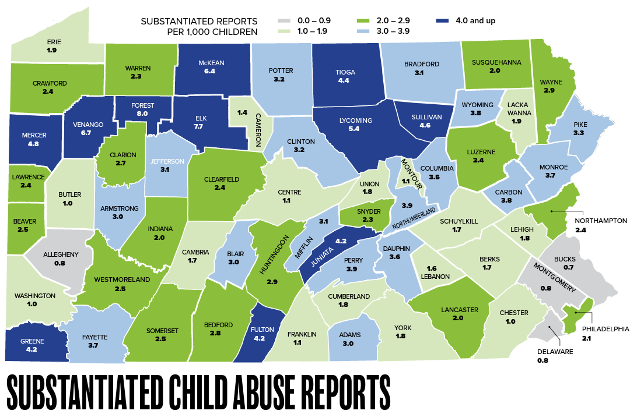
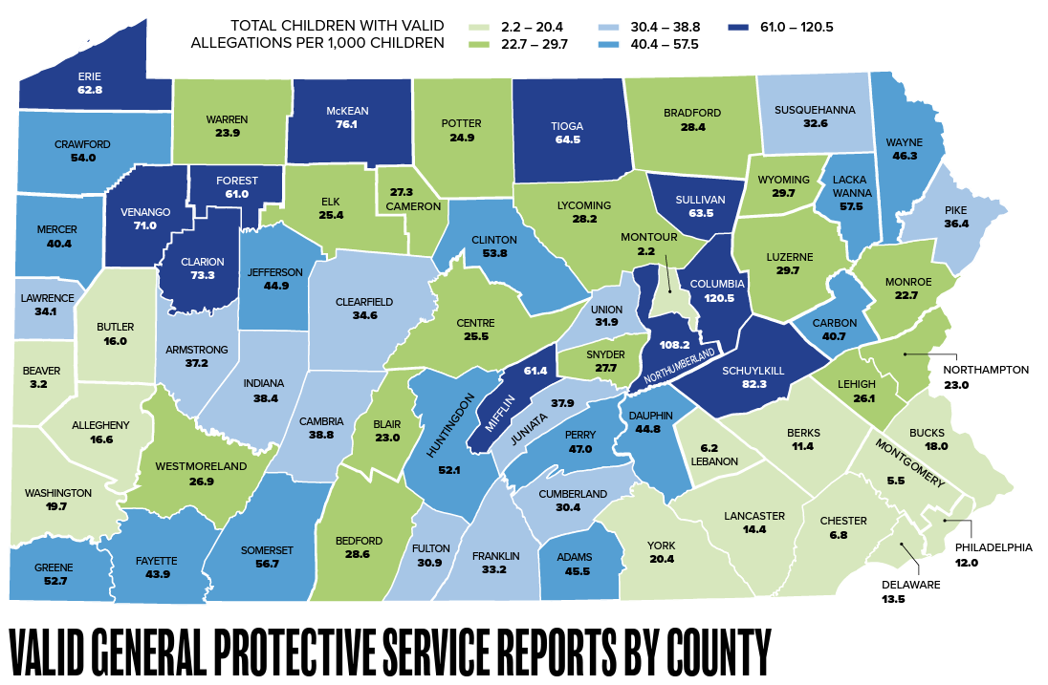
Pennsylvania Child Welfare Context
State-Supervised, County-Administered
Dual Track:
  CPS: Child Abuse & Serious Physical Neglect
  GPS: General Child Welfare Concerns
67 county Child Youth Service offices, responsible for:
  CPS/GPS Investigation Response
  CW Service Provision & Foster Care Placement
Statewide (2021):
  ~38K CPS & ~161K GPS Referrals
  ~9K foster care entries
Notes:
I’m going to give a cursory overview of our state CW and JJ systems to provide context – but this is really a bird’s eye view:
Pennsylvania is a state-supervised, county-administered CW, comprising two tracks: child protective services (CPS) and general protective services (GPS).
CPS is an investigation track that responds to allegations of child physical and sexual abuse, and serious physical neglect
GPS is a family assessment track that responds to a range of child and family concerns including: child neglect, parental substance abuse, and domestic violence. For adolescents, GPS cases involve child behavior problems, truancy, and parent-child conflict. Counties can screen out GPS referrals without providing any further response
[if more detail is wanted]
In 2021, ChildLine sent approximately 38,000 CPS and 161,000 GPS referrals to counties. Both CPS and GPS cases may be opened for ongoing services, or result in a court petition or foster care placement. In many counties, they are investigated by the same caseworkers and services are provided by the same contractors.
Approximately 9,000 children entered foster care in Pennsylvania in 2021.

Slide 10
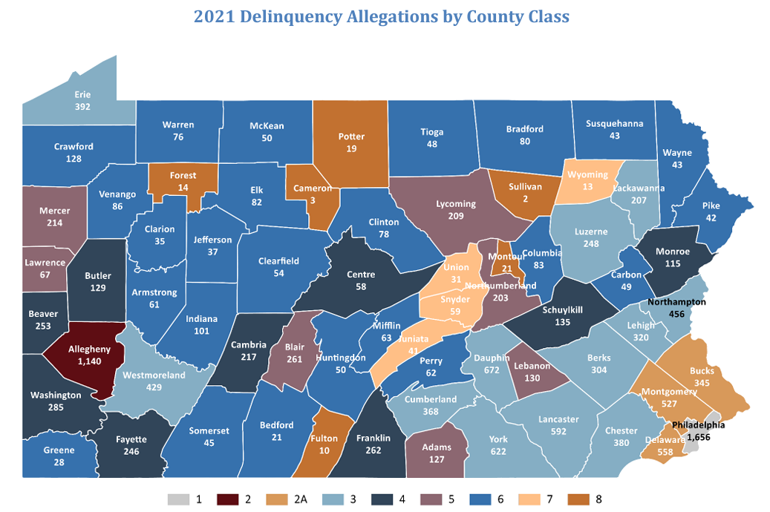
Pennsylvania Juvenile Justice Context
Decentralized system spread across 6 divisions:
courts, court admin, probation, detention, state facilities, private providers
  State leadership (across multiple organizations)
  Local Court jurisdictions responsible for courts, probation, detention facilities
Dually adjudicated cases: “shared case responsibility” for delinquency/dependency courts
Statewide (2021)
  14K delinquency allegations
  12K delinquency dispositions
  3600 secure detentions / 1200 delinquency placements
Notes:
Similarly, PA JJ is also very decentralized, and JJ operations fall across multiple systems, with local courts having primary responsibility for administering juvenile court, probation, and most juvenile detention facilities.
Also want to highlight that the state operates under a model of “Shared Case Responsibility” for dually-adjudicated youth (i.e., those determined to be both delinquent and dependent).
HOWEVER, a presiding judge for a delinquency case may order any dependency disposition (e.g., family support, transfer of temporary legal custody to a relative, placement), even if a youth is not alleged or determined to be statutorily dependent (Commission, 2018).
[if more detail wanted:]
State statutes divide JJ responsibilities into six divisions: juvenile courts, court administration, juvenile probation, detention, state-operated facilities, and private providers. Pennsylvania JJ operates with statewide leadership, while local court jurisdictions have primary responsibility for administering juvenile court, probation, and most juvenile detention facilities.
Pennsylvania operates under a model of “Shared Case Responsibility” for dually-adjudicated youth (i.e., those determined to be both delinquent and dependent), but a presiding judge for a delinquency case may order any dependency disposition (e.g., family support, transfer of temporary legal custody to a relative, placement), even if a youth is not alleged or determined to be statutorily dependent (as may be the case for informal adjustment or consent decree cases; (Commission, 2018)).
In 2021, Pennsylvania’s JJ system received 13,785 delinquency-related allegations, filed 12,290 delinquency-related dispositions, made 3,612 secure detention admissions, and 1,269 delinquency
placements (Commission, 2021).
Statewide, only four counties reported the number of dependency cases processed by juvenile probation departments without accompanying delinquency allegations; such cases accounted for a small overall percentage of cases in these counties (11.1 percent), but county rates varied from 1.5 percent to 30.2 percent.

Slide 11
Question 1: What is the prevalence of JJ Involvement among youth indicated by CW, and what differences exist among these groups?

Slide 12
Prevalence of JJ Status among CW-Substantiated Youth
Among CW-substantiated adolescents:
12% of cases involve dual system youth
At time of CW Referral dual system cases evenly divided among:
  Prior JJ history (dual contact)
  Active JJ cases (dually involved)
Notes:
When starting with a CW-substantiated cohort of adolescents, about 12-13% of youth had an indication of dual system involvement, and these were fairly evenly divided among prior and active histories at the time of CW referral.

Slide 13
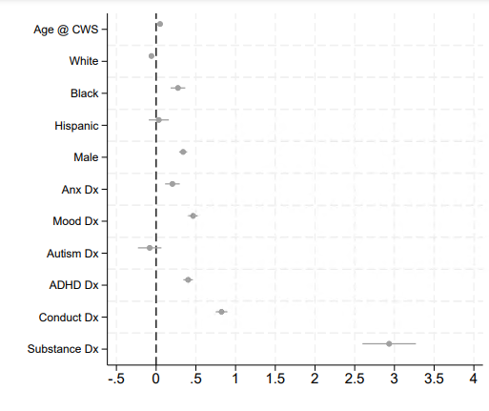

Group Differences – Youth Characteristics (compared to CW-only)
Prior JJ Contact
Active JJ Contact
Notes:
Compared to CW-only cases, both JJ groups were more likely to be:
Older (by 6-9 months) @ CW report
Black
Male
Had a past-year Medicaid claim involving a behavioral health diagnosis of ADHD, conduct/behavior, mood, and substance abuse***

Slide 14
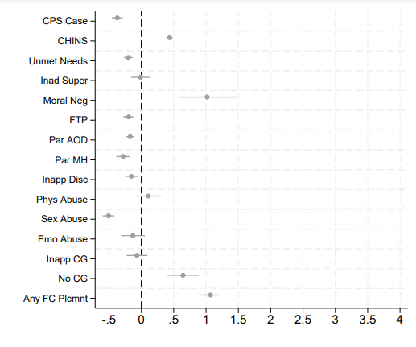
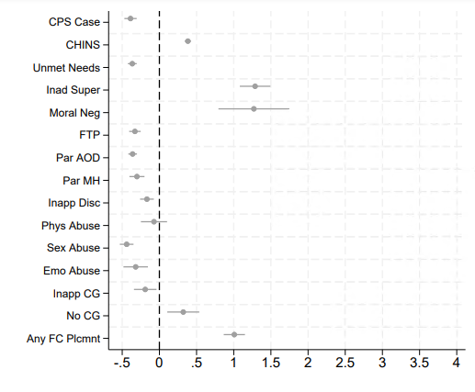
Group Differences – Case Characteristics (compared to CW-only)
Prior JJ Contact
Active JJ Contact
Notes:
Dual contact and dually involved youth also presented to CW for different reasons from CW-only cases – they were both more likely to be referred for GPS (vs. CPS-referred), and the referrals most often involved:
Child in Need of Service (child behavior or AOD) -- ~60% vs. 43%
Moral neglect (3% vs. 1%), or
No Caregiver present (~6% vs. 4%)
Active cases also were referred more often for inadequate supervision (14% vs. 6%)
Dual system youth were also significantly more likely to have a prior FC placement (~25% vs. 12%) – giving us some insight into the prior history of CW among these JJ→CW involved youth.

Slide 15
Question 2: What is the effect of JJ Involvement on post-substantiation CW service and placement outcomes?

Slide 16
Methodology: Selection-on-observables design
Comparisons restricted to exactly-matched groups by: county, year of CW report,
youth’s gender and race.
After exact match—estimate probability of the case involving a youth with JJ Contact based on youth, case, and diagnostic characteristics (separate models for prior and active JJ cases)
Within exactly-matched group comparisons, analytic model is weighted by the probability of predicted JJ involvement.
Notes:
Again – I’m going to skip over this, given Ezra’s talk. Our approach was similar (though reversed, obviously)
Conditional on observable characteristics, JJ involvement at the time of the CW case is comparable to random assignment
Assumes there are not large differences in unobserved characteristics between the two groups.

Slide 17
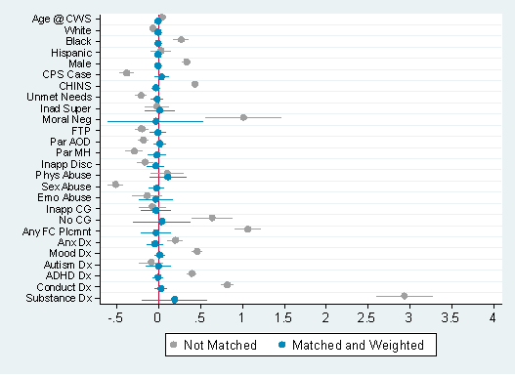
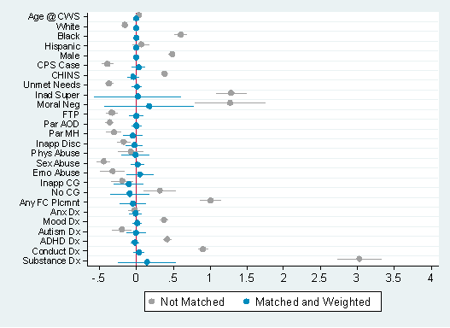
Covariate Balance (pre/post matching & weighting)
Prior JJ (Dual Contact JJ)
Active JJ (Dually Involved JJ)
Notes:
On all the dimensions that were included in the model and I showed you earlier

Slide 18
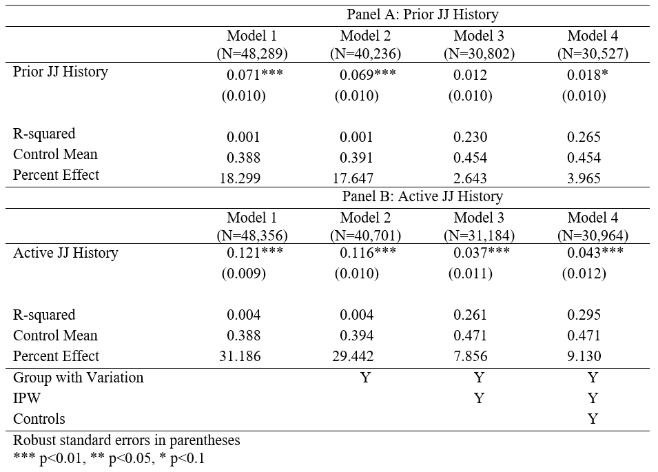
Main estimates of CW case outcomes bias (Acceptance for Services)
Raw comparison suggests that dual system youth (especially active JJ cases) are more likely to be accepted for CW services
After selection-on-observables:
  Prior JJ contact had minimal effect on rates of acceptance for service
  Active JJ contact maintained a significant (though smaller) effect on acceptance for service
Notes:
First, let’s look at the main model comparing prior and active JJ cases with CW-only with respect to acceptance for service outcomes.
Our unmatched/unweighted comparison showed an increased likelihood for both JJ-involved groups relative to CW-only cases.
However, with the selection-on-observables process fully implemented, prior JJ (i.e., dual contact) had minimal effect on outcomes, while active JJ (i.e., dually involved) cases experienced a small-but-significant increase in likelihood. The control group mean rate of acceptance was about .47, and active JJ cases had an increased rate reflecting about a 9% increase.

Slide 19
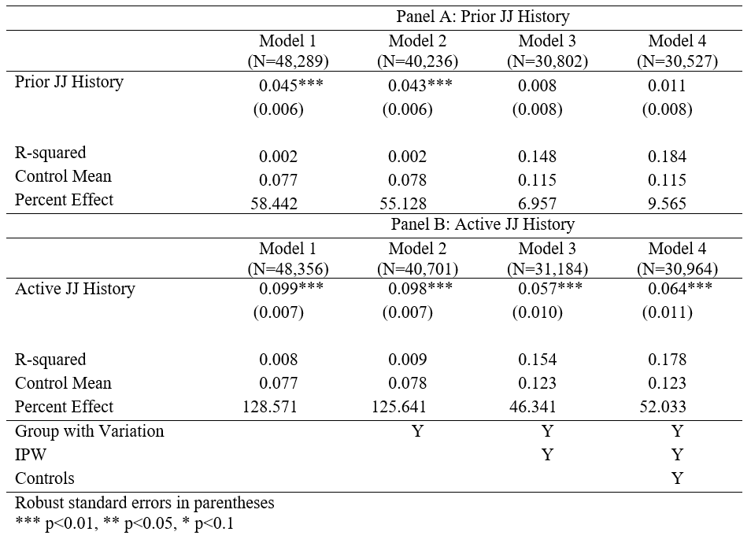
Main estimates of CW case outcomes bias (Placement within 90 Days)
Raw comparison suggests that dual system youth (especially active JJ cases) are more likely to be placed in foster care
After selection-on-observables:
  Prior JJ contact had no effect on rates of placement
  Active JJ contact had a sizeable effect on placement
Notes:
Next, turning to the main model comparing prior and active JJ cases with CW-only with respect to CW foster care placement within 90-days of report:
Our naïve/raw comparison again showed an increased likelihood for both JJ-involved groups relative to CW-only cases.
Similarly, though, with the selection-on-observables process fully implemented, prior JJ (i.e., dual contact) had no effect on outcomes.
Here, however, active JJ (i.e., dually involved) cases experienced a fairly sizeable increased likelihood of placement relatively to the CW-only group. The control mean for placement was only about .12, and active JJ cases increased this likelihood by over 50%.

Slide 20
Question 3: How do the effects of JJ Involvement on CW outcomes differ based on child characteristics and CW case factors?
Notes:
Next, I’m going to quickly show some of our sub-group comparisons for each of these JJ conditions across our two CW outcomes.

Slide 21
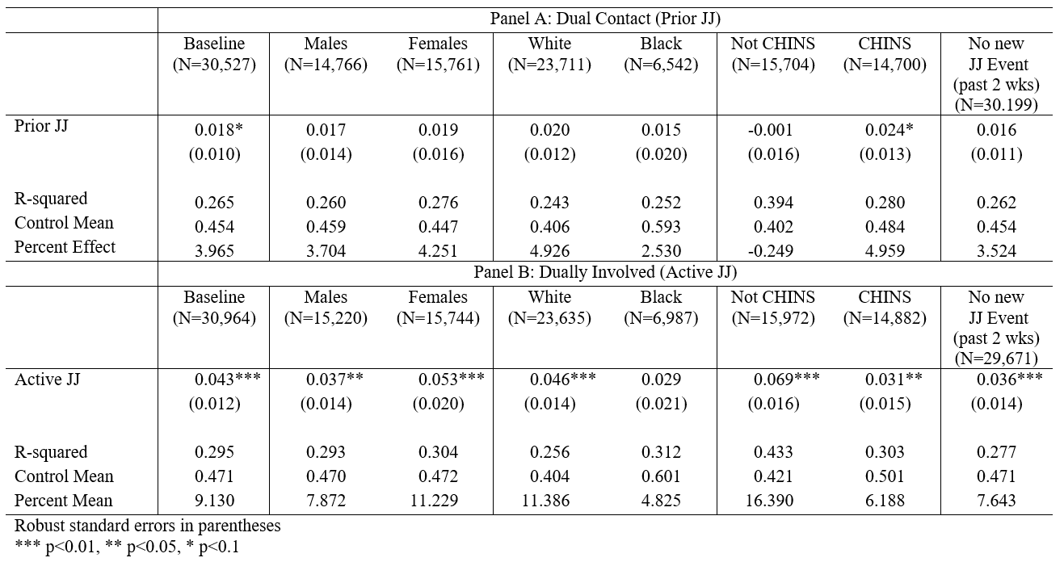
Acceptance For Services
Notes:
For CW Acceptance for Services: Group-level differences made little-to-no difference for prior JJ cases (with minor effect for CHINS CW cases)
Some group differences emerged for Active JJ cases (though relatively small comparative effects): acceptance effects were slightly large magnitude for Females, white youth, and non-CHINS cases;
We also checked to see whether excluding youth that had a recent court-related event, to see whether that may account for the direct pressure from JJ to motivate a CW response. When these cases were excluded, effects were slightly smaller in magnitude, but differences were relatively minor across sub-groups – suggesting a fairly stable pattern of small-but-significant increases in rates of acceptance for services.

Slide 22
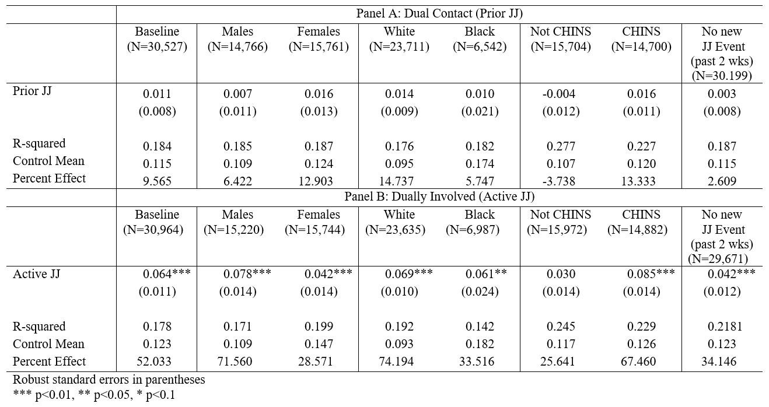
Placement within 90 Days
Notes:
Similarly, for CW Placement outcomes:
Group-level differences made no difference for prior JJ cases, and
Among for Active JJ cases: placement effects were larger in magnitude among Males and CHINS cases, now. – with effects for those without recent JJ-related court events again slightly smaller in magnitude.
The differences, again, were fairly minor, suggesting a reasonably stable pattern of increased rates of placement – especially when CHINS referrals were involved.

Slide 23
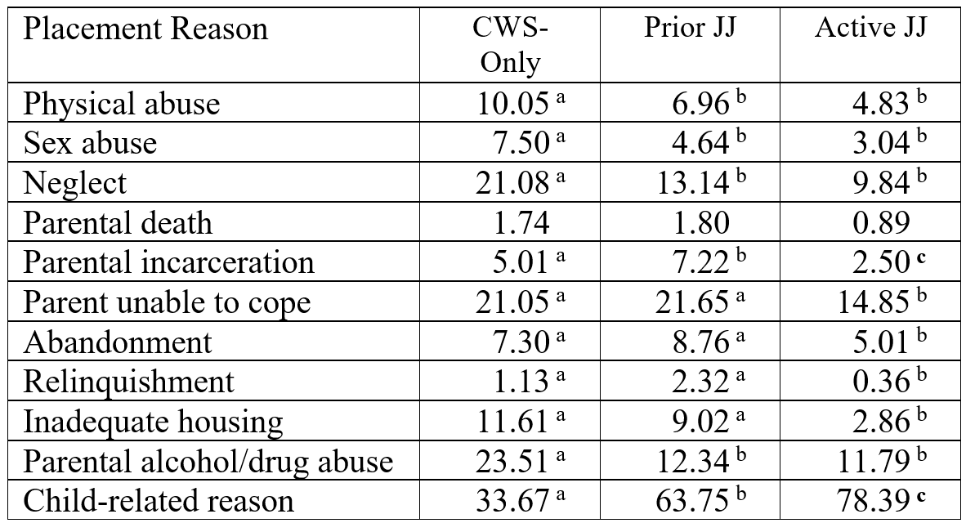
Reasons for Placement*
Active JJ cases:
  Increased CHINS/Child Behavior
  Decreased CM, housing, Parental AOD
Prior JJ cases:
  Increased CHINS/Child Behavior, Parent unable to cope, Parent Incarceration
  Decreased CM, Parental AOD
* Pre- Match/Weighting
Notes:
Further, among cases entered a foster care placement, JJ-involved cases showed a very different pattern of reasons for placement than CW-only cases.
The overall pattern suggests a significant pathway involved child behavioral difficulties for both prior and active JJ cases. Other differences are also summarized on the slide, but suggest that prior JJ cases also have increased rates of parental inability to cope and parental incarceration.

Slide 24
Conclusions
Dual system youth reflect a sizeable minority of the adolescent CW sample experiencing a new substantiated CPS/GPS referral, evenly divided among those with prior JJ history or active JJ history at the time of CW contact.
Dual contact and dually involved groups are similar to each other and differ from CW-only cases— suggesting sociodemographic differences as well as complex behavioral health needs and CW histories, as well as unique pathways to current CW involvement
Dual contact (Prior JJ History) did not substantively affect CW outcomes (vs. CW-only) – similar outcomes for ‘Accepted for Services’ and Placement within 90 Days, including across subgroups
Dually involved (Active JJ) experienced a small but significant increase in acceptance for services and a sizeable increase in Placement within 90 days
Notes:
Dual contact and dually involved groups are similar to each other and differ from CW-only cases on a number of youth (older/male/black/behavioral Dx) and case-related (e.g., case type, foster care history) characteristics.
On last bullet – slight decrease in effect size when we excluded cases where a juvenile court event occurred within the past 2-week period may suggest that court activity could serve as a slight precipitating factor for CW activity (e.g., are court procedures contributing to the

Slide 25
Implications
Cases entering CW with active JJ involvement (dually involved) are likely to increase pressure on services and (especially) placements
Despite similar sociodemographic, behavioral health, and case-related characteristics, only dually involved cases experienced increased rates of CW response to substantiated referrals
Given similar needs – what supports are necessary to engage dual contact (prior JJ) youth in appropriate services and supports? Are these youth and families getting supports elsewhere?
Notes:
Cases entering CW with active JJ involvement (dually involved) are likely to increase pressure on services and (especially) placements
May particularly impact congregate care – given adolescent home-based placements can be difficult to procure, and these youth have significant behavioral health needs
Despite similar sociodemographic, behavioral health, and case-related characteristics, only dually involved JJ→CW cases experienced increased rates of CW response to substantiated referrals
What other factors are driving CW response for dually involved cases?
-- Does ‘Shared Case Responsibility’ increase dependency disposition in dually involved cases?
-- Are courts utilizing CW to address:
service or treatment needs (service or placement)?
lack of caregiver options (placement)?
Finally – Given similar needs, what supports are necessary to engage dual contact (prior JJ) youth in appropriate services and supports?
-- Better cross-system communication and screening to identify these youth
-- Strategies to boost engagement in voluntary community supports

Slide 26
Thank you
Questions: cmc128@psu.edu

Slide 27
Research on Prevalence and Outcomes
OJJDP 3-County Study of youth @ time of 1st juvenile petition (Herz et al., 2019)
  Dual System youth: 44 - 70%
  Of these:
  Dual Contact: CW→JJ: 48 - 70% JJ→CW: 1 - 5%
  Dually Involved: CW→JJ: 20 - 34% JJ→CW: 9 - 16%*
LA County Study of youth involved in Probation Dept matched to state-level child welfare records (Herz et al., 2021)
  Dual System youth: 64% (i.e., JJ Only: 36%)
  Of these:
  Dual Contact: CW→JJ: 52% JJ→CW: 1%
  Dually Involved: CW→JJ: 14% JJ→CW: 33%*
* Includes historic CW contact
Notes:
As Denise suggested, there is some degree of variability across locales, but the overall pattern of findings across a number of localities indicates that dual system youth rates ranged from 44-70% of JJ cases, with dual contact occurring more frequently than dually involved, and CW preceding JJ contact as the predominant pattern of contact.
Prior research has shown over-representation of minority (esp. black) and female youth in dual system and dually involved populations, relative to JJ-involved youth without CW history.
Otherwise, research on prevalence is fairly limited. Unpublished data by Ryan and Moore of 52,000 processed juvenile offenders in Michigan indicates that 26% had a subsequent CPS investigation and 3% had a subsequent foster care placement. Another study of statewide data from Shipe and colleagues identified 20% of adolescent reunification cases had a history of “prior JJ complaints” but these contacts were non-specific.

Slide 28
Propensity Score Distribution
(pre/post matching & weighting)
Notes:
Our selection-on-observables design equated the groups on overall propensity for JJ contact, and…

